Slide 1
机器学习在原子核α衰变中的简单应用
——— Machine Learning for Nuclear α-Decay: A Simple Application ———
报告人：Na-Na Ma (马娜娜)
兰州大学稀有同位素前沿科学中心 核科学与技术学院
CPC 45, 024105(2021); PRC 107, 014310(2023); PRC 111, 034330(2025); arXiv.2504.04449

Slide 2
Outline
Does machine learning lead to a new paradigm in nuclear physics research?
Diffuseness effect and RBF for optimizing α decay
Simple DL approach for α-decay half-life studies
A MLP+AE hybrid neural network for preformation factor
Influence of shape inheritance and staggering on α decay
Conclusion and outlook

Slide 3
Outline
Does machine learning lead to a new paradigm in nuclear physics research?
Diffuseness effect and RBF for optimizing α decay
Simple DL approach for α-decay half-life studies
A MLP+AE hybrid neural network for preformation factor
Influence of shape inheritance and staggering on α decay
Conclusion and outlook

Slide 4
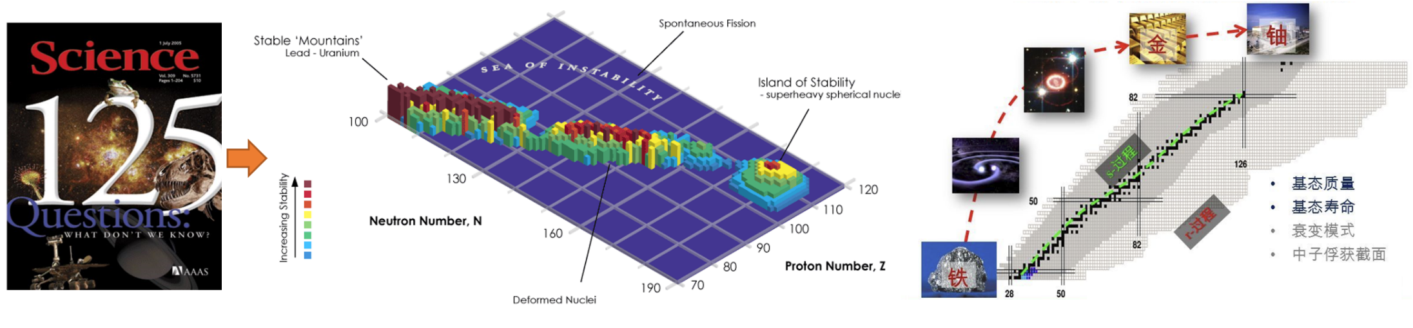

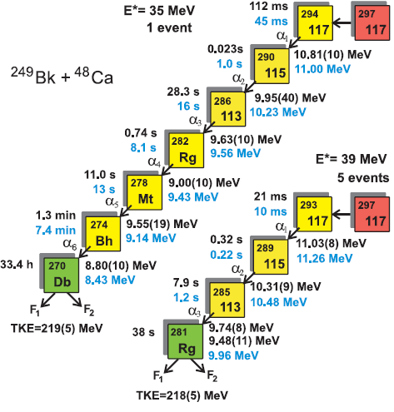
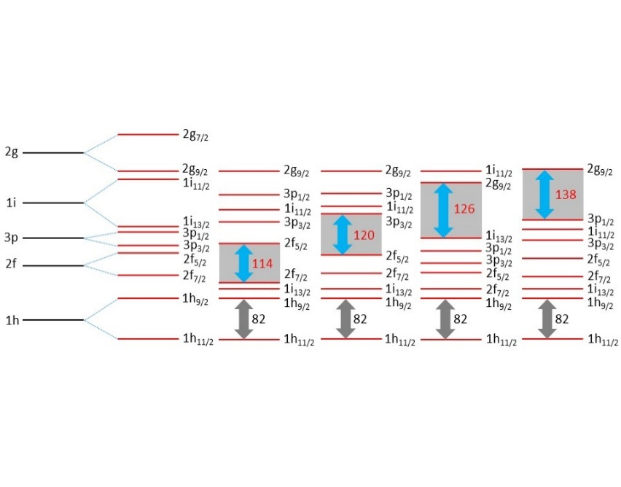
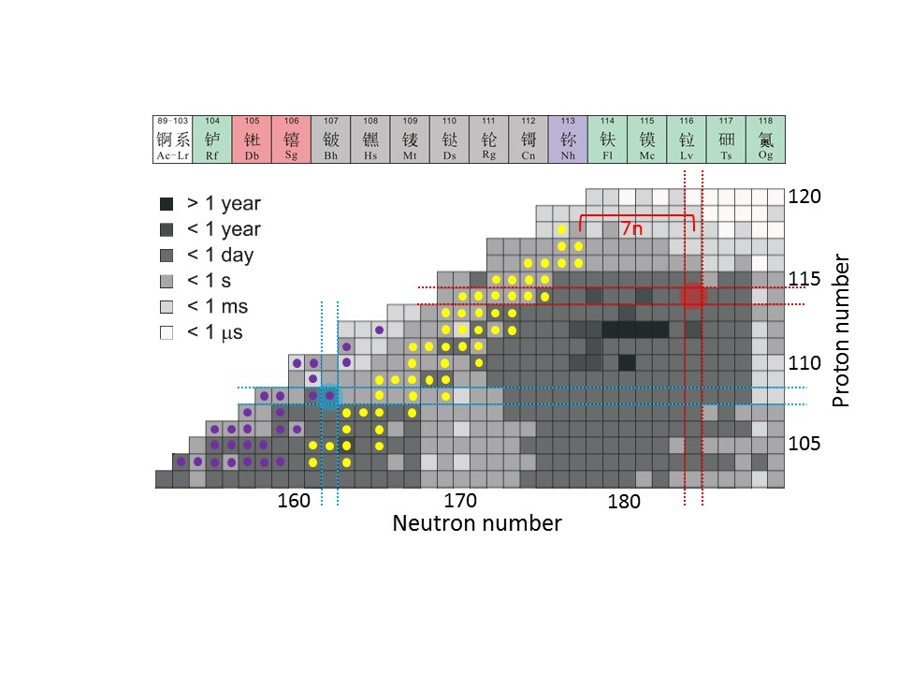
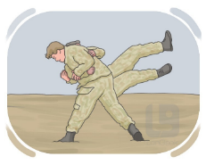

The existence limit of electric charge
The study of superheavy elements and long-lived superheavy nuclei is an essential content for exploring the limits of the existence of electric charge.
O. Hahn, F. Strassmann, Naturwissenschaften 27, 11 (1939)
P. Indelicato, A. Karpov, Nature 498, 40 (2013)
An important frontier in current nuclear physics is the synthesis of superheavy elements with proton numbers Z > 118.
Z. Patyk, et al. Nucl. Phys. A 502, 591 (1989)
PRC 74, 044602 (2006)
PRL 104, 142502 (2010)
SHN
How to determine the identity of newly synthesized elements?

Slide 5
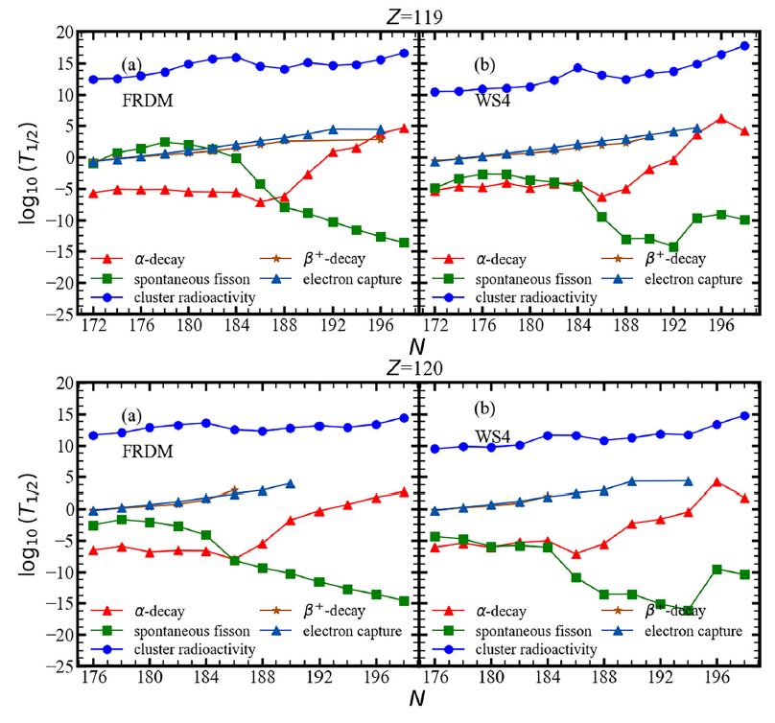
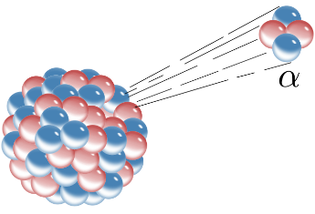

Alpha decay
Alpha decay vs. Beta decay vs. Spontaneous fission vs. cluster radioactivity
Alpha decay
Wenxia Wang, Nana Ma, Yu Zhang, Zheng Wei, Hongfei Zhang, Eur. Phys. J. A (2024) 60:2264
Alpha decay: Currently, alpha decay is almost the only means to identify the synthesis of new nuclides.
The development of α-decay theory focuses mainly on：
decay energy
barrier curves
the nuclear medium effect
the nuclear deformation
α-particle preformation factor, and so on.
Y. Z. Wang, PRC 79, 014316 (2009)
D. Ni, Z. Ren, PRC 83, 067302 (2011)
J. Dong, W. Zuo, J. Gu, Y. Wang, B. Peng, PRC 81, 064309 (2010)
C. Xu, Z. Ren, NPA 778, 1 (2006)
Nuclear decay model
Semi-empirical formula
A quartetting wave function approach
BCS
Geiger and J. Nuttall, Phil. Mag. 22, 613 (1911)
C. Qi et al., PRL 103, 072501 (2009)
R. Moustabchir, G. Royer, NPA 683, 266 (2001)
Dong et al., NPA 832, 198 (2010)
Hartree-Fock-Bogoliubov
cluster-formation model
Sobiczewski, Z. Patyk, S. Cwiok, PLB 224 (1989)
Deng, PRC 101, 034307 (2020)

Slide 6
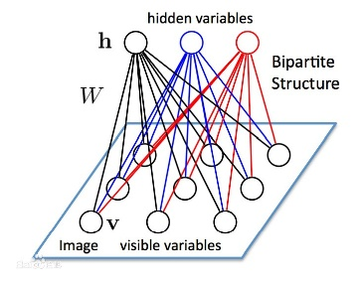
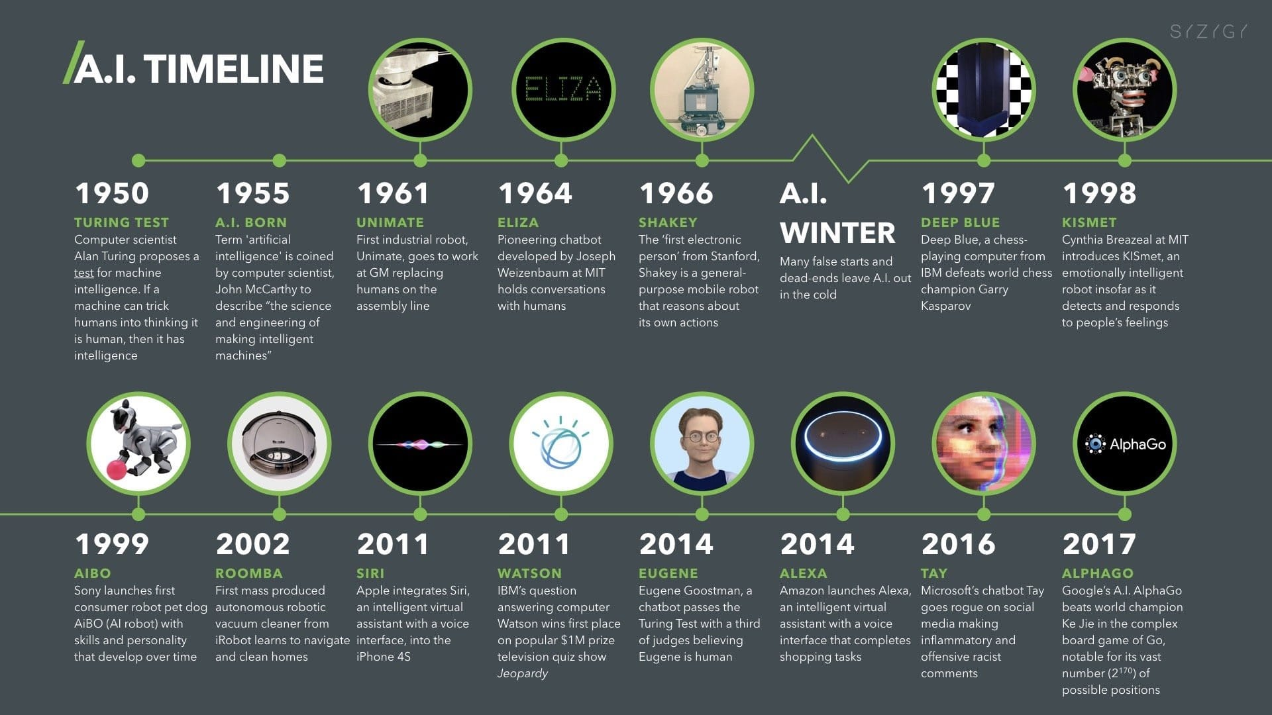
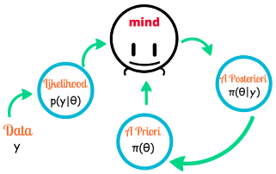
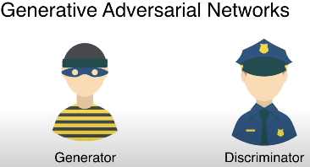
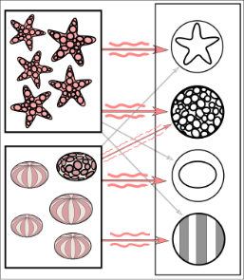
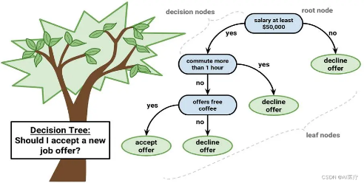
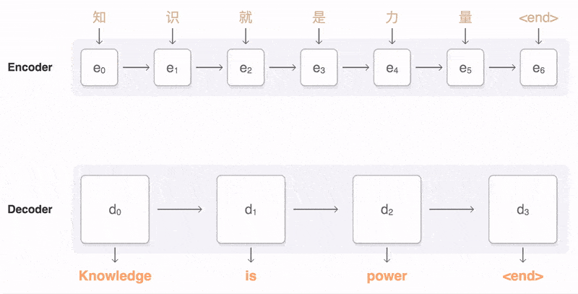



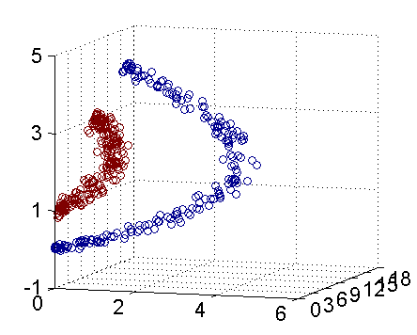


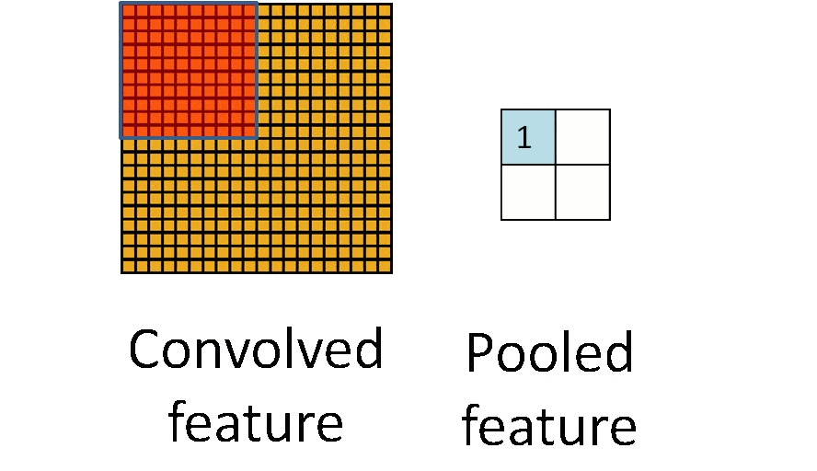

Machine Learning and Nuclear Physics: A Cross-Disciplinary Study
The development of machine learning
The development of machine learning
Feedforward neural network
CNN
Decision tree
Random forest
Reinforcement learning | RL
Restricted Boltzmann machine | RBM
Naive Bayes classifier | NBC
Generative Adversarial Networks | GAN
Autoencoder
Support Vector Machine | SVM
… … … …
Notes:
20世纪50年代到60年代
1950年10月，图灵提出了人工智能（AI）的概念，同时提出了图灵测试来测试 AI。
图灵测试提出没有几年，人们就看到了计算机通过图灵测试的“曙光”。
1966年，心理治疗机器人 ELIZA 诞生
那个年代的人对他评价很高，有些病人甚至喜欢跟机器人聊天。但是他的实现逻辑非常简单，就是一个有限的对话库，当病人说出某个关键词时，机器人就回复特定的话。
第一次浪潮并没有使用什么全新的技术，而是用一些技巧让计算机看上去像是真人，计算机本身并没有智能。
20世纪80年代到90年代
在第二次浪潮中，语音识别是最具代表性的几项突破之一。核心突破原因就是放弃了符号学派的思路，改为了统计思路解决实际问题。
在《人工智能》一书中，李开复详细介绍了这个过程，他也是参与其中的重要人物之一。
第二次浪潮最大的突破是改变了思路，摒弃了符号学派的思路，转而使用了统计学思路解决问题。
第三次浪潮（深度学习+大数据）
21世纪初
2006年是深度学习发展史的分水岭。杰弗里辛顿在这一年发表了《一种深度置信网络的快速学习算法》，其他重要的深度学习学术文章也在这一年被发布，在基本理论层面取得了若干重大突破。
之所以第三次浪潮会来主要是2个条件已经成熟：
2000年后互联网行业飞速发展形成了海量数据。同时数据存储的成本也快速下降。使得海量数据的存储和分析成为了可能。
GPU 的不断成熟提供了必要的算力支持，提高了算法的可用性，降低了算力的成本。
在各种条件成熟后，深度学习发挥出了强大的能力。在语音识别、图像识别、NLP等领域不断刷新纪录。让 AI 产品真正达到了可用（例如语音识别的错误率只有6%，人脸识别的准确率超过人类，BERT在11项表现中超过人类…)的阶段。
第三次浪潮来袭，主要是因为大数据和算力条件具备，这样深度学习可以发挥出巨大的威力，并且 AI 的表现已经超越人类，可以达到“可用”的阶段，而不只是科学研究。

Slide 7

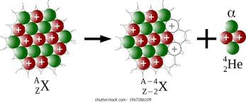

Machine Learning and Nuclear Physics: A Cross-Disciplinary Study
Machine Learning and Nuclear Physics
Machine Learning and α decay
Nuclear Reaction
Half-life
decay energy
the nuclear deformation
α-particle preformation factor
L. G. Pang, Nat. Commun. 9, 210 (2018).
N. N. Ma, PRC 107, 014310 (2023).
H. Q. You, PRC 110(2), 024319 (2024).
Nuclear Structure
Diffuseness effect and RBF for optimizing α decay
Simple DL approach for α-decay half-life studies
A MLP+AE hybrid neural network for preformation factor
Influence of shape inheritance and staggering on α decay
Nuclear Matter
CPC 45, 024105(2021)
PRC 107, 014310(2023)
PRC 111, 034330(2025)
Nuclear Astrophysics
arXiv.2504.04449

Slide 8
Outline
Does machine learning lead to a new paradigm in nuclear physics research?
Diffuseness effect and RBF for optimizing α decay
Simple DL approach for α-decay half-life studies
A MLP+AE hybrid neural network for preformation factor
Influence of shape inheritance and staggering on α decay
Conclusion and outlook

Slide 9
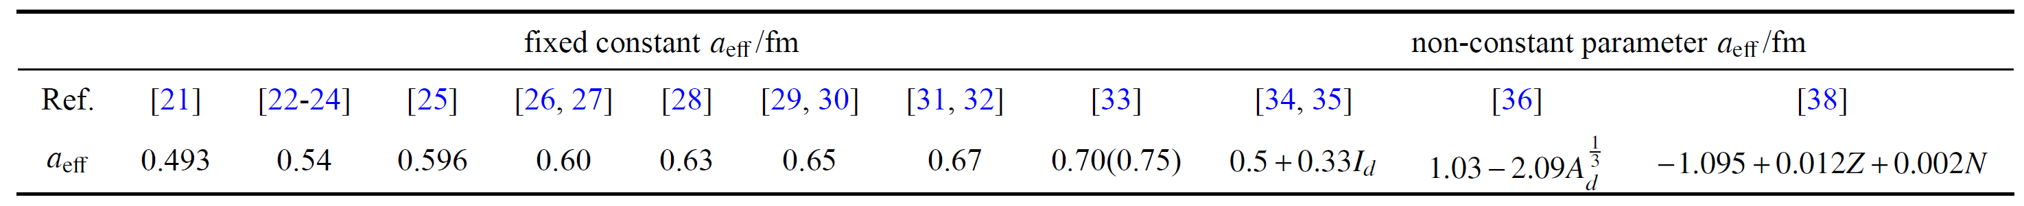
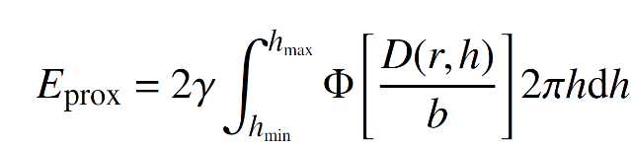




1. Diffuseness effect and RBF for optimizing α decay calculations
To reproduce the experimental decay half-life of known SHN with high accuracy and achieve a reliable extrapolation in the unknown SHN region, exploration of certain physical effects and methods is required.
Diffuseness correction to the generalized liquid drop model （GLDM）
Theoretically, α decay is regarded as the progress of a particle tunneling through the potential barrier between the cluster and the daughter nucleus. The surface diffuseness is presented in the following:
The proximity energy
The surface diffuseness
The surface width
b=0.99 fm
Most values of for odd-X ( and A) nuclei are smaller than 0.54 fm. Moreover, these odd-X nuclei live longer than the even-Z and even-N nuclei around them.
The surface diffuseness 0.54 fm
for even-X nuclei,
for odd-X nuclei,

Slide 10
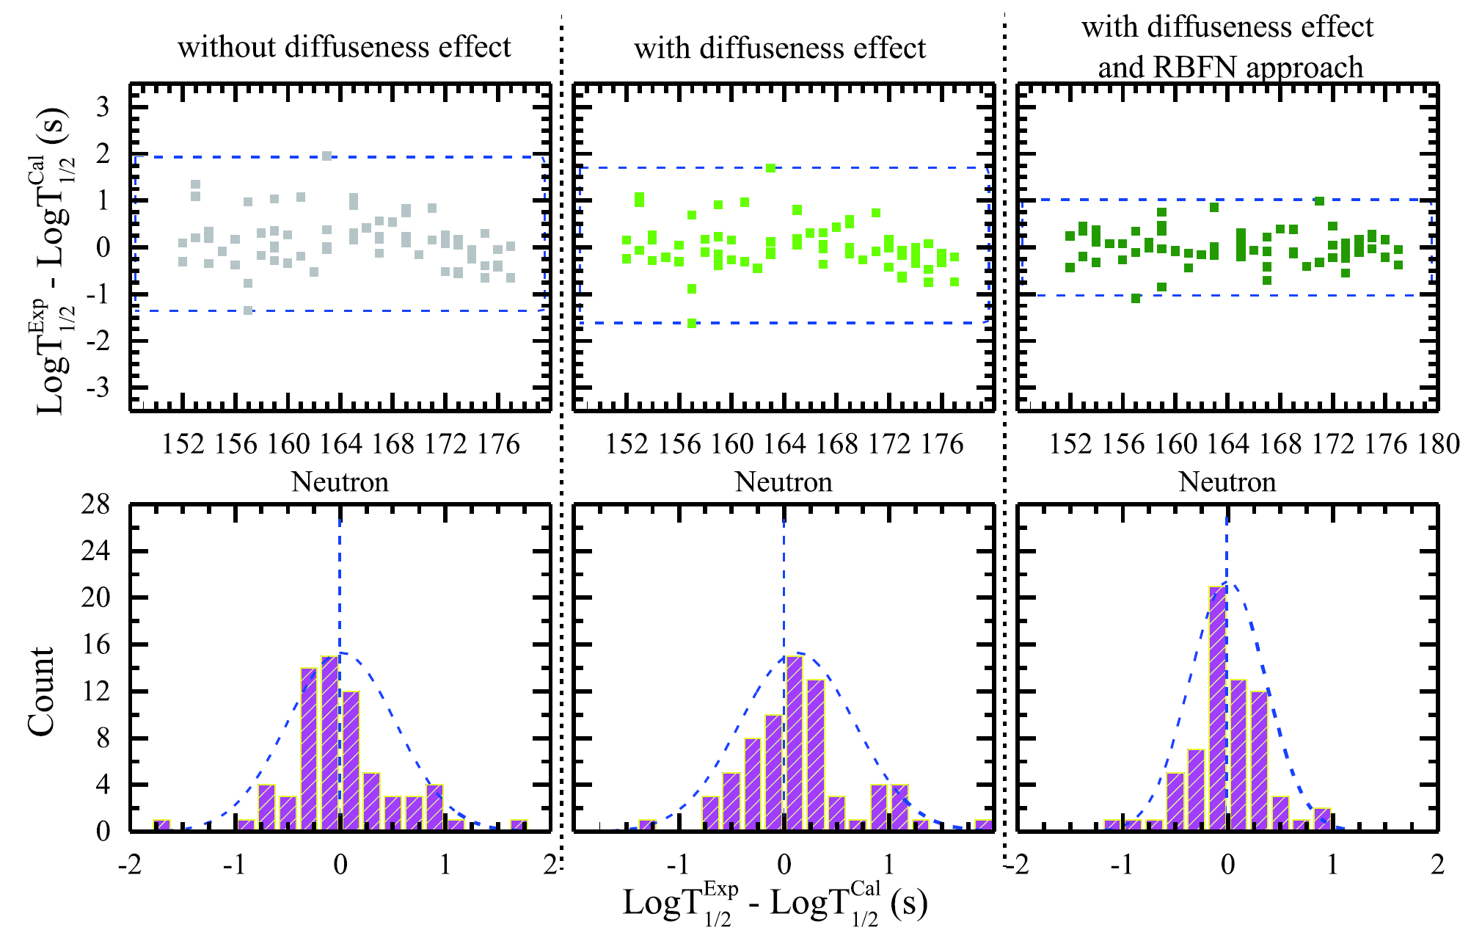
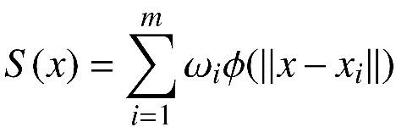
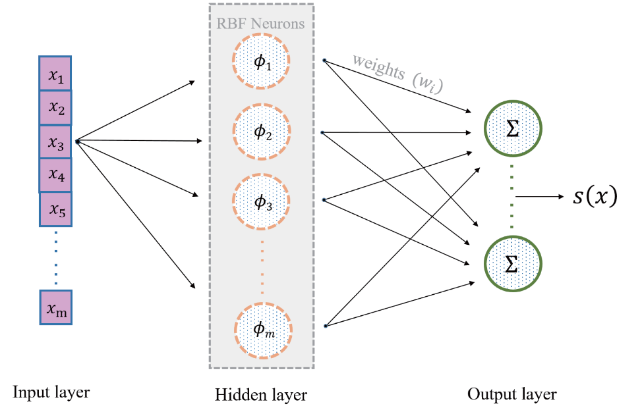

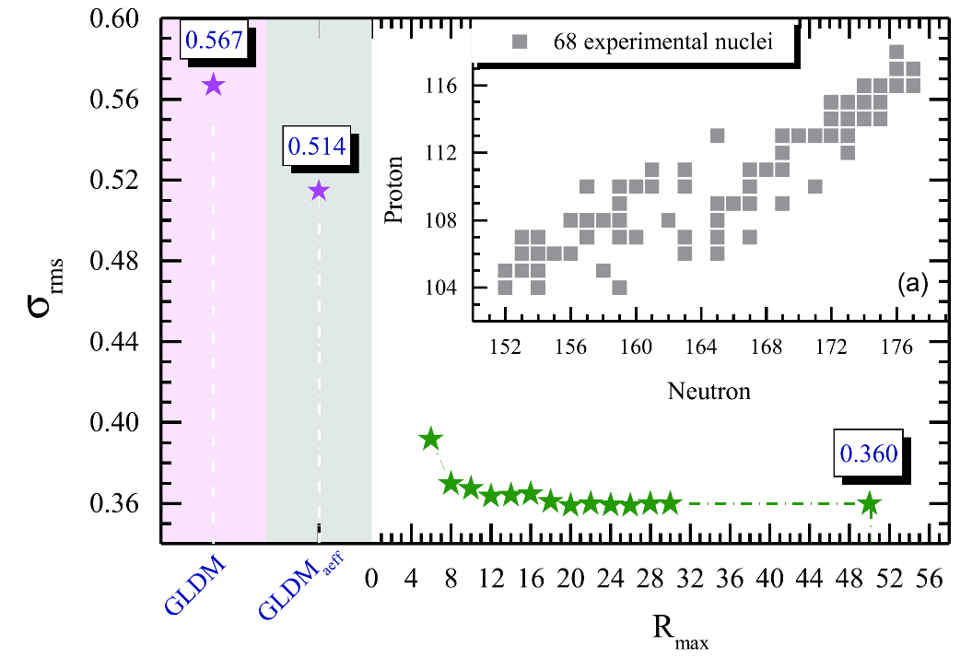






1. Diffuseness effect and RBF for optimizing α decay calculations
To reproduce the experimental decay half-life of known SHN with high accuracy and achieve a reliable extrapolation in the unknown SHN region, exploration of certain physical effects and methods is required.
The Radial Basis Function Network (RBFN) method （RBFN）
The reconstructed smooth function
The Radial Basis Function
Performance of RBFN

Slide 11
Outline
Does machine learning lead to a new paradigm in nuclear physics research?
Diffuseness effect and RBF for optimizing α decay
Simple DL approach for α-decay half-life studies
A MLP+AE hybrid neural network for preformation factor
Influence of shape inheritance and staggering on α decay
Conclusion and outlook

Slide 12
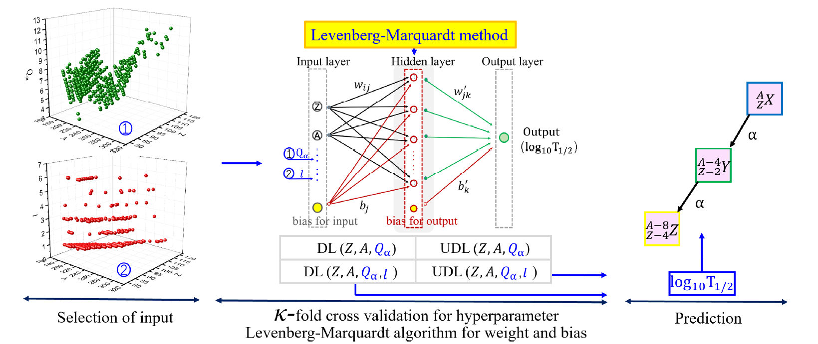
2. Simple DL approach for α-decay half-life studies
A successful operation of DL technique requires an input, a data set, a backpropagation algorithm, and a hierarchical structure.
We treat DL as an alternative approach that is directly trained by experimental half-life rather than using it as a scheme of residual correction between experimental data and the calculation.
The architecture of this work: selecting input and training data sets; determining hyperparameters; and testing

Slide 13
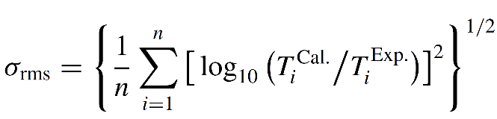
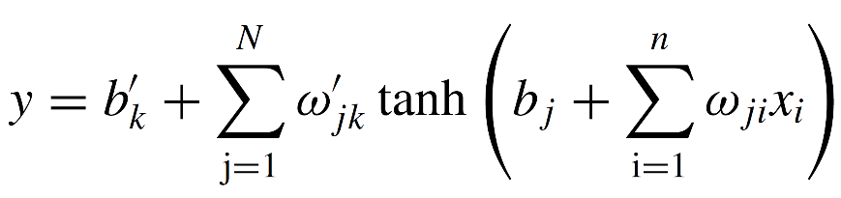

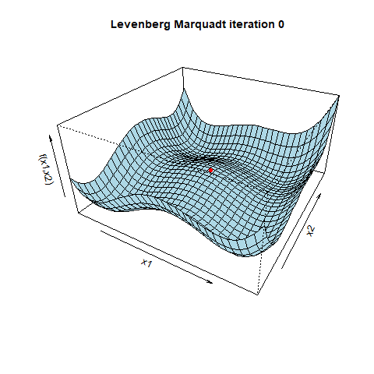
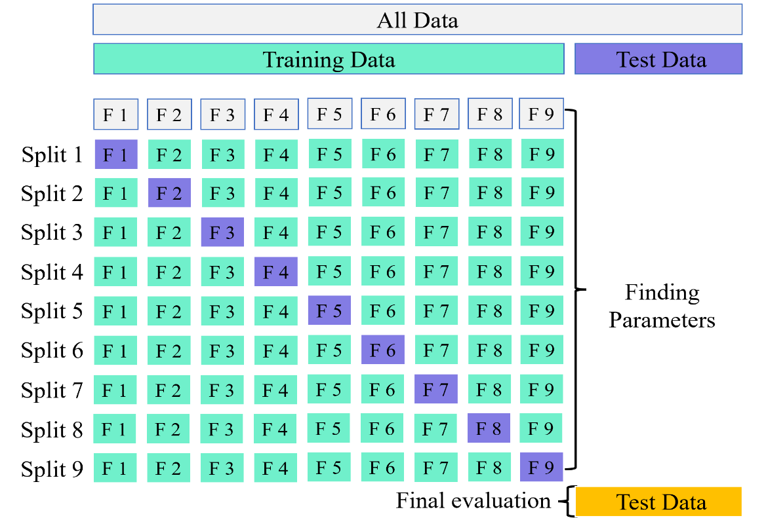
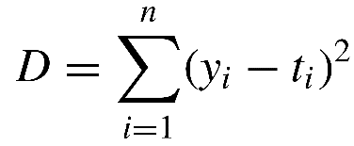

2. Simple DL approach for α-decay half-life studies
Algorithm and method interspersed in artificial neural network
The input-to-intermediate and input-to-output mappings is
Levenberg-Marquardt backpropagation algorithm
K-fold cross validation
The weights and biases are estimated by minimizing the objective function:
The weights in this algorithm:

Slide 14
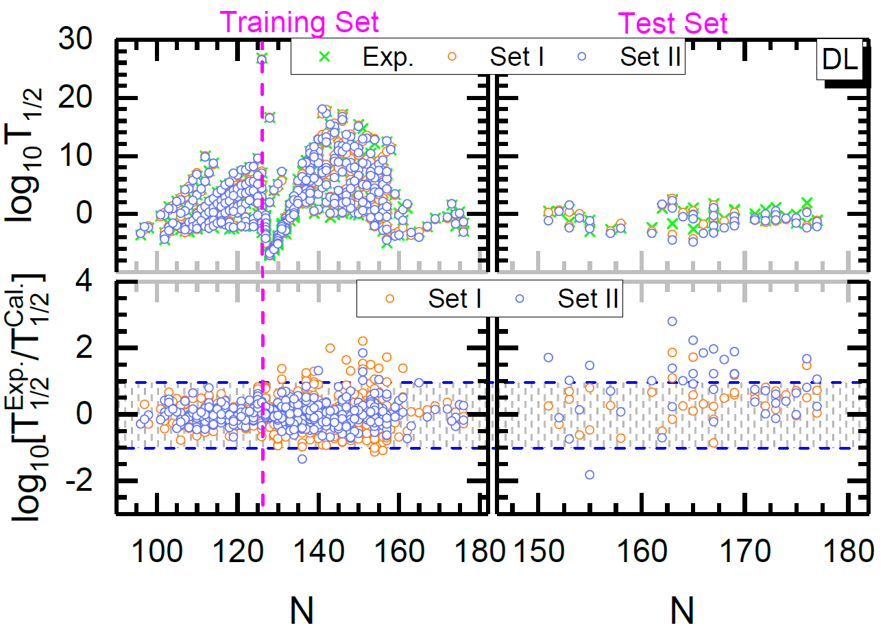
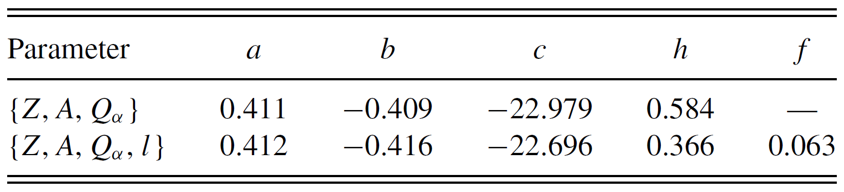
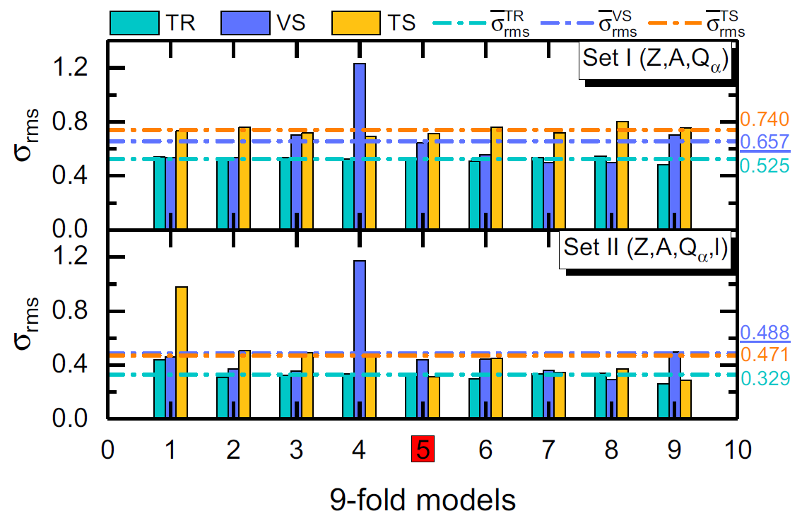
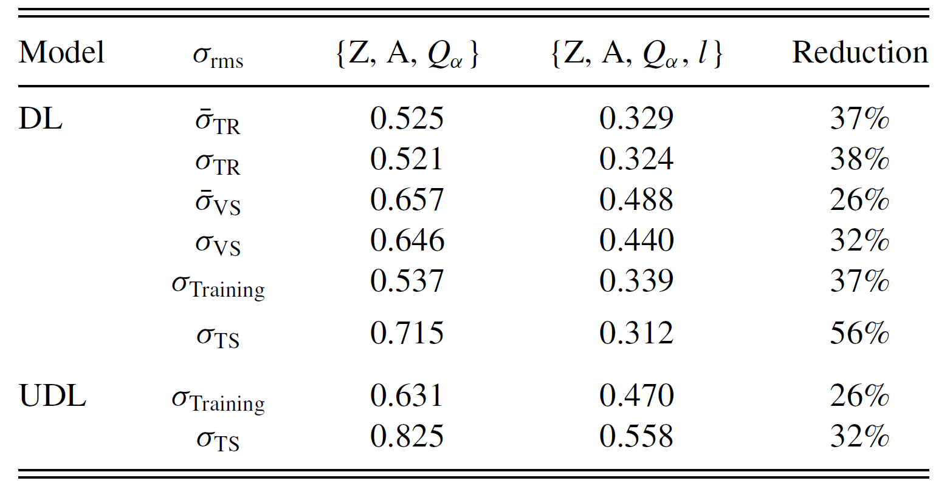
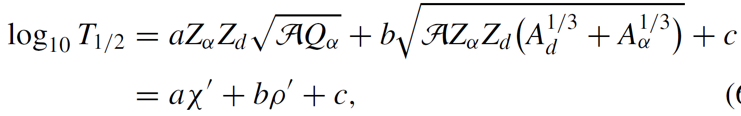
2. Simple DL approach for α-decay half-life studies
Performance of DL in α decay and inspiration for the universal decay law (UDL)
Determination of inputs and hyperparameters
Inspiration of DL in α decay
Set I—three-dimensional input vector {Z, A,Qα};
Set II—four-dimensional input vector {Z, A,Qα, l}.
The parameter was determined by fitting 369 experimental half-lives. δoe = 2 for odd Z-odd N, 1 for odd-A, and 0 for even Z-even N nuclei.
learning time is 104, step size is 5 × 10−4, the number of neurons in the hidden layer is N = 21.
homologous

Slide 15
Outline
Does machine learning lead to a new paradigm in nuclear physics research?
Diffuseness effect and RBF for optimizing α decay
Simple DL approach for α-decay half-life studies
A MLP+AE hybrid neural network for preformation factor
Influence of shape inheritance and staggering on α decay
Conclusion and outlook

Slide 16
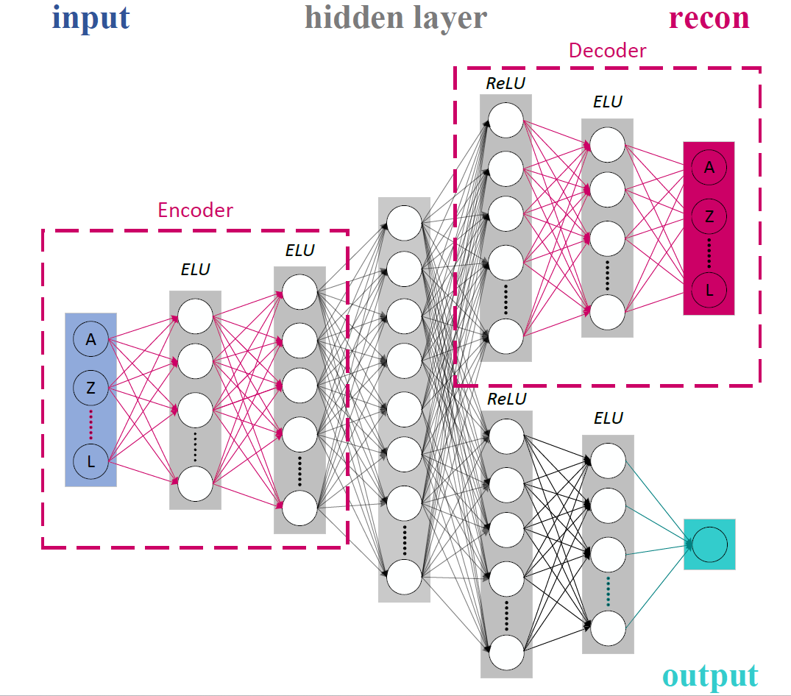
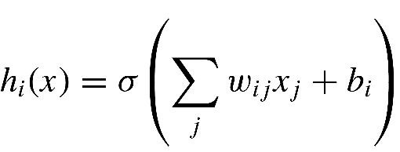

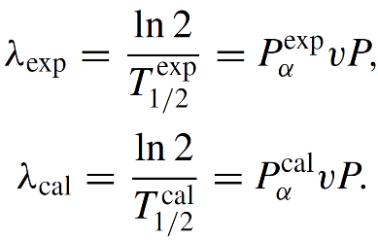
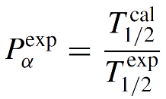


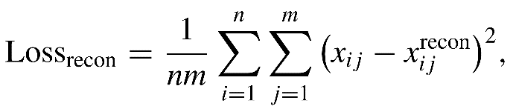
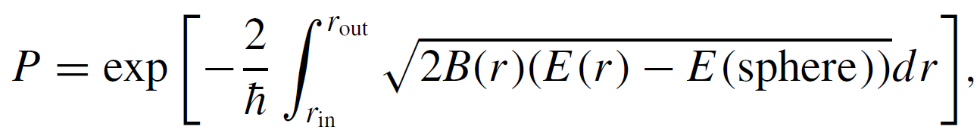
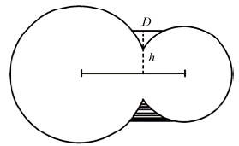
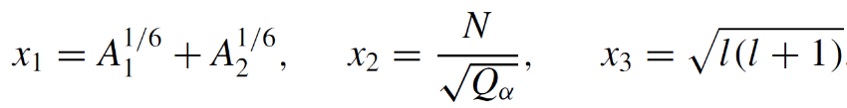
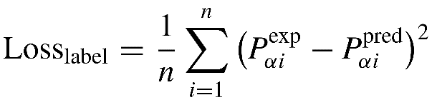
3. A MLP+AE hybrid neural network for preformation factor
One of the important divergences between theoretical α-decay half-life and experimental data is how to calculate the α-particle preformation factor.
ML has advantages in handling the differences between two sets of data and in extracting physical information.
The extraction of experimental preformation factors
Multilayer perceptron(MLP) Autoencoder(AE)
We improve MLP model based on the autoencoders (AE) and incorporating the reconstruction error
In α-decay theory, the decay constant is
The data-flow between adjacent layers in the feedforward neural
Pα: the α-particle preformation factor;
P : the assault frequency;
v : the barrier penetration probability.
Hidden neural units
16, 32, 64, 32, 16
The MLP + AE method has two sets of outputs, one is the reconstruction of the input features , and the other is the prediction of the label .
we choose the generalized liquid drop model (GLDM) as this unified decay theory
A, Z, N, Qα, l, x1, x2, x3
Notes:
Alpha衰变中的衰变常数是由预形成因子、碰撞频率和穿透几率相乘得到。如果我们不考虑预形成因子，那我们理论半衰期和实验半衰期之间的差值主要是由预形成因子导致的。因此，我们可以借助这个思路提取实验预形成因子的大小，当然提取的过程还是依赖于理论模型的半衰期，我们所采用的是推广液滴模型的理论值。提起差值，经常做机器学习的人自然而然就想到了用机器学习学习这个差值，那这个差值就等同时机器学习给定的预形成因子。基于这样的几个思想，我们所采用的方法是多层感知器。但是同时我们引入了自动编码器，，发展了这样一个混合神经网络，这个结构中包含了两部分的输出。通过调整可调参数beta寻找最佳的rms。另外，这是我们采用的隐藏层的神经元个数。这是输入层的特征量。

Slide 17
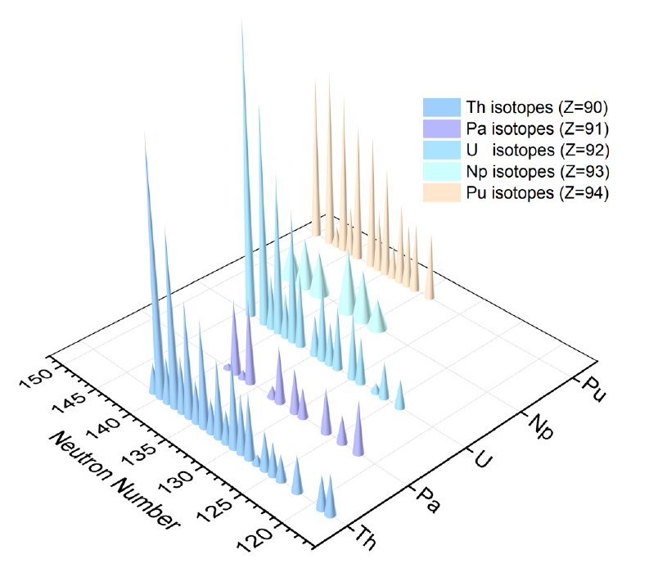
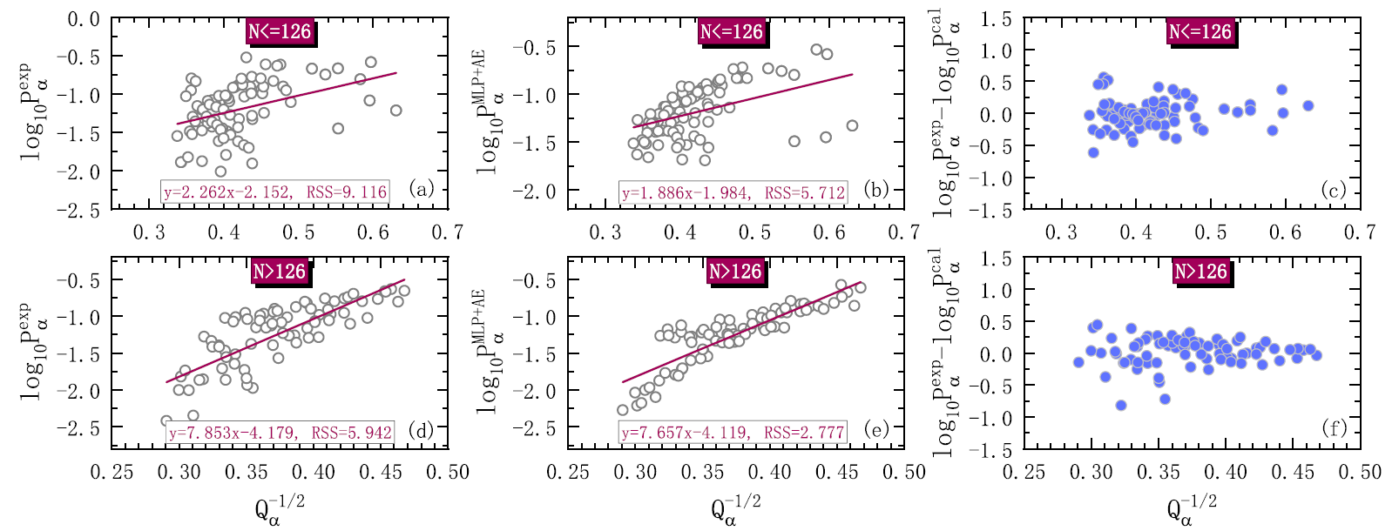
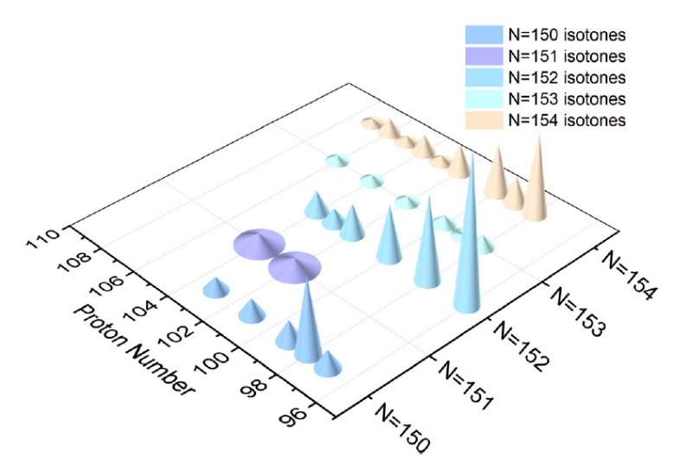
3. A MLP+AE hybrid neural network for preformation factor
Nuclear structure information
Extrapolation capability
Prediction
An approximate linear relationship between the logarithm of the experimental preformation factor log10Pexp and the square root of the decay energy ratio Q−1/2.
The Geiger-Nuttall law can not only describe α decay half-lives but also deal with preformation factors.
The odd-even staggering effect exists in the α-particle preformation factors
Unpaired nuclei reduce the probability of α particles forming on the surface of the parent nucleus.

Slide 18
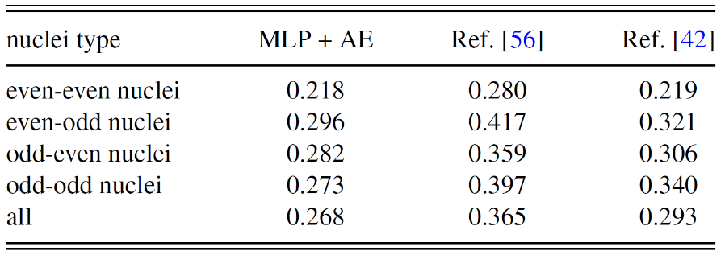
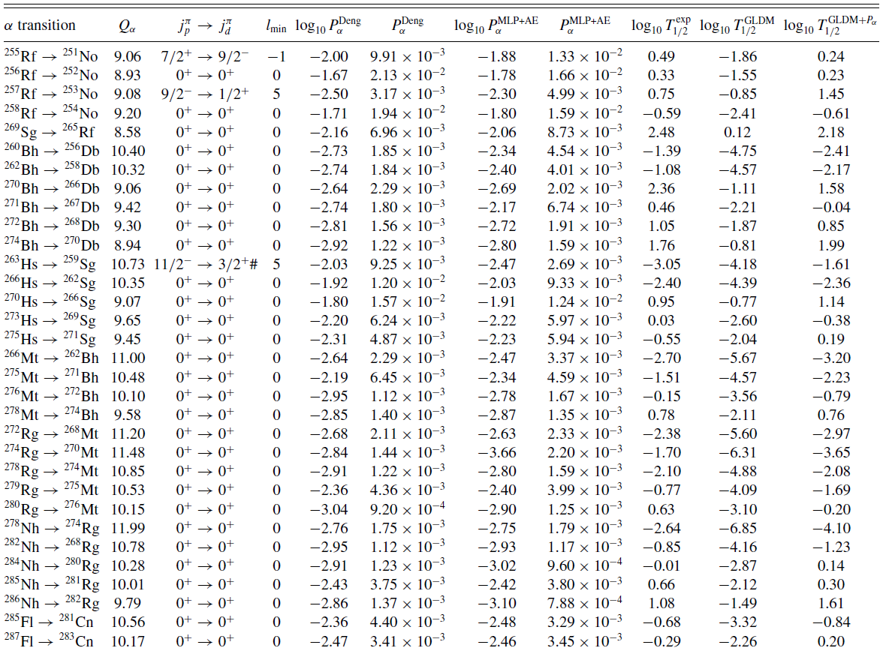
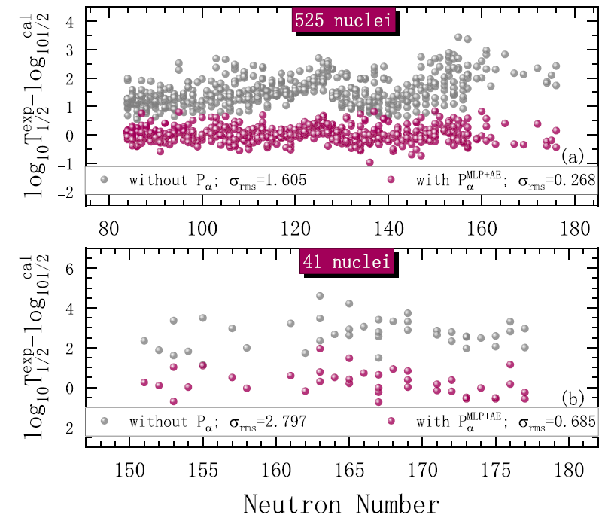
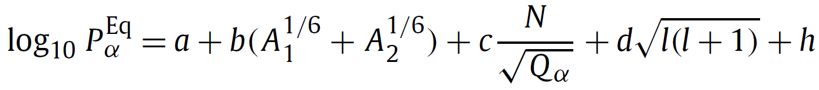
3. A MLP+AE hybrid neural network for preformation factor
Nuclear structure information
Extrapolation capability
Prediction
The preformation factors of the 41 newly added nuclei (Z > 104) in NUBASE2020 relative to the 2016 mass table and compared them with the results calculated by the empirical formula.
Y. He, X. Yu, and H.-F. Zhang, Chin. Phys. C 45, 014110 (2021)
J.-G. Deng and H.-F. Zhang, Phys. Lett. B 816, 136247 (2021).

Slide 19


3. A MLP+AE hybrid neural network for preformation factor
Nuclear structure information
Extrapolation capability
Prediction
Prediction of superheavy nuclei with Z = 119 and Z = 120
a notable odd-even staggering effect
The overall preformation factor of the Z = 120 isotope chain is greater than that of Z = 119.

Slide 20
Outline
Does machine learning lead to a new paradigm in nuclear physics research?
Diffuseness effect and RBF for optimizing α decay
Simple DL approach for α-decay half-life studies
A MLP+AE hybrid neural network for preformation factor
Influence of shape inheritance and staggering on α decay
Conclusion and outlook

Slide 21




4. Influence of shape inheritance and staggering on α decay
Poor interpretability and opaque black-box algorithms are dilemmas that need to be urgently addressed in the development of machine learning.
The quantum many-body atomic nuclear systems seem to provide a natural platform for the application of ML.
a strong correlation may send the signal
that nuclei with hexadecapole deformation are more likely to
form α clusters
We incorporate existing physical knowledge into the screening of ML inputs and perform a Pearson and Spearman correlation analysis.
Pearson and Spearman correlations
Shape inheritance
shape inheritance：the shapes of the parent and daughter nucleus in the decay system tend to remain consistent or similar.
Linear relationships
A high degree of similarity of the parent and daughter nuclei leads to increased overlap in their wave functions.
A. N. Andreyev, et al., Nature 405 (2000) 430–433.
The closed shell effect of Z = 82, N = 126 is stronger than that of (50, 82) since the shape of the parent nucleus (82,126) and its daughter nucleus (80,124) are quite different.
J. G. Deng and H. F. Zhang, Phys. Lett. B 816, 136247 (2021).
Geiger-Nuttall law
Nuclei with hexadecapole deformation are more likely to form α clusters.

Slide 22


4. Influence of shape inheritance and staggering on α decay
Machine Learning performance
The datasets contain 369 known nuclei, 328 of which are used for training and 41 for testing.
A LeakyReLU is used as the activation function. The model is optimized using the Adam algorithm, with rms deviation serving as the evaluation.
Each set of different inputs was subjected to 100 times in total.
Neural Network
Input-layer
Single hidden-layer with only ten neurons
Out-layer
The rms of UDL is 0.86, this work is 0.26
The rms of UDL is 0.74, this work is 0.313

Slide 23

4. Influence of shape inheritance and staggering on α decay
Half-life inversion
For daughter nuclei with an oblate configuration, the ML predictions tend to be shorter than the UDL predictions. In contrast, daughter nuclei with prolate deformation exhibit longer half-lives.
From a dynamics perspective: compared with the prolate ellipsoid, the oblate ellipsoid has a small difference in main moment of inertia and high rotation stability.
Half-life inversion: a phenomenon caused by the shape staggering of adjacent even-even nuclei.
Differences in nuclear shape are observed for adjacent even-even nuclei at both ends of the intersection of the ML predicted curve and the UDL curve, whether in the parent nucleus, the daughter nucleus, or both.
Notes:
which is consistent with why this region frequently experiences such reversal events.

Slide 24


4. Influence of shape inheritance and staggering on α decay
Half-life inversion
For daughter nuclei with an oblate configuration, the ML predictions tend to be shorter than the UDL predictions. In contrast, daughter nuclei with prolate deformation exhibit longer half-lives.
From a dynamics perspective: compared with the prolate ellipsoid, the oblate ellipsoid has a small difference in main moment of inertia and high rotation stability.
Half-life inversion: a phenomenon caused by the shape staggering of adjacent even-even nuclei.
Differences in nuclear shape are observed for adjacent even-even nuclei at both ends of the intersection of the ML predicted curve and the UDL curve, whether in the parent nucleus, the daughter nucleus, or both.
rich in shape coexistence: spherical, oblate and prolate, and rapidly transitioning between them.
The change rate of the hexadecapole deformation (β4) is more obvious, which will also cause a smaller inversion, although its value is one order of magnitude smaller than β2.
Notes:
which is consistent with why this region frequently experiences such reversal events.

Slide 25






4. Influence of shape inheritance and staggering on α decay
The phenomenon of half-life inversion caused by shape staggering also exists in β decay
Our model achieved a root mean square deviation of 0.25 (RMS=0.25) on the test set, significantly outperforming the Sobhani formula (RMS=0.85) used as a comparison, and also outperforming some traditional models such as FRDM+QRPA (RMS=0.82).
For daughter nuclei with an oblate configuration, the ML predictions tend to be shorter than the UDL predictions. In contrast, daughter nuclei with prolate deformation exhibit longer half-lives.
From a dynamics perspective: compared with the prolate ellipsoid, the oblate ellipsoid has a small difference in main moment of inertia and high rotation stability.
H. Sobhani and H. Khalafi, Chinese Journal of Physics 85 (2023) 475–507
Z. M. Niu H. Z. Liang , Phys. Rev. C 99, 064307 (2019)
Notes:
which is consistent with why this region frequently experiences such reversal events.

Slide 26
Outline
Does machine learning lead to a new paradigm in nuclear physics research?
Diffuseness effect and RBF for optimizing α decay
Simple DL approach for α-decay half-life studies
A MLP+AE hybrid neural network for preformation factor
Influence of shape inheritance and staggering on α decay
Conclusion and outlook

Slide 27


Conclusion and Outlook
Conclusion
Diffuseness effect and RBF for optimizing α decay
Simple DL approach for α-decay half-life studies
A MLP+AE hybrid neural network for preformation factor
Influence of shape inheritance and staggering on α decay
Physical effect+ RBFN
Direct Learning + Half-life
Preformation factor
Effect of Deformation on α decay
Outlook
The nuclei in the Z = 119, 120 isotope chains also exhibit shape coexistence phenomena, similar to the neutron-deficient nuclei near the Pb nucleus.
Beta decay\Spontaneous fission\Cluster radioactivity

