Slide 1

Recent progress of neural networks in nuclear structures
Amir Jalili
Notes:
First and foremost

Slide 2
Outlines
Nuclear structure: Properties of NN
Statistics of AI
First paper in AI (1980-1990)
AI and Machine Learning (ML)
How ML works
How to apply in nuclear system
Results

Slide 3
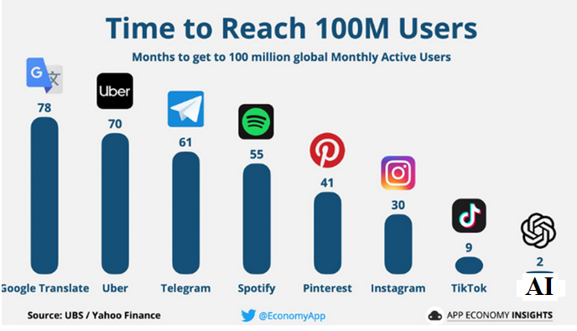
Statistics

Slide 4
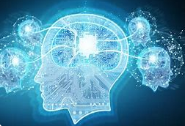
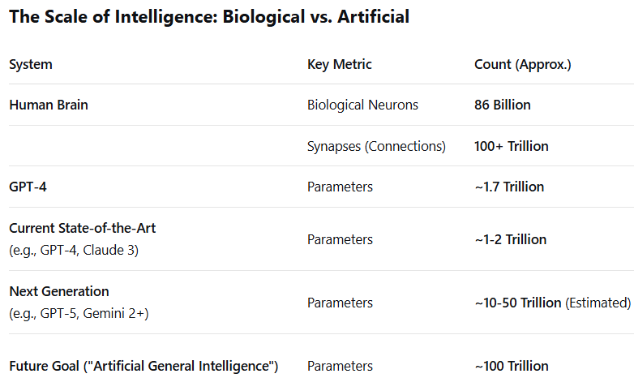
For Fifty years, we thought that our brain was a supercomputer or had microchips or super-processors. But we were wrong. These days, we believe that our brain, with those neurons and connections, is the simple artificial intelligence or (Machine learning). Neurons are like batteries. Michio Kaku

Slide 5
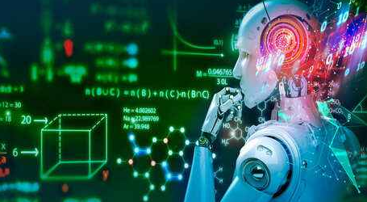
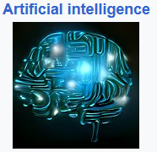
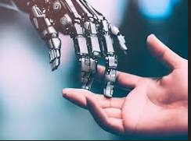
Artificial intelligence
Artificial intelligence (AI) is the intelligence of machines or software.
You will try to create the machine then this machine will try to learn from you. Finally this machine solve your problems.
Pros and cons: Speed

Slide 6
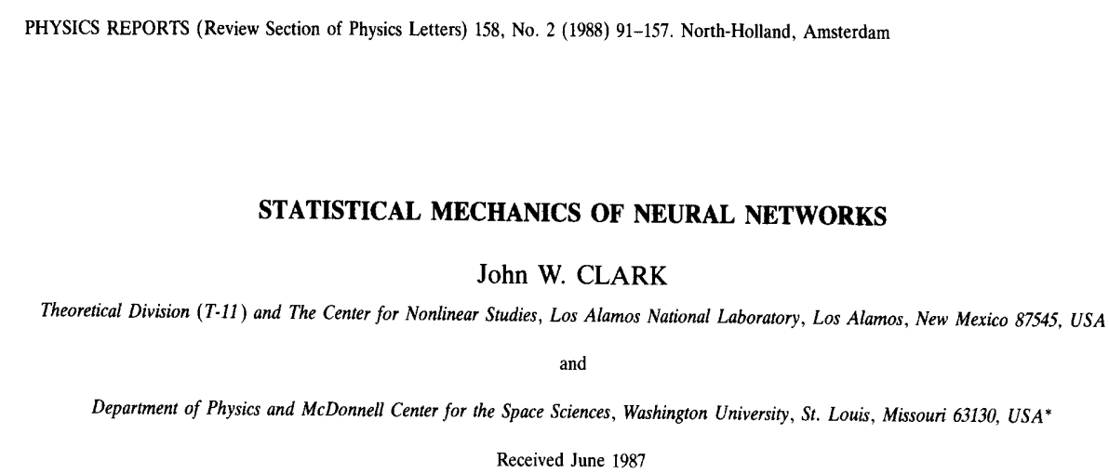

Slide 7
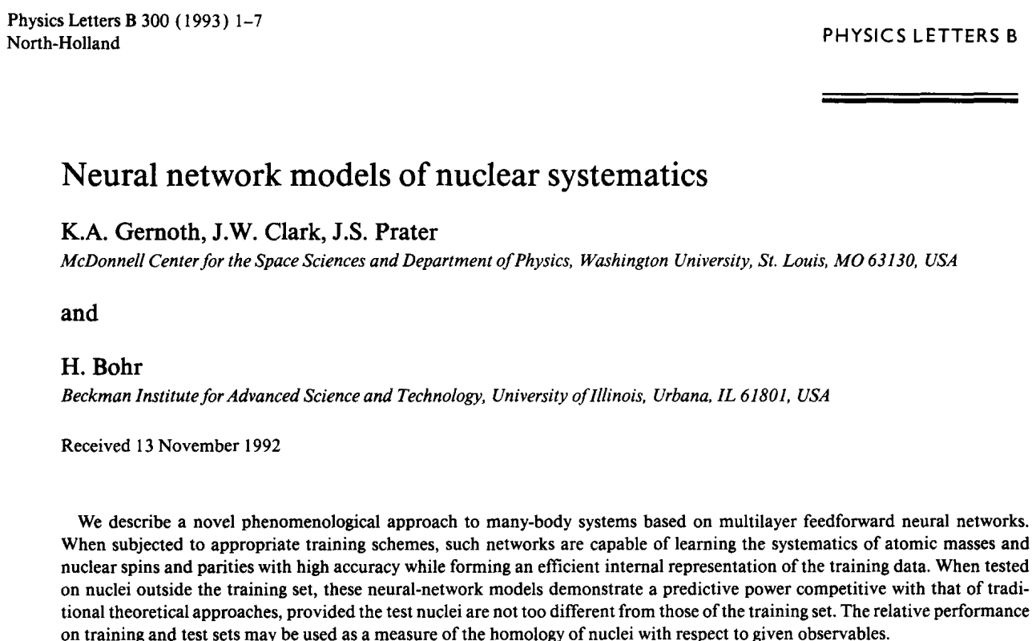

Slide 8
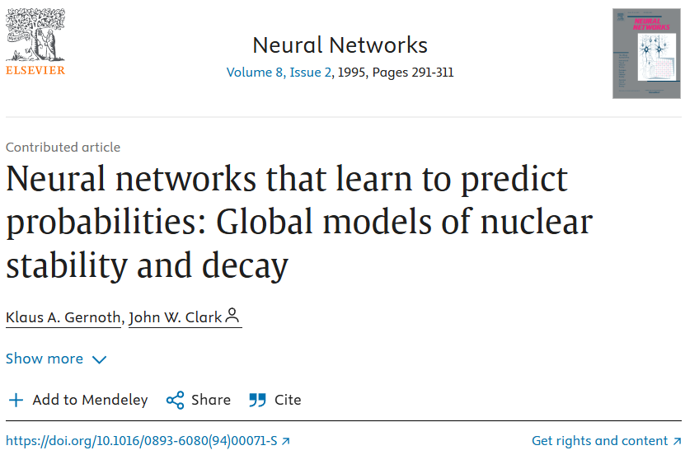

Slide 9
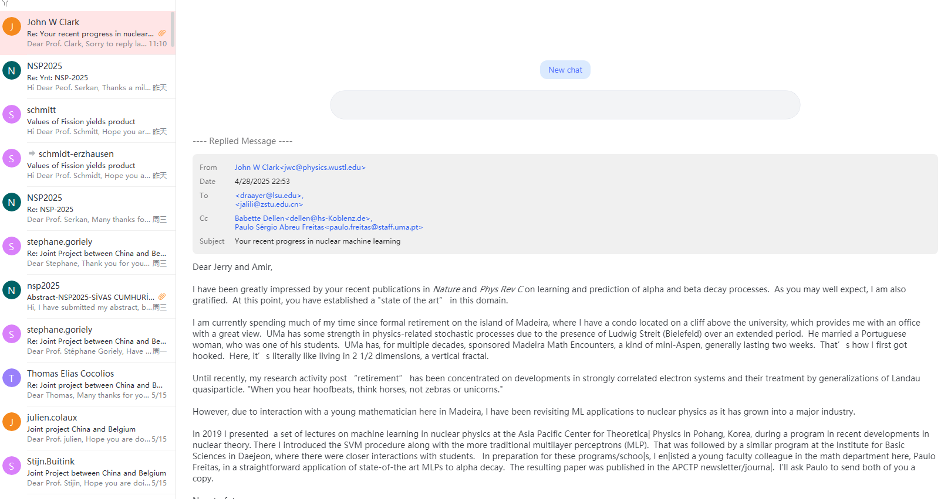

Slide 10
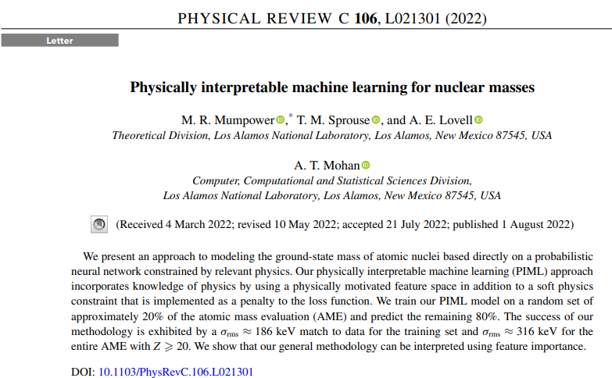

Slide 11
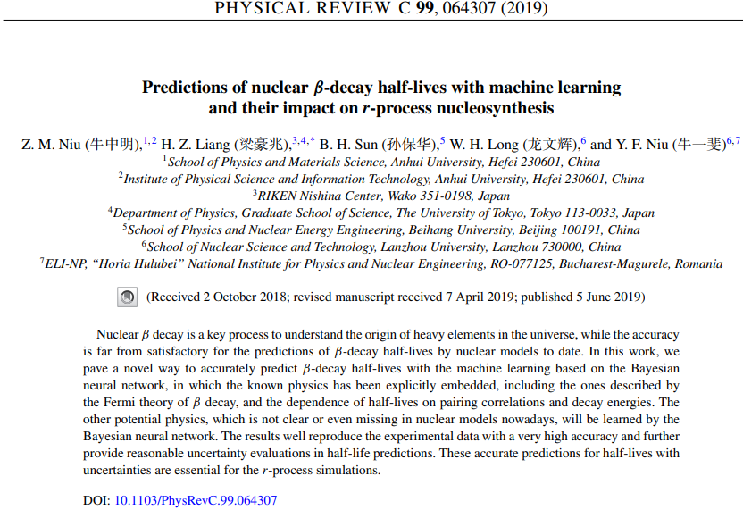

Slide 12







Slide 13
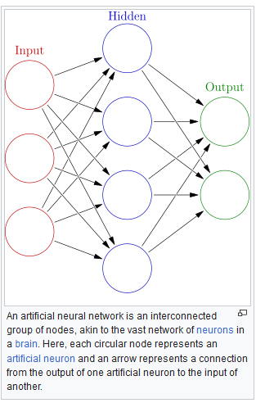
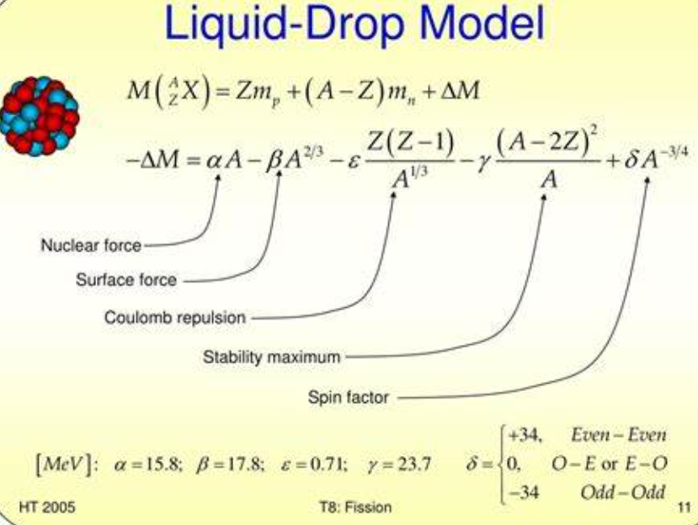
Neural Networks
Input layer:Data
Hidden layer: Objective
or activation functions
Outputs layer: Results
And predictions

Slide 14
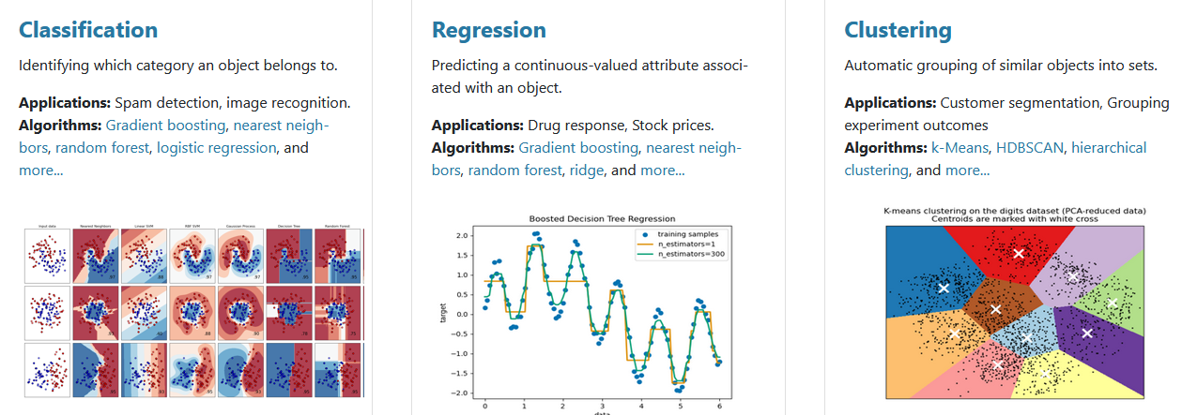

Slide 15
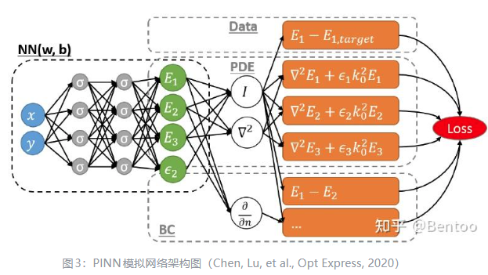

Physics-Guided versus Physics-Informed
What Is Physics-Guided Machine Learning (PGML)?
Physics-Guided Machine Learning leverages physics-based simulations or domain knowledge to augment conventional ML models. Instead of embedding equations into the model architecture, PGML uses physics-based insights to guide feature selection, data augmentation, or hybrid modeling strategies.
What Is Physics-Informed Machine Learning (PIML)?
Physics-Informed Machine Learning integrates physical principles directly into the ML model structure, embedding equations such as conservation laws, differential equations, and thermodynamic constraints into the learning process. This approach enables models to infer behavior even with limited data, improving robustness and generalizability.

Slide 16

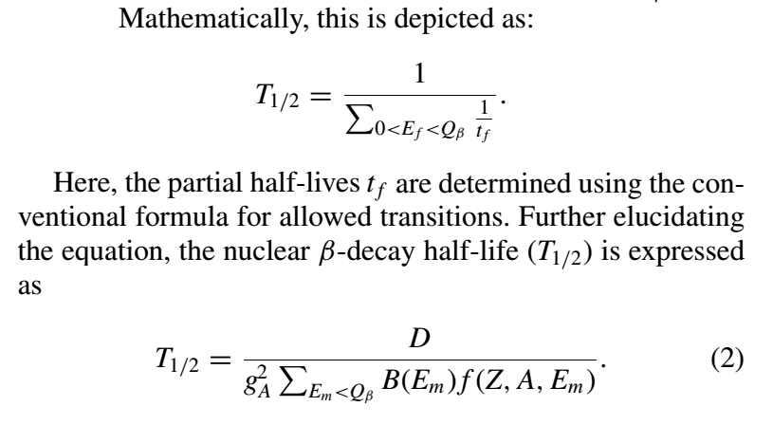
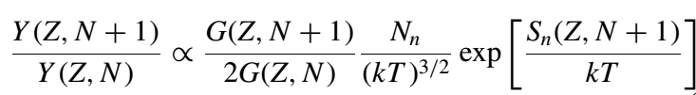
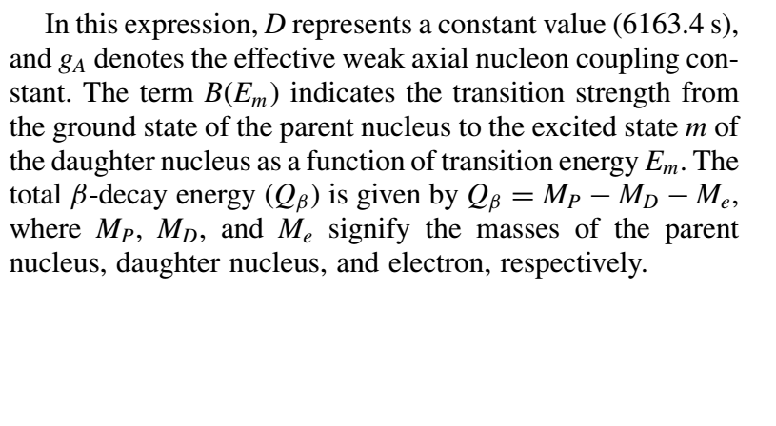

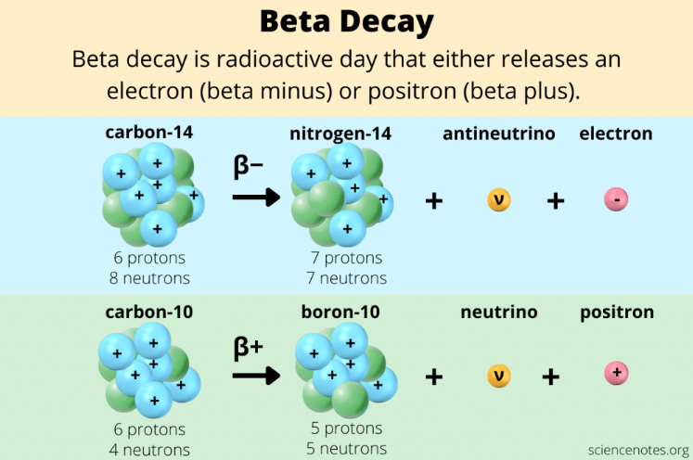
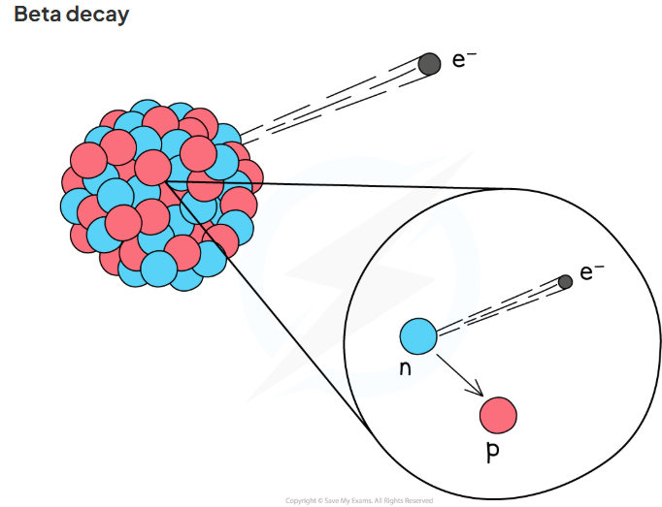

Slide 17
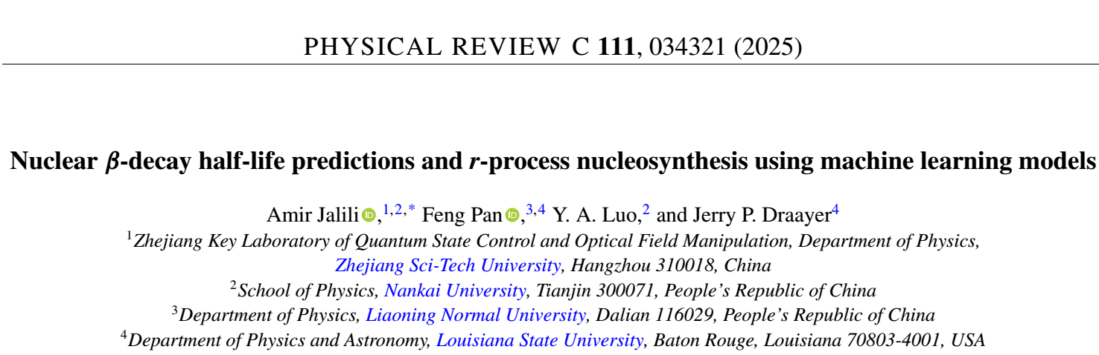
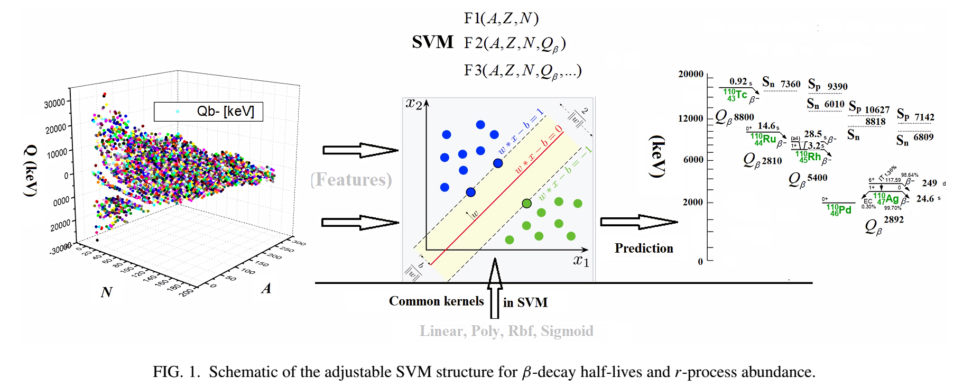

Slide 18
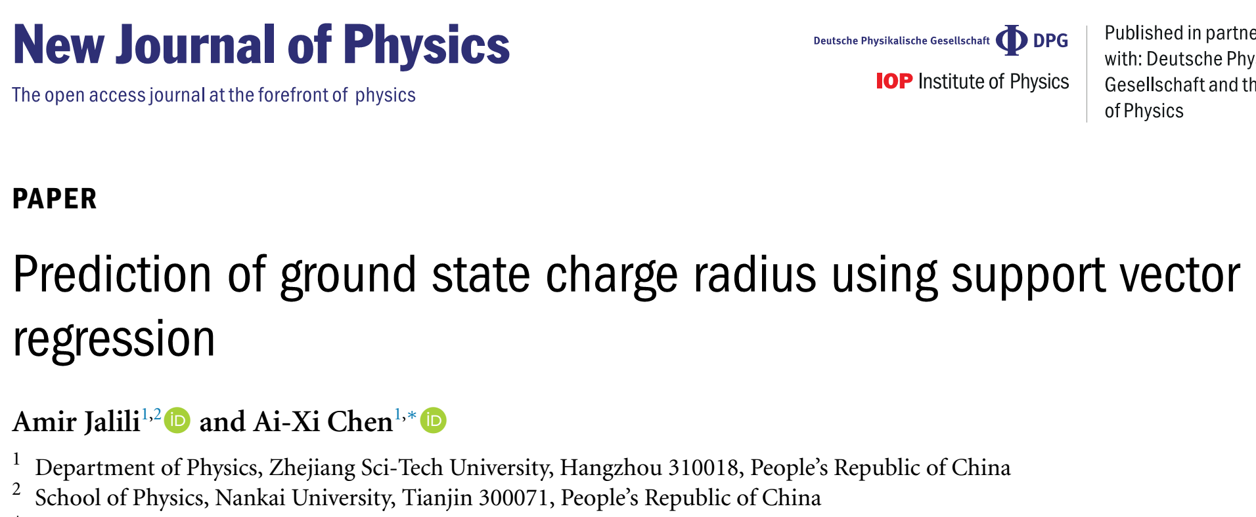
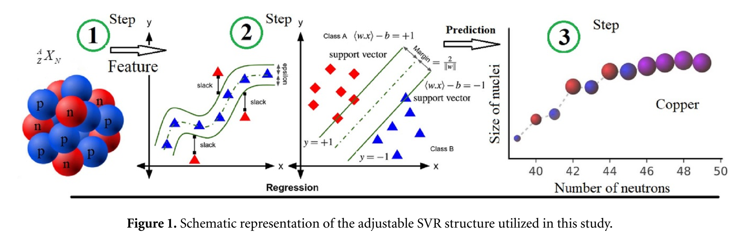

Slide 19
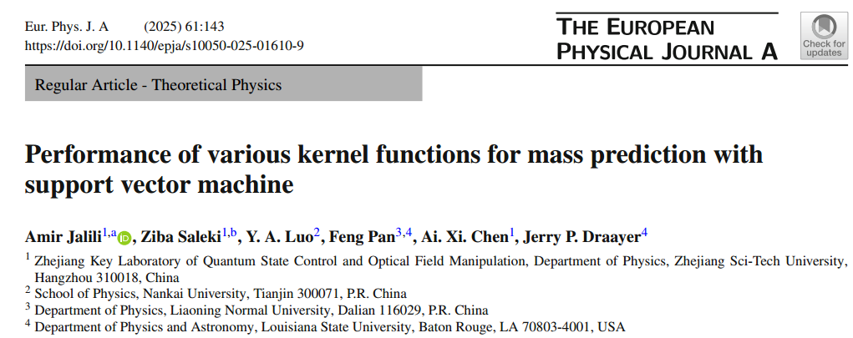
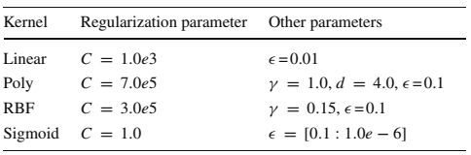
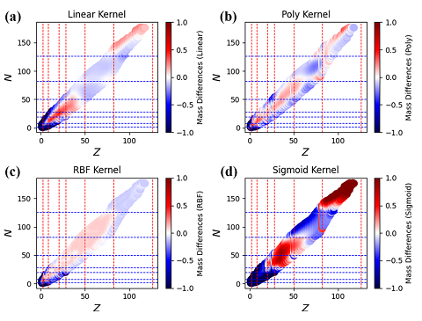
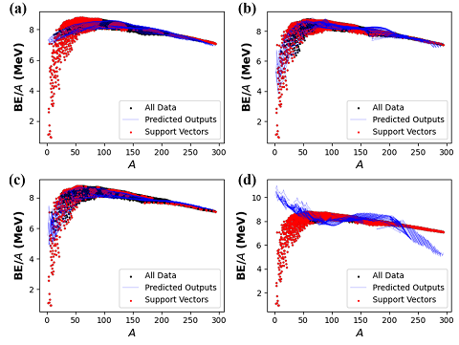

Slide 20
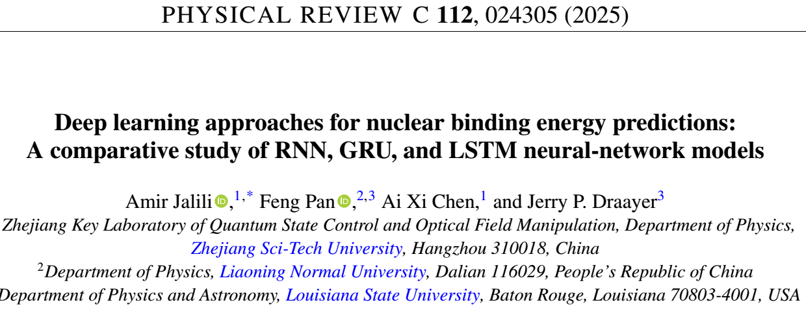
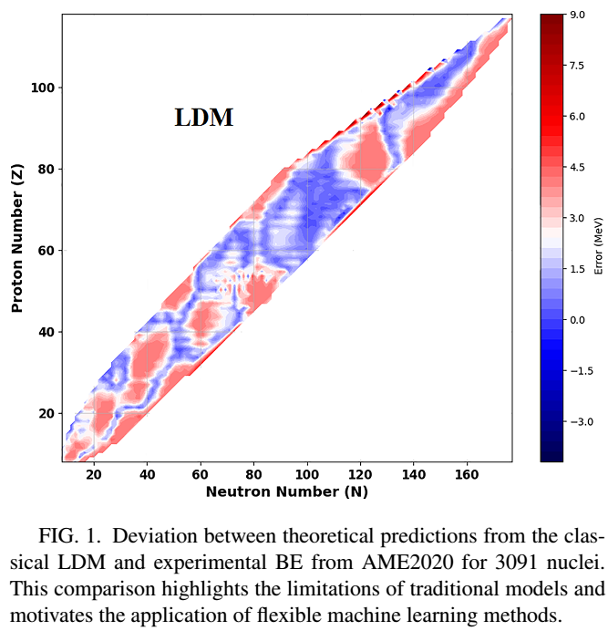
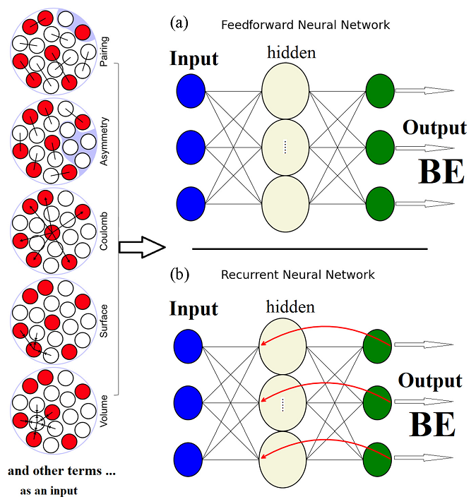

Slide 21
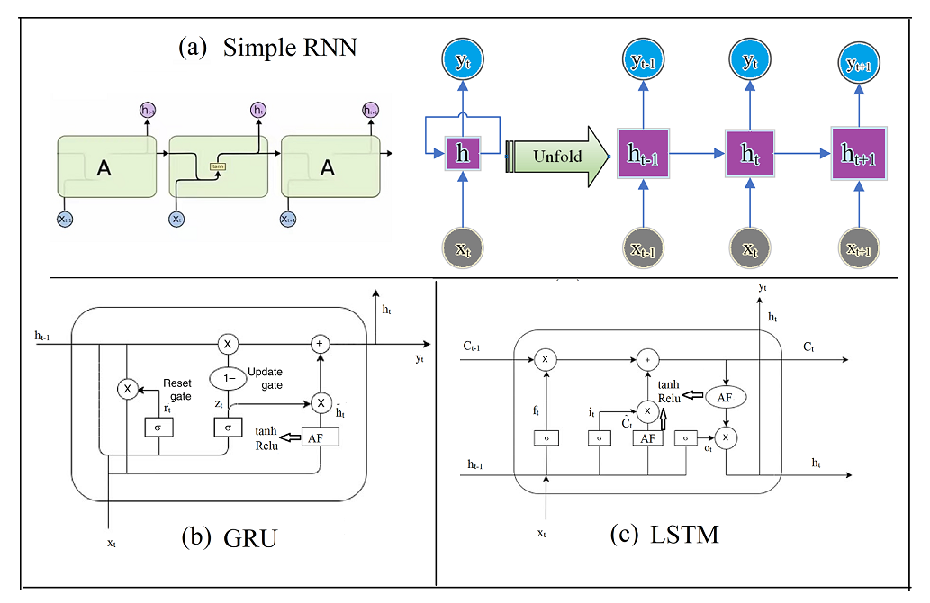
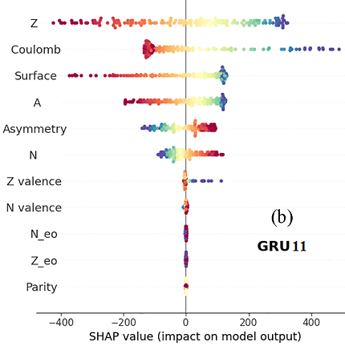
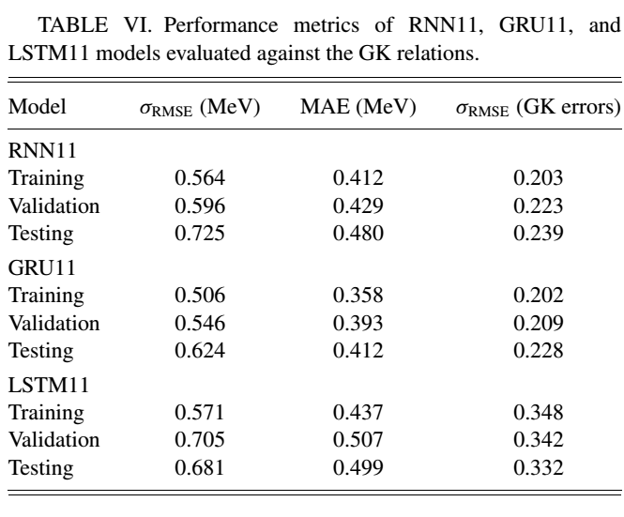
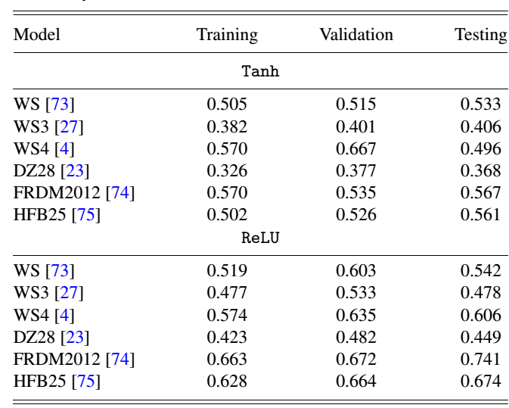

Slide 22
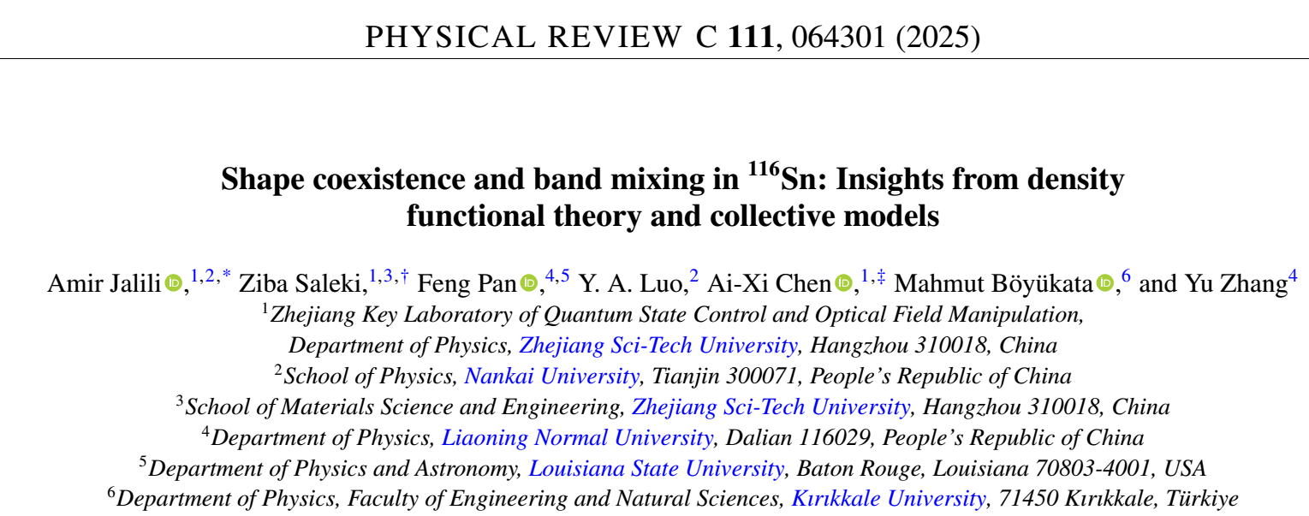
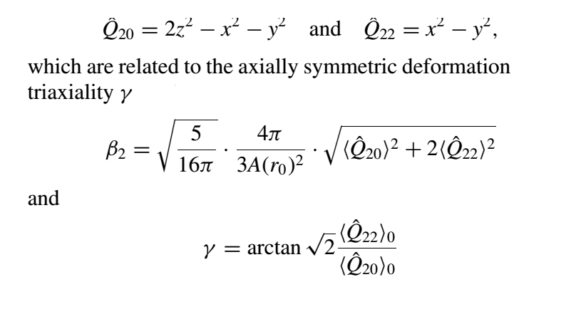

Slide 23
Optimization algorithm
GA: Genetic Algorithm
PSO: Particle Swarm optimization
Common ML algorithms:
Neural networks
Support Vector Machines
Random Forests
eXtreme Gradient Boosting
Cluster and regression
Hybrid model

Slide 24
Suggestion for prospective works
Nonlinear dynamic pattern
New neural networks
Earthquake prediction by ML+hybrid
RMT in cosmology (Astro)
New network in stock market
New network in high energy physics
Spectral statistics

Slide 25

我欠中国人民一份情。
" 现招研究岗位（可远程或现场）： IBM、密度泛函理论（DFT）、
神经网络。 有意者请联系我。
jalili@zstu.edu.cn
Phone: 19941199753

