Slide 1

第四届全国核物理及核数据中的机器学习应用研讨会
衡阳，2025-11-02
Kernel Ridge Regression, Principal Component Analysis,
and applications in nuclear physics
Xin-Hui Wu (吴鑫辉)
Department of Physics, Fuzhou University
福州大学 物理系

Slide 2


Machine learning
Machine learning applications in nuclear physics
Boehnlein+, Rev. Mod. Phys. 94, 031003 (2022); He+, Sci. China. Phys. 66, 282001 (2023); He+, Nucl. Sci. Tech. 34, 88 (2023)
(Bayesian) neural network
Radial basis function
Pang et al., Nature Communication 9, 210 (2018)
Wang et.al., Phys. Rev. C 84, 051303 (2011)
Niu & Liang, Phys. Rev. C 106, L021303 (2022)
Niu et.al., Sci. Bull. 63, 759 (2018)
Gaussian process
Bayesian/uncertainty quantification …
Neufcourt et.al., Phys. Rev. Lett., 122, 062502 (2019)
Liu et.al., Phys. Rev. C 104, 014315 (2021)
Gong et.al., Phys. Rev. C, 111, 044912 (2025)
Zhang & Chen, Phys. Rev. C 108, 024317 (2023)
Yang & Zhao, Phys. Rev. Lett. 134, 242502 (2025)
Decision tree
Light GBM
Carnini & Pastore, J. Phys. G 47, 082001 (2020)
Gao et.al., Nucl. Sci. Tech. 32, 109 (2021)
Li et.al., Phys. Rev. C 112, 014312 (2025)
Liu et.al., Phys. Rev. C 111, 024306 (2025)
$$⋮$$
Kernel ridge regression (KRR)
Principal component analysis (PCA)
WXH & P. W. Zhao, Phys. Phys. C 101, 051301 (R) (2020)
WXH & P. W. Zhao, Sci. China-Phys. Mech. Astron. 67, 272011 (2024)
WXH, Z. X. Ren, and P. W. Zhao, Communications Physics, 8, 316 (2025)
Giuliani et.al., Phys. Phys. Research 6, 033266 (2024)
轻便型
数值稳定
适合小样本
可解释性强

Slide 3

Contents
Kernel Ridge Regression (KRR)
Principal Component Analysis (PCA)
KRR + PCA for nuclear orbital-free DFT
Summary

Slide 4
Kernel Ridge Regression

Slide 5

Kernel ridge regression
Regression
Data and Goal
Data: ${\left\{\left(x^{i},y^{i}\right)\right\}}_{i=1}^{m}$， $x^{i}∈ℝ^{D}$, $y^{i}∈ℝ$
Goal: $x^{∗}→y^{∗}$
Linear regression
$y^{∗}=w_{1}x_{1}^{∗}+w_{2}x_{2}^{∗}+…+w_{D}x_{D}^{∗}$ $→$ $y^{∗}=w^{T}x$
Project $x$ to a new space $φ$ to deal with non-linear problem
$$φ\left(x\right)=\left({\begin{aligned}φ_{1}(x) \\ φ_{2}(x) \\ ⋮\end{aligned} \atop φ_{D}(x)}\right)∈ℝ^{D}$$
$y^{∗}=w_{1}φ_{1}^{∗}+w_{2}φ_{2}^{∗}+…+w_{D}φ_{D}^{∗}$ $→$ $y^{∗}=w^{T}φ(x^{∗})$

Slide 6
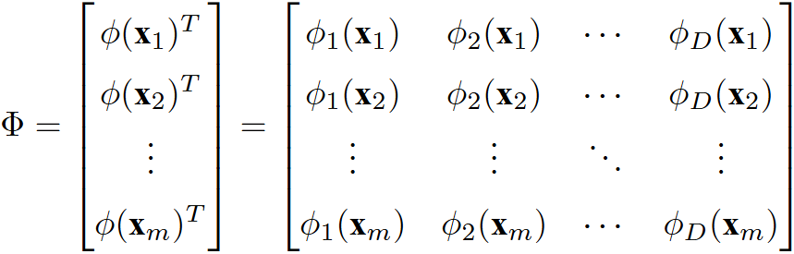
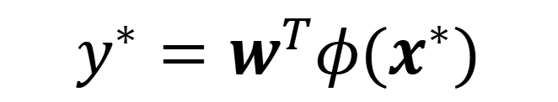
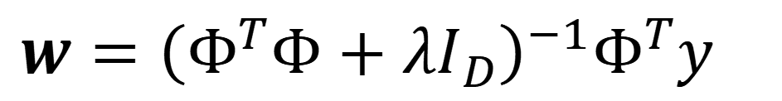
Kernel ridge regression
Optimization and Loss function
$$y^{∗}=w^{T}φ(x^{∗})$$
$w$ determined by minimizing Loss function:
Possible overfitting !
$$L\left(w\right)={\left[y_{i}−w^{T}φ\left(x_{i}\right)\right]}^{2}$$
Ridge regression
penalty term
$$L\left(w\right)={\left[y_{i}−w^{T}φ\left(x_{i}\right)\right]}^{2}+λ{||w||}^{2}$$
Minimizing Loss function obtains:
$$w={\left(Φ^{T}Φ+λI_{D}\right)}^{−1}Φ^{T}y$$

Slide 7
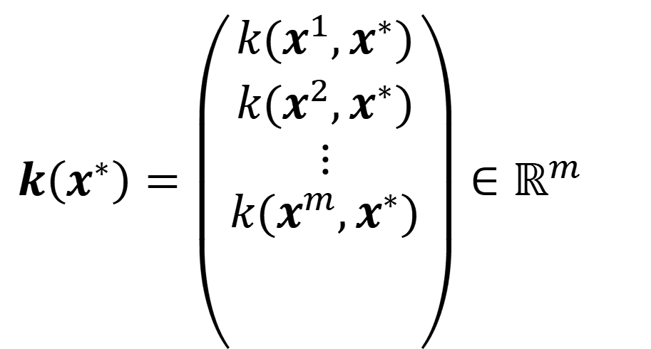


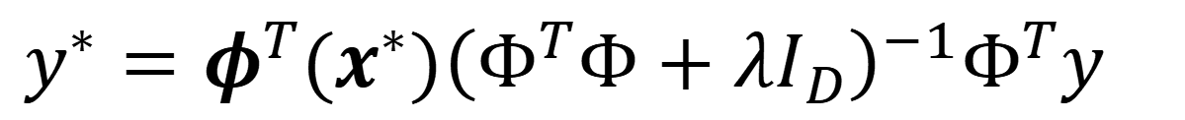




Kernel ridge regression
Representation and kernel trick
$$y^{∗}=w^{T}φ(x^{∗})$$
$$→$$
$$y^{∗}=φ^{T}(x^{∗}){\left(Φ^{T}Φ+λI_{D}\right)}^{−1}Φ^{T}y$$
$$w={\left(Φ^{T}Φ+λI_{D}\right)}^{−1}Φ^{T}y$$
How to define map $φ$ ?
Kernel trick
Cortes & Vapnik, Machine learning, 20, 273 (1995)
Define: $K=ΦΦ^{T}$ ($m×m$ matrix), element $K_{ij}=φ^{T}\left(x^{i}\right)φ\left(x^{j}\right)≡k(x^{i},x^{j})$
$$k\left(x^{∗}\right)=\left({\begin{aligned}k(x^{1},x^{∗}) \\ k(x^{2},x^{∗}) \\ ⋮\end{aligned} \atop k(x^{m},x^{∗})}\right)∈ℝ^{m}$$
Representation with kernel
Boser et al., COLT, 144-152 (1992)
$y^{∗}=k^{T}\left(x^{∗}\right){\left(K+λI_{m}\right)}^{−1}y$
Avoids computing mapping $φ(x)$

Slide 8
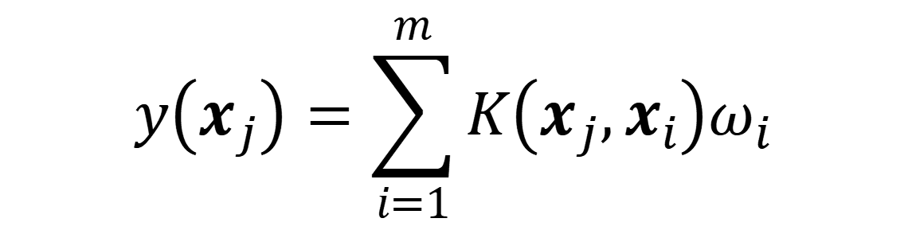

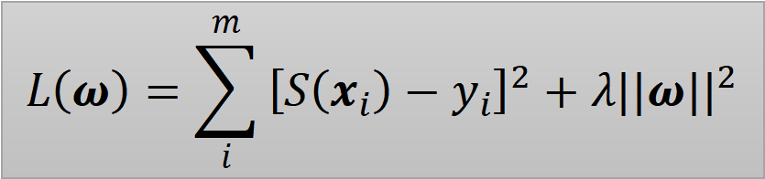
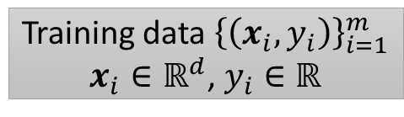
Kernel ridge regression
KRR prediction function
Evgeniou et al., Adv. Comput. Math., 13, 1 (2000)
$$y\left(x_{j}\right)=\sum_{i=1}^{m}{K\left(x_{j},x_{i}\right)ω_{i}}$$
Training data ${\left\{\left(x_{i},y_{i}\right)\right\}}_{i=1}^{m}$
$x_{i}∈ℝ^{d}$, $y_{i}∈ℝ$
轻便型
Kernel function
$K\left(x_{j},x_{i}\right)=⟨φ\left(x_{j}\right),φ(x_{i})⟩$ ；$φ: ℝ^{D}→𝓗$
In practice: $K\left(x_{j},x_{i}\right)$ is a designed function, i.e., Gaussian Kernel.
$$L\left(ω\right)=\sum_{i}^{m}{{\left[S\left(x_{i}\right)−y_{i}\right]}^{2}+λ{||ω||}^{2}}$$
Weight parameters $ω_{i}$
Determined by training data: $ω={\left(K+λI\right)}^{−1}y$
数值稳定
Control contribution of samples: each $ω_{i}$ encodes the influence of training point $x_{i}$ on predictions.

Slide 9
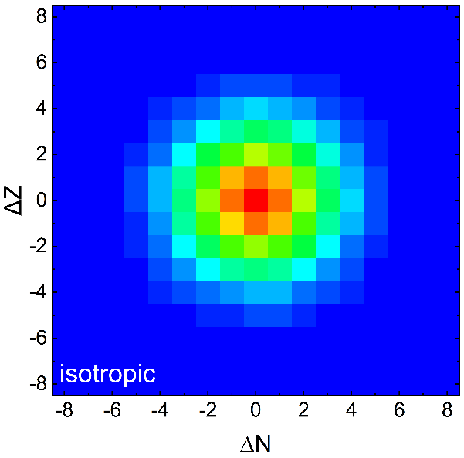
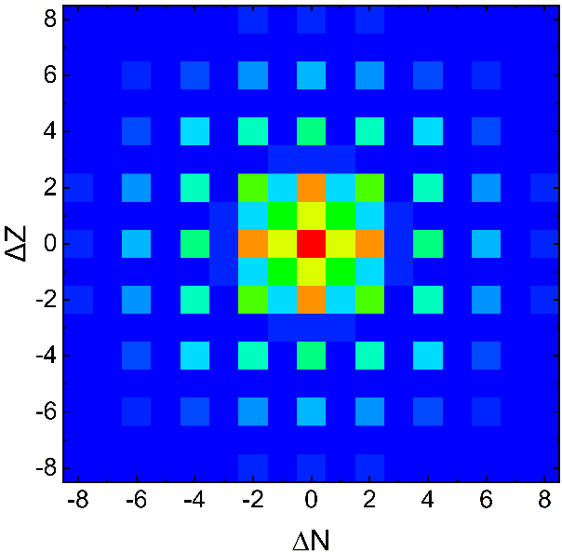
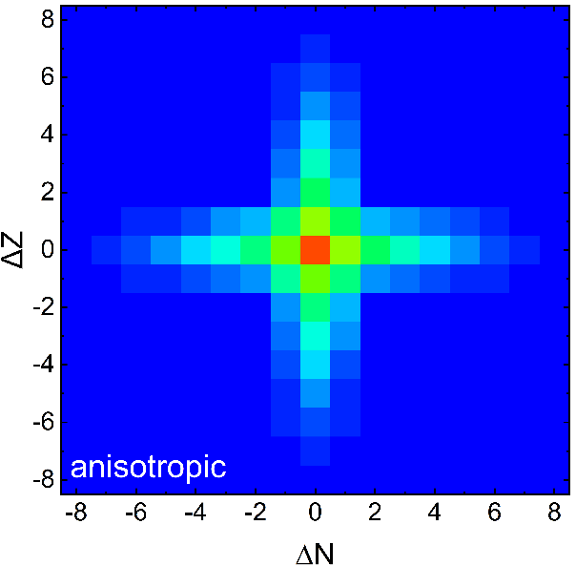
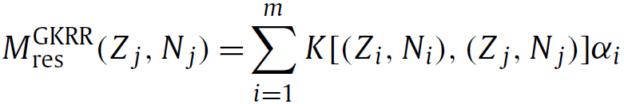
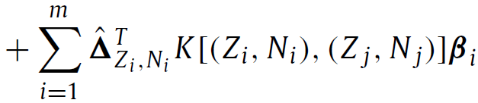

Kernel ridge regression
Example: nuclear mass $→$ testbed for ML in nuclear physics
Kernel function $K[\left(Z_{i},N_{i}\right), (Z_{j},N_{j})]$
Gaussian kernel
KRRoe
odd-even kernel
anisotropic kernel
KRR
AKRR
199 keV
128 keV
141 keV
WXH & P.W. Zhao, PRC 101, 051301 (R) (2020)
WXH, L.H. Guo, and Zhao, PLB 819, 136387 (2021)
WXH & C. Pan, PRC 110, 034322 (2024)
GKRR
KRR with gradient term
--- Multitask learning for $M$ and $S_{n}$
WXH, Y. Y. Lu, and P. W. Zhao, Phys. Lett. B, 834, 137394 (2022)
可根据研究对象的物理特征设计 Kernel 函数
可解释性强

Slide 10
Principal Component Analysis

Slide 11
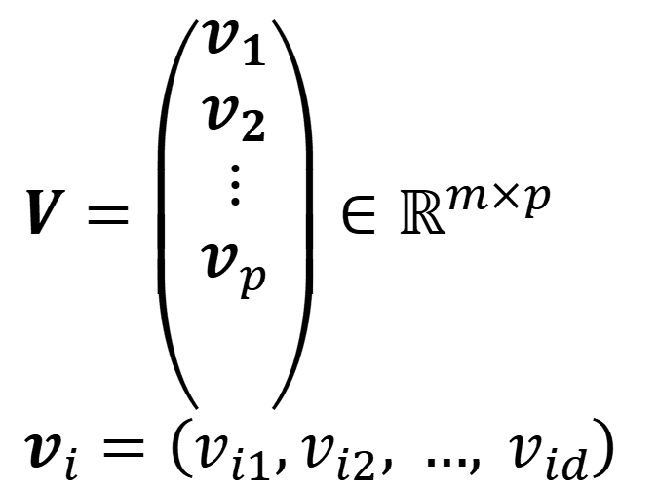

Principal Component Analysis
Principal Component Analysis (PCA) is a technique used for identifying a set of Principal Components (PCs) that capture the principal features in data.
I. T. Jolliffe, Principal Component Analysis for Special Types of Data (Springer, New York, 2002)
Original feature
Principal component
$$X=\left({\begin{aligned}x_{1}^{T} \\ x_{2}^{T} \\ ⋮\end{aligned} \atop x_{m}^{T}}\right)∈ℝ^{m×d}$$
$$x_{i}=\left(x_{i1},x_{i2}, …, x_{id}\right)$$
$$V=\left({\begin{aligned}v_{1} \\ v_{2} \\ ⋮\end{aligned} \atop v_{p}}\right)∈ℝ^{m×p}$$
$$v_{i}=\left(v_{i1},v_{i2}, …, v_{id}\right)$$
Features correlated
Features uncorrelated
Not ordered by importance
Ordered by importance
Need high-dimensional representation
Reduced-dimensional representation
Contain redundancy
Remove redundancy

Slide 12
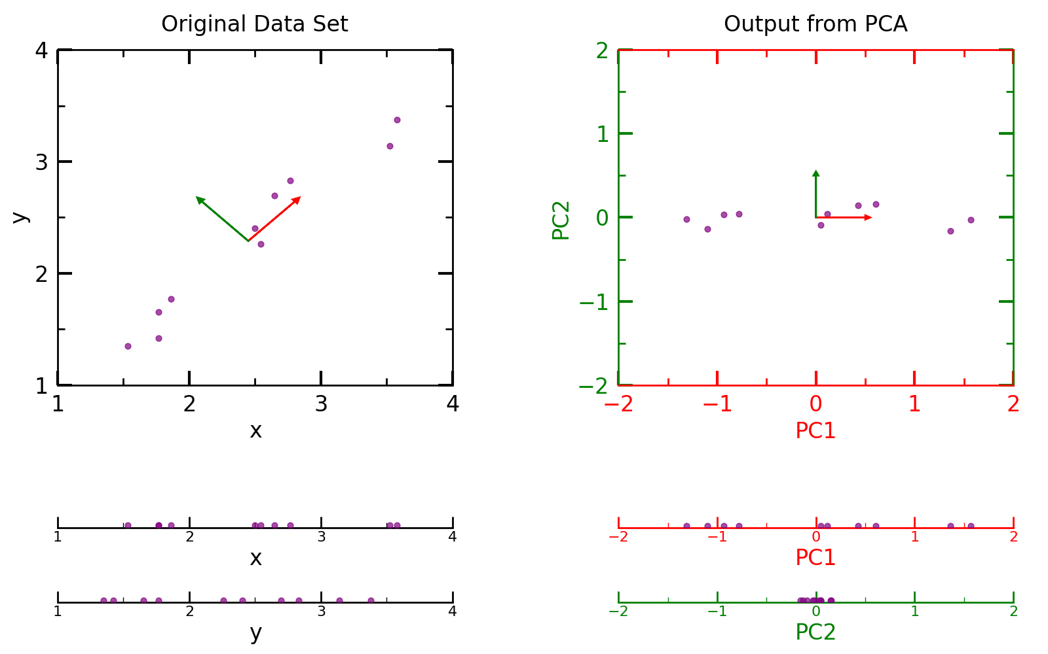
Principal Component Analysis
Principal Component Analysis (PCA) is a technique used for identifying a set of Principal Components (PCs) that capture the maximum features in data.

Slide 13
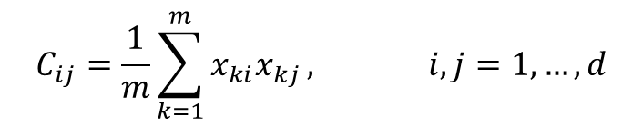
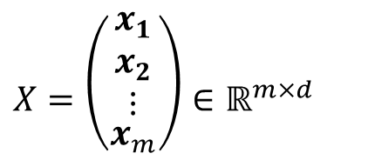
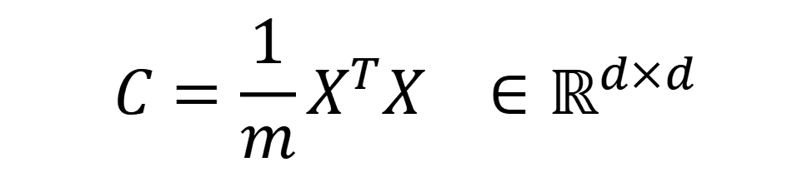

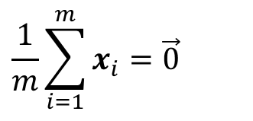
Principal Component Analysis
Step-1: Data preparation
Step-by-step procedure
Input data
Center the data
$$X=\left({\begin{aligned}x_{1} \\ x_{2} \\ ⋮\end{aligned} \atop x_{m}}\right)∈ℝ^{m×d}$$
$$\frac{1}{m}\sum_{i=1}^{m}{x_{i}}=\vec{0}$$
Focuses on variance, not absolute values.
$$x_{i}=\left(x_{i1},x_{i2}, …, x_{id}\right)$$
Step-2: Compute covariance matrix
$$C=\frac{1}{m}X^{T}X ∈ℝ^{d×d}$$
$$C_{ij}=\frac{1}{m}\sum_{k=1}^{m}{x_{ki}x_{kj}}, i,j=1,…,d$$
Each element $C_{ij}$ is the covariance between feature $i$ and feature $j$.

Slide 14
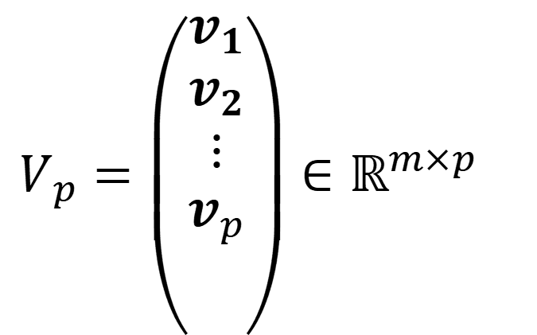
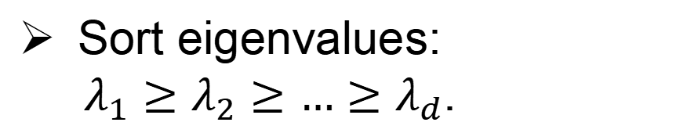
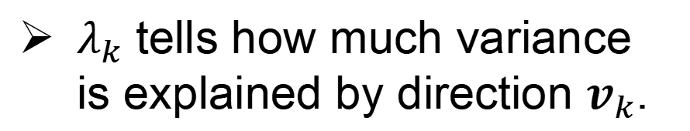


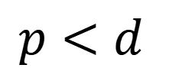
Principal Component Analysis
Step-3: Diagonalize covariance matrix
Step-by-step procedure
Find eigenvalues and eigenvectors of $C$
$$Cv_{k}=λ_{k}v_{k}$$
$λ_{k}$ tells how much variance is explained by direction $v_{k}$.
Sort eigenvalues:
$λ_{1}≥λ_{2}≥…≥λ_{d}$.
Step-4: Select top components
Choose the first $p$ components (corresponding to largest eigenvalues).
Form a projection matrix
Orthogonality: principal components are mutually uncorrelated.
$$V_{p}=\left({\begin{aligned}v_{1} \\ v_{2} \\ ⋮\end{aligned} \atop v_{p}}\right)∈ℝ^{m×p}$$
$$p<d$$
Dimensionality reduction: keep only the first $p$ eigenvectors, with $p<d$.

Slide 15
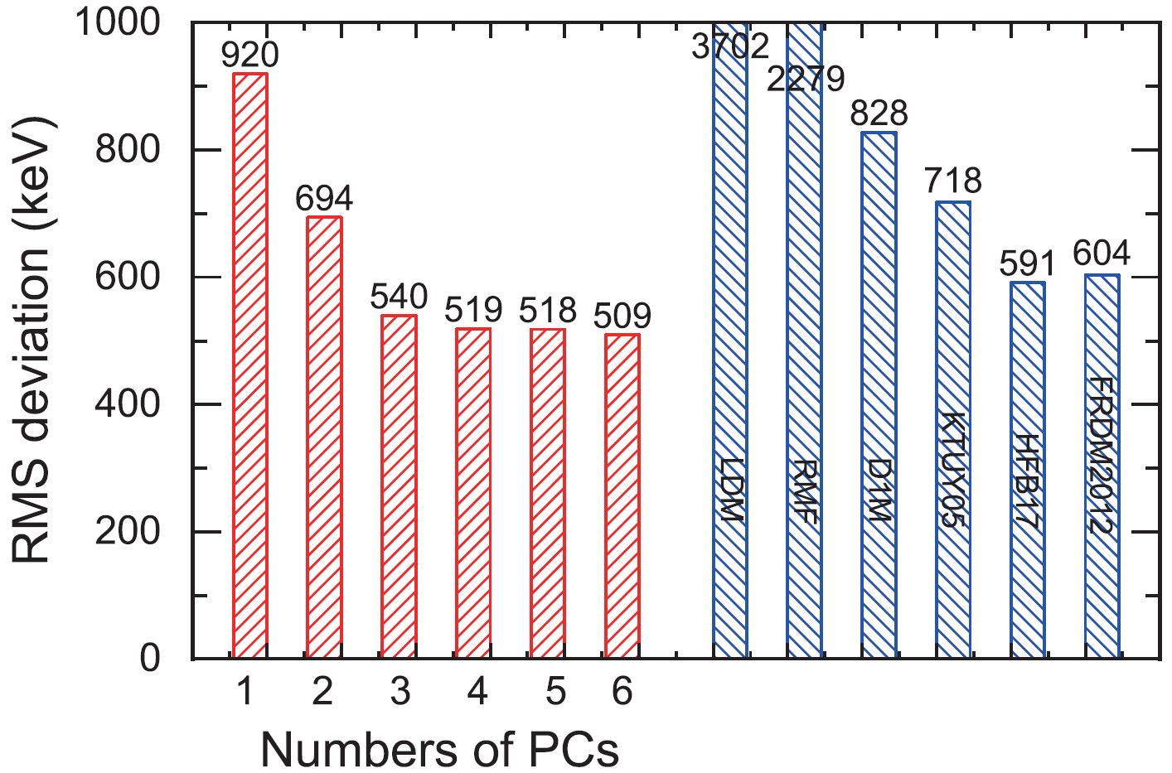
Principal Component Analysis
Example: Extract principal features of nuclear mass models
WXH & P. W. Zhao, Sci. China-Phys. Mech. Astron. 67, 272011 (2024)
Y. Y. Huang & WXH, arXiv : 2510.03020 (2025)
Giuliani, Godbey, Kejzlar, and Nazarewicz, Phys. Rev. Res. 6, 033266 (2024)
PC2
RMF
HFB
FRDM
PC1
LDM
D1M
PC3
KTUY
Imaginative mass prediction space
Various nuclear mass models include different types and different degrees of nuclear many-body effects.
PCA provides a new idea to build nuclear mass tables by extracting and combining the effects included in different models.

Slide 16

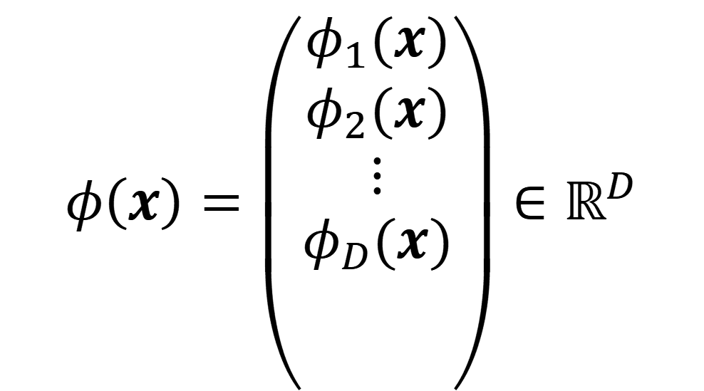
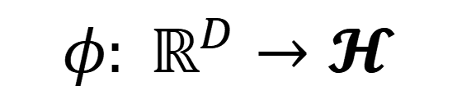
Something more: Kernel PCA
Standard PCA addresses linear correlations only.
Many datasets exhibit nonlinear features.
Kernel PCA applies PCA in a high-dimensional feature space via the kernel trick.
Nonlinear mapping
$$φ\left(x\right)=\left({\begin{aligned}φ_{1}(x) \\ φ_{2}(x) \\ ⋮\end{aligned} \atop φ_{D}(x)}\right)∈ℝ^{D}$$
$$φ: ℝ^{D}→𝓗$$
kernel trick
$$K\left(x_{j},x_{i}\right)=⟨φ\left(x_{j}\right),φ(x_{i})⟩$$

Slide 17
KRR & PCA for nuclear orbital-free DFT

Slide 18
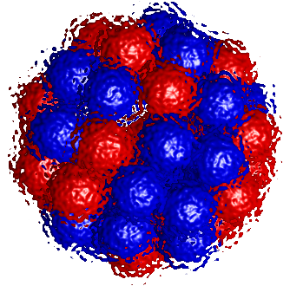

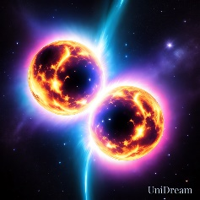

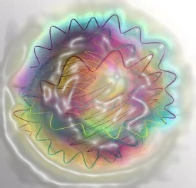
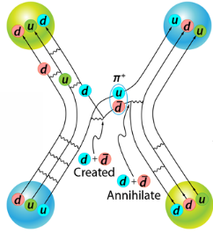
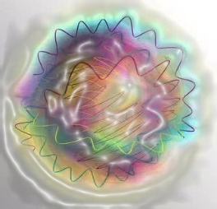
Nuclei – Quantum many-nucleon systems
Nuclear physics studies systems from the lightest nuclei to neutron stars. They are complicated quantum many-body systems consisting of nucleons.
Solution of nuclear many-body systems is a long-standing challenge.
Nuclear force
(Residual of complex strong interaction)
? ?
Quantum many-body difficulties
physics.aps.org
(Computational complexity increases rapidly with particle number)

Slide 19
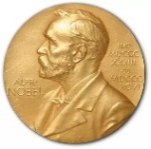
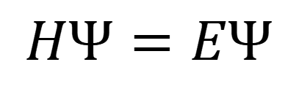

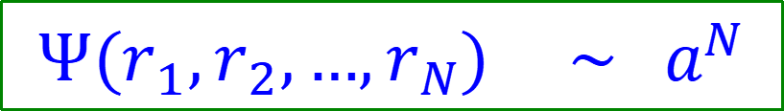

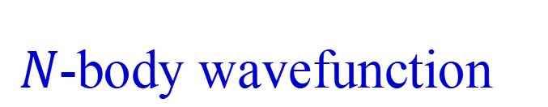
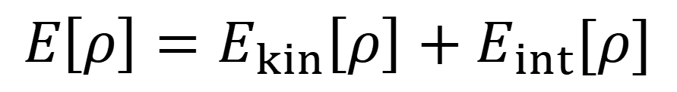


Nuclear DFT
Quantum Many-body difficulties
$$\hat{H}Ψ\left(r_{1},r_{2},…,r_{N}\right)=EΨ\left(r_{1},r_{2},…,r_{N}\right)$$
$Ψ(r_{1},r_{2},…,r_{N})$ $\sim a^{N}$
$r_{i}=r_{i}$ (ignore spin, isospin), complexity $\sim G^{3N}$
$^{16}O$：${10}^{(3×16)}$ [B] $≈ {10}^{33}$ [PB] (Tianhe-1 ~ $1$ PB)
Density functional theory (DFT)
1998 Nobel prize
In 1964, Hohenberg and Kohn proved that the ground-state energy of a quantum many-body system can be expressed as a functional of the particle-number density.
Hohenberg and Kohn, Phys. Rev., 136 B864 (1964)
$$HΨ=EΨ$$
$$arg min{ }$$
$$E\left[ρ\right]=E_{kin}\left[ρ\right]+E_{int}[ρ]$$
Hohenberg-Kohn
$$Ψ(r_{1},r_{2},…,r_{N})$$
$$ρ(r)$$
$N$-body wavefunction
$1$-body density

Slide 20
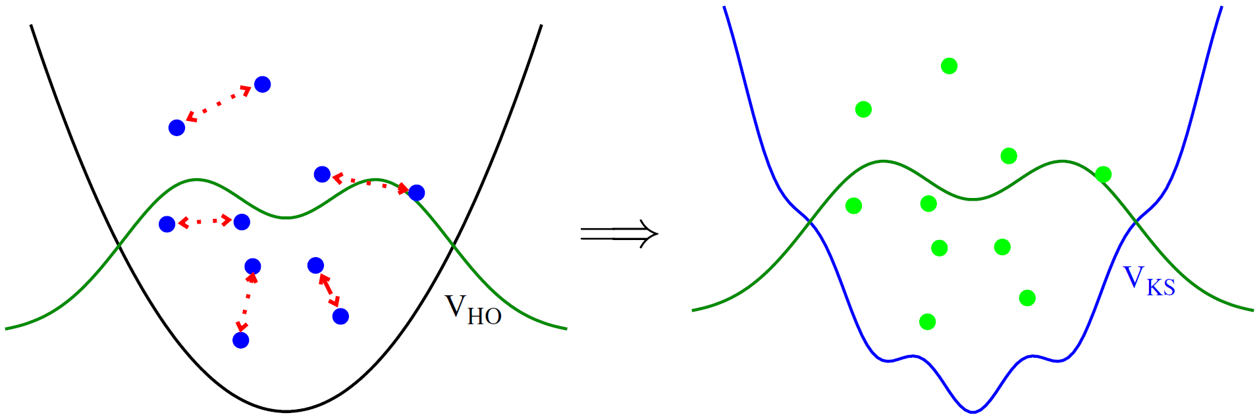

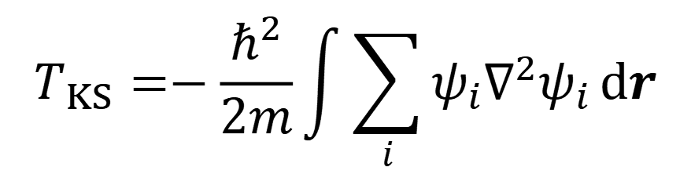
Kohn-Sham DFT and orbital-free DFT
Kohn-Sham Scheme
Kohn and Sham, Phys. Rev., 140 A1133 (1965)
non-interacting many-body system simulate interacting many-body system
$$T_{KS}=−\frac{ℏ^{2}}{2m}\int{\sum_{i}{ψ_{i}∇^{2}ψ_{i}}}dr$$
Auxiliary one-body orbitals are introduced.
Orbital-free DFT: express energy solely as a functional of the density
Levy et.al, Phys. Rev. A 30, 2745 (1984)
Why to do OF-DFT ?
Idealism：Return to the Hohenberg-Kohn theorem.
Realism：Save computational cost.
Because it is a combination of idealism and realism.

Slide 21
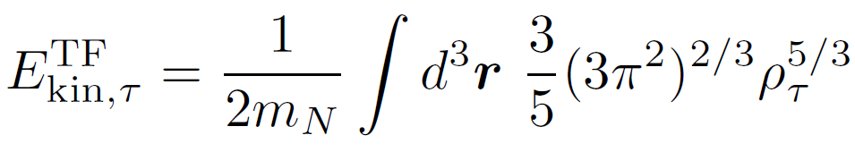
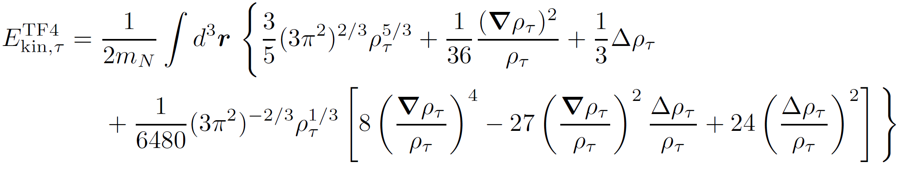
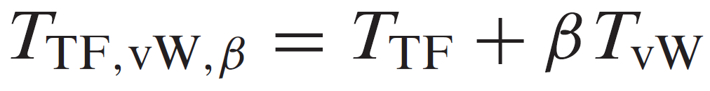
Nuclear orbital-Free DFT
Existing attempts in nuclear OF-DFT
Thomas-Fermi functional
Thomas, Math Proc Cambridge, 23, 542 (1927); Fermi, Rend. Accad. Naz. Lincei, 6, 5 (1927)
Extended Thomas-Fermi functionals
Brack et al., Phys. Rep., 123, 275 (1985); Centelles et al., Ann. Phys., 322, 363 (2007)
Thomas-Fermi functional + von Weizsäcker functional
Weizsäcker, Z. Physik, 96 431 (1935); Colò and Hagino, Prog. Theor. Exp. Phys., 03D01 (2023)

Slide 22
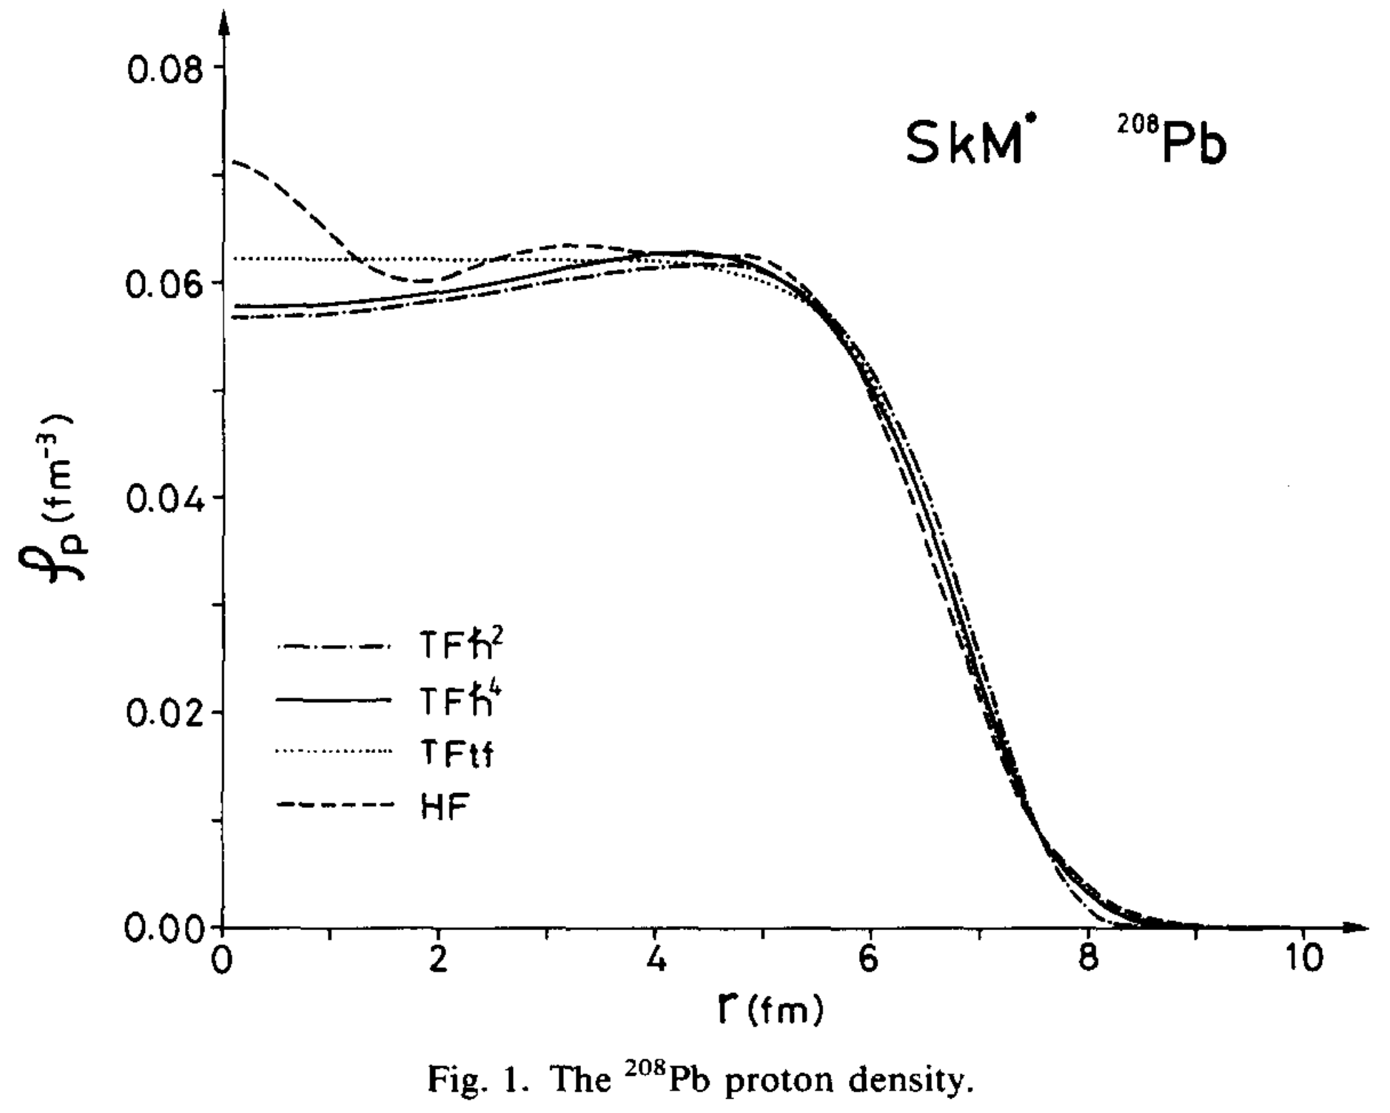
Nuclear orbital-Free DFT
However, current attempts based on TF and extensions can only provide average nuclear properties similar to the liquid drop model.
poor accuracy; only spherical ground states; densities are smooth; ...
Brack+, Phys. Rep., 123, 275 (1985)
Centelles+, Ann. Phys., 322, 363 (2007)
Lack of quantum shell effects.
Shell correction
Strutinsky-integral method
Chu+, Phys. Lett. B, 68, 5 (1977)
Expectation-value method
Brack+, Phys. Rep., 123, 275 (1985)
No longer an OF-DFT, as it introduces auxiliary one-body orbitals.
Centelles+, Ann. Phys., 322, 363 (2007)

Slide 23
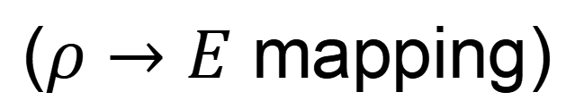

Nuclear orbital-free DFT
Whether orbital-free DFT can provide a high-accuracy description of atomic nuclei?
In principle: Yes, guaranteed by the HK theorem
In practice: No, not yet been achieved
Need new ideas
OF-EDF：Exists in principle，Not established in practice
($ρ→E$ mapping)
existing but complicated pattern
machine-learning √

Slide 24
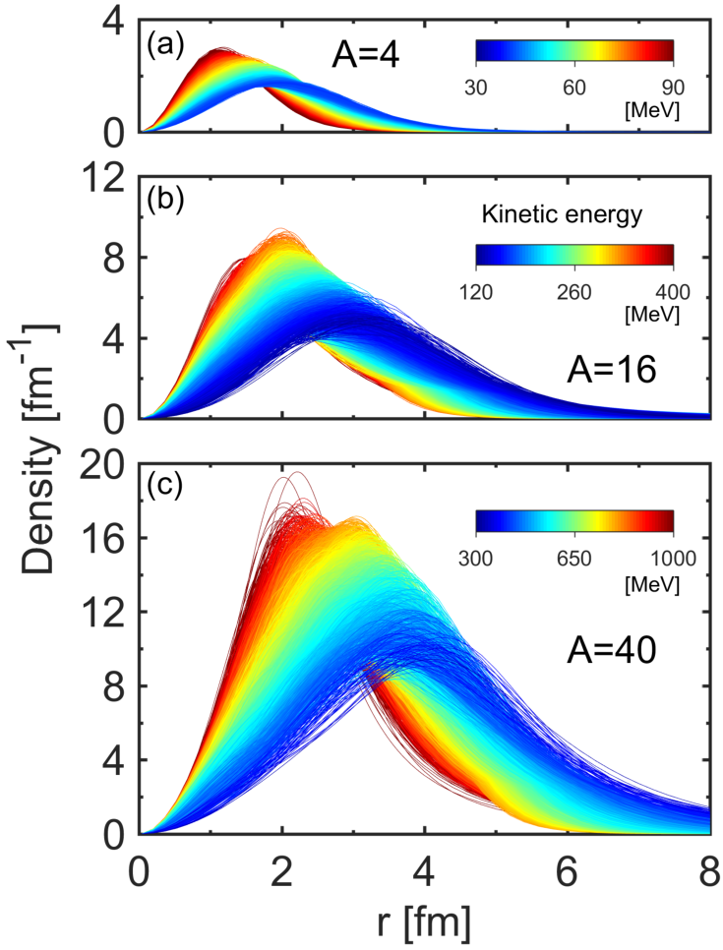
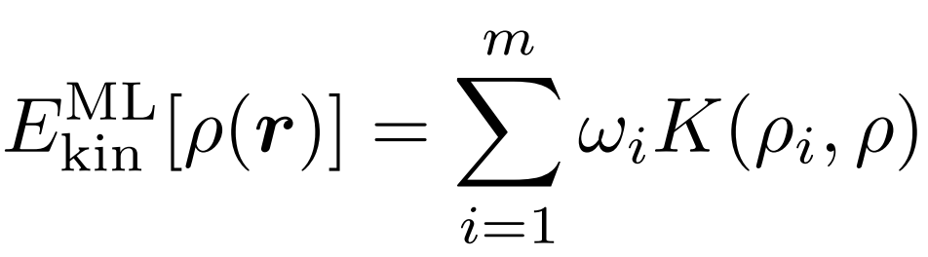
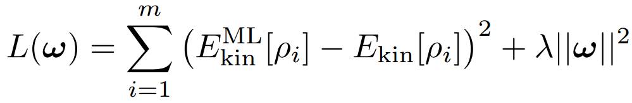
KRR representation for kinetic energy
$$E_{tot}[ρ]=E_{kin}[ρ]+E_{int}[ρ]$$
Kinetic energy
Skyrme interaction energy
Express kinetic energy by KRR function
WXH, Z. X. Ren, and P. W. Zhao, Phys. Rev. C, 105, L031303 (2022)
WXH, Z. X. Ren, and P. W. Zhao, Communications Physics, 8, 316 (2025)

Slide 25
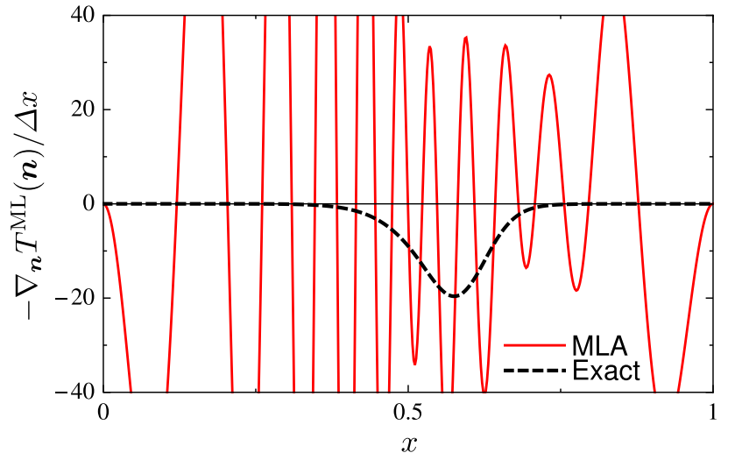





Functional derivative meets noise
Ground-state density can be found by a variation
$$arg min{ }$$
$$E_{tot}\left[ρ\right]=E_{kin}\left[ρ\right]+E_{int}[ρ]$$
$$ρ(r)$$
Gradient descent method
$$ρ_{n+1}=ρ_{n}−ε\frac{δE_{tot}\left[ρ\right]}{δρ},$$
Kinetic part
Sum of $m$ terms contains terrible noisy.
Snyder et.al, Phys. Rev. Lett. 108,253002 (2012)

Slide 26

Noise Reduction with PCA
Noise leads to non-convergence
PCA-guided step direction
Way to find GS
Density manifold
Trial density
Gradient descent with noise
Noise Reduction with PCA
Perform PCA for
$$Δρ=\left({\begin{aligned}ρ_{1}−ρ \\ ρ_{2}−ρ \\ ⋮\end{aligned} \atop ρ_{3}−ρ}\right)$$
WXH, Z. X. Ren, and P. W. Zhao, Phys. Rev. C, 105, L031303 (2022)

Slide 27

Stabilizing Iterations via PCA
Gradient descent method with PCA
Iteration process is very robust with the help of PCA!

Slide 28


ML orbital-free DFT
ML orbital-free DFT is succeed for both spherical and deformed nuclei.
WXH, Ren, and Zhao, Phys. Rev. C, 105, L031303 (2022)
Hohenberg-Kohn theorem is no longer just a theoretical concept but also a practical entity.
Foundation and confidence for further developments of nuclear orbital-free DFT.
WXH, Z. X. Ren, and P. W. Zhao, Communications Physics, 8, 316 (2025)

Slide 29
Summary

Slide 30
Summary
KRR and PCA approaches are introduced.
KRR: efficient regression method combining ridge regularization with the kernel trick to capture nonlinear features.
PCA: identifies principal features of data, removes redundancy, and provides reduced-dimensional representations.
KRR + PCA in nuclear OF-DFT
KRR represents non-linear kinetic density functionals
PCA stabilizes iterations
$→$ making nuclear orbital-free DFT feasible in practice.
The end
Thanks
First orbital-free DFT incorporating
nuclear quantum shell effects.

