Slide 1


Efficient machine learning from sparse data in high-D feature spaces
Sergei Manzhos
Ihara-Manzhos Laboratory
https://sites.google.com/site/sergeimanzhos/
http://www.chemeng.titech.ac.jp/~iharalab/
School of Materials and Chemical Technology

Slide 2
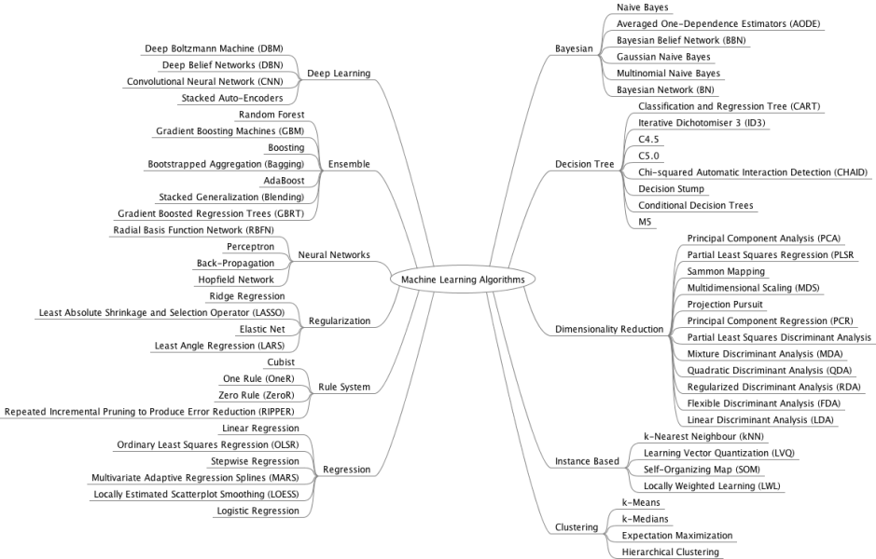
ML is a vast and branched field…
We will focus on regression problems
And methods based on neural networks and kernel methods

Slide 3
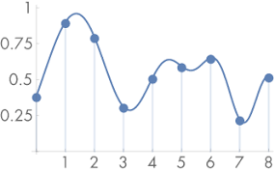
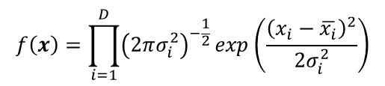

Off-the-shelf ML methods work well in moderately high-D with moderately sparse data
Curses of dimensionality
Exponentially difficult to fill space: N_{data}=ρ ^{D}
Data are always sparse in multidimensional spaces (example: 10⁶ points in 20D ~ 2 points/DOF, 10⁷ ~ 2.2 points/DOF)
Exponential growth of required no. of data and terms hold for direct product type representations (think a regular grid / Fourier expansion)
ML methods avoid them
What is local in low-d may be non-local in high-D: 1d: 68% of quadrature within σ; 6d: 10% of quadrature
Possible blessings of dimensionality
Concentration of metrics:
Some ML methods work better in high than in low dimensionality (e.g. NN)
ρ = 9, D = 1
$$f\left(x\right)=\prod_{i=1}^{D}{{\left(2πσ_{i}^{2}\right)}^{−\frac{1}{2}}}exp\left(\frac{{\left(x_{i}−\overline{x_{i}}\right)}^{2}}{2σ_{i}^{2}}\right)$$
Consequential for kernel regressions
$$\lim_{D→∞}{E\left(\frac{dist_{max}\left(D\right)−dist_{min}(D)}{dist_{min}(D)}\right)→0}$$
But in very high-D or with very low density of data specialized ML methods are desired
Notes:
Remember we had 32 features in the example of perovskite materials? Are 32 dimensions high or low? – it is high. In multidimensional spaces one is hit by the so-called curse of dimensionality. Imagine you sample some univariate function with rho points for example with 9 points as shown here. You can see from the shape of this particular function that 9 points seem to be enough to reconstruct the function but sampling with 2 or 3 points would not be enough. If one wants to maintain the same density of sampling in D dimensions, the number of sampling points would grow exponentially. This is the curse of dimensionality. Moreover, when one constructs a function with polynomials or Fourier expansions not only the number of required samples grows exponentially but the number of terms in the representation as well. The result of this is that it is impossible to achieve good density of sampling just by adding more data. For example in 20 dimensions a million data points is equivalent to only about 2 data per degree of freedom. If we somehow managed to get 10 times more data, it would only increase the density of sampling to about 2.2 data per degree of freedom. Practically, one therefore always works with extremely sparse data. So yes, 32 dimensions is a lot. In fact, one starts practically feeling this curse of dimensionality from about 6 dimensions and up.
The good news is that this horrible scaling strictly speaking only holds for direct product representations. One reason why various machine learning methods work well in multidimensional spaces is because they avoid direct product representations and thereby alleviate the problem of the curse of dimensionality.
In multidimensional spaces some intuitions break down. For example, what is local in low-D may not be in high-D. An example is the Gaussian function, which is localized around the mean in the sense that about 70% of the quadrature of this function is within one standard deviation from the mean, in the one-dimensional case. In six dimensions, for example, only 10% of the quadrature is from within one standard deviation. That is, a multidimensional Gaussian function is no longer a localized function by this measure.
Working in high dimensionality has also its advantages. For example, there is the concentration of measure whereby as dimension is increased, the width of the distribution of distances between data points collapses. We observed in our own experience that for example neural networks perform better in high-dimensional spaces than in 1, 2, 3 dimensions. This ultimately relates to growing advantages of non-direct product representations in high dimensions.
I now would like to ask you: if I have a dataset of e.g. 1 million point in 20D, what is the dimensionality of such a dataset?
….
One consequence of the low density of sampling is that the dimensionality of the data set is less than the dimensionality of the space. This is obvious when the data are confined to lower-dimensional hypersurfaces or other shapes, but even if the data are not confined to such a sub-dimensional shape, simply by the virtue of low density, the dimensionality is lowered. This ultimately justifies representations with lower-dimensional functions, and I will talk about that next.

Slide 4
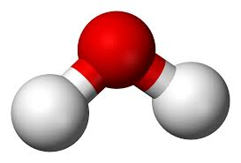
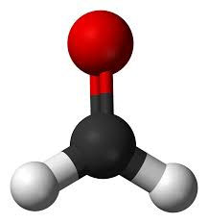
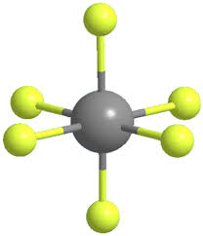
How high-D Matern kernels die: sparse data
$$H_{2}O (3D) H_{2}CO (6D) UF_{6} (15D)$$
Number of training pts
We used rectangularized GPR/KRR to not deal with δ and to be able to use multi-ζ
Mach Learn Appl 13, 100487 (2023)
Matern type kernels lose the property of locality…
J. Chem. Phys. 158, 044111 (2023)

Slide 5
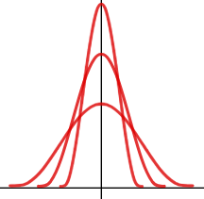
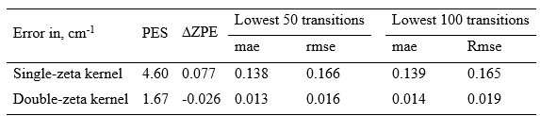
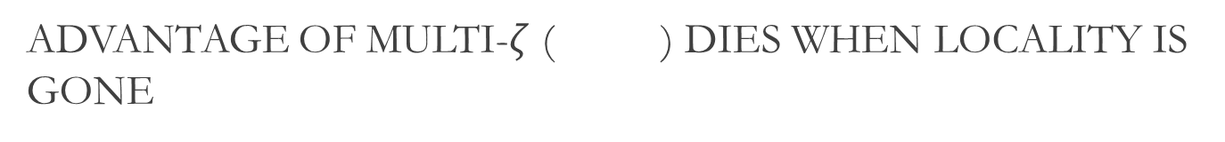
Advantage of multi-$ζ$ ( ) dies When locality is gone
single-ζ
H₂O
UF₆
Double-ζ
Double-ζ kernel PES representation useful for properties when it is meaningful (H₂CO, 2000 kernel centers)
J. Chem. Phys., 158, 044111 (2023)

Slide 6
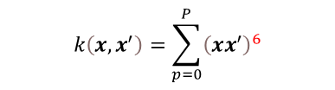



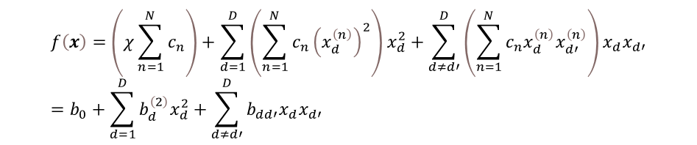

How high-D kernels die: sparse data
5,600 train pts
20,000 test pts
l_{opt}~5
l =50
$$RBF$$
$$RBF$$
$$k\left(x,x^{′}\right)=\sum_{p=0}^{P}{{\left(xx^{′}\right)}^{3}}$$
$$k\left(x,x^{′}\right)=\sum_{p=0}^{P}{{\left(xx^{′}\right)}^{6}}$$
Product kernel = polynomial regression
$$f\left(x\right)=\left(χ\sum_{n=1}^{N}{c_{n}}\right)+\sum_{d=1}^{D}{\left(\sum_{n=1}^{N}{c_{n}{\left(x_{d}^{\left(n\right)}\right)}^{2}}\right)x_{d}^{2}}+\sum_{d≠d′}^{D}{\left(\sum_{n=1}^{N}{c_{n}x_{d}^{\left(n\right)}x_{d′}^{\left(n\right)}}\right)x_{d}x_{d′}}=b_{0}+\sum_{d=1}^{D}{b_{d}^{\left(2\right)}x_{d}^{2}}+\sum_{d≠d′}^{D}{b_{dd′}x_{d}x_{d′}}$$
$$k\left(x,x^{′}\right)=χ+{\left(xx^{′}\right)}^{2}:$$
J. Chem. Phys., 160, 012201(2024)
…and may degenerate into a low-order polynomial basis

Slide 7




How high-D matern kernels die: sparse data
150 train pts
l_{opt}~15
$$RBF$$
$$k\left(x,x^{′}\right)=\sum_{p=0}^{3}{{\left(xx^{′}\right)}^{p}}$$
15D
5600 train pts
l_{opt}~30
$$k\left(x,x^{′}\right)=\sum_{p=0}^{4}{{\left(xx^{′}\right)}^{p}}$$
Higher D → lower data density → higher l_{opt}
J. Chem. Phys., 160, 012201(2024)

Slide 8
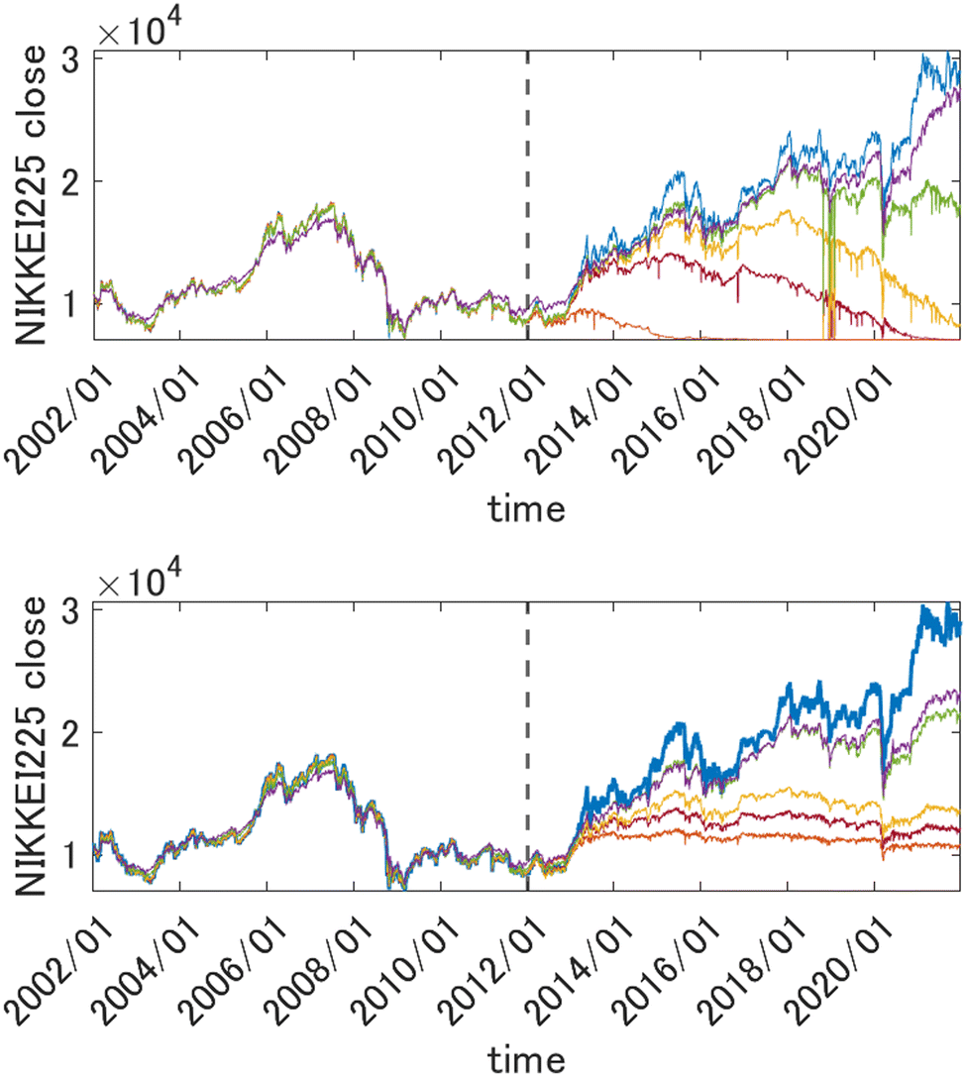
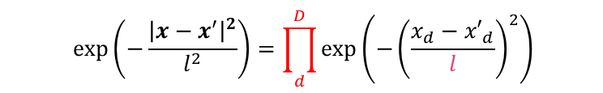

Failure or collapse of GPR with matern kernels in very high-D Example from quantitative finance
$$exp\left(−\frac{{\left|x−x^{′}\right|}^{2}}{l^{2}}\right)=\prod_{d}^{D}{exp\left(−{\left(\frac{x_{d}−{x′}_{d}}{l}\right)}^{2}\right)}$$
$$y(t+∆t)=f(x_{1}\left(t\right),x_{2}\left(t\right),…x_{D}\left(t\right))$$
l = 10, l = 30, l = 50, l = 100, l = 500. Blue: target
A product of very many functions each of value <1
value of Nikkei225 one week into the future with GPR from 2346 descriptors (normalized)
Test: 2012-2020
Training: 2002-2011
GPR collapses unless l is so large it loses any advantage over simple linear regression
Phys. Chem. Chem. Phys.
25, 1546 (2023)
Notes:
When the dimension of the feature space becomes high, both neural networks and Gaussian process regressions eventually suffer from the necessarily low data density. GPR with Matern-type kernels is actually bound to collapse when the dimension of the feature space tends to infinity. This is because the kernel behaves as a product of very many functions each smaller than one.
In this example, this is illustrated by fitting the value of Nikkei225 stock index as a function of more than 2300 descriptors: here the value of Nikkei225 one week ahead is predicted from prices of many stocks, commodities and currencies one week prior. Data from 2002 to 2011 were used for training, and the model was then tested on data from 2012 to 2020. We observe that the predicted value will tend to 0 unless the kernel length parameter is set so high that any advantage over simple linear regression is lost.

Slide 9
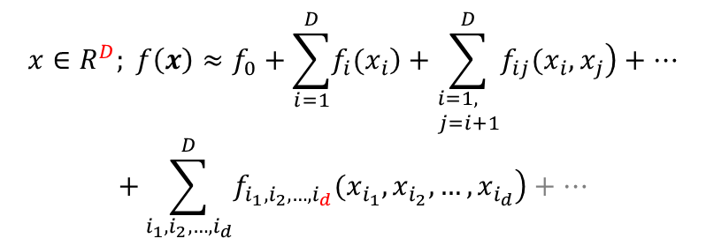
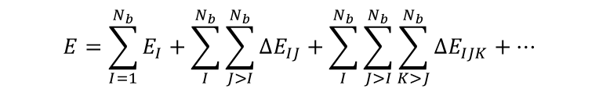
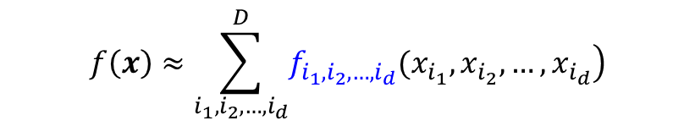
High-Dimensional Model Representation (HDMR)
1st order additive
In some form dates back 100 years (ANOVA)
HDMR is formalized in a series of
papers by Rabitz’s group at Princeton
J Math Chem A 1999, 25, 197 etc
$$x∈R^{D}; f\left(x\right)≈f_{0}+\sum_{i=1}^{D}{\left.f_{i}(x_{i}\right)}+\sum_{\begin{aligned}&i=1, \\ &j=i+1\end{aligned}}^{D}{\left.f_{ij}(x_{i},x_{j}\right)}+…$$
$$+\sum_{i_{1},i_{2},…,i_{d}}^{D}{\left.f_{i_{1},i_{2},…,i_{d}}(x_{i_{1}},x_{i_{2}},…,x_{i_{d}}\right)+…}$$
C_{d}(D) component functions at each d
Particular cases: physics – MBE, …
… computational spectroscopy: N-mode approximation
$$E=\sum_{I=1}^{N_{b}}{E_{I}}+\sum_{I}^{N_{b}}{\sum_{J>I}^{N_{b}}{ΔE_{IJ}}}+\sum_{I}^{N_{b}}{\sum_{J>I}^{N_{b}}{\sum_{K>J}^{N_{b}}{ΔE_{IJK}}}}+…$$
Can consider only highest-d terms:
Comput Phys Commun 2009, 180, 2002
J Phys Chem A 2020, 124, 7598
Comput Phys Commun 2022, 271, 108220
$$f\left(x\right)≈\sum_{i_{1},i_{2},…,i_{d}}^{D}{\left.f_{i_{1},i_{2},…,i_{d}}(x_{i_{1}},x_{i_{2}},…,x_{i_{d}}\right)}$$
Formalization of representation with lower-dimensional functions (many-body, N-mode)
Easier to build: component functions are lower-dimensional, could be built with fewer data w/out overfitting (e.g. J Math Chem 61 (2023) 7)
Fitting method can work in its comfort zone
Easier to use (integrals etc)
Provides elements of insight (see e.g. Comput Phys Commun 2022, 271, 108220)

Slide 10
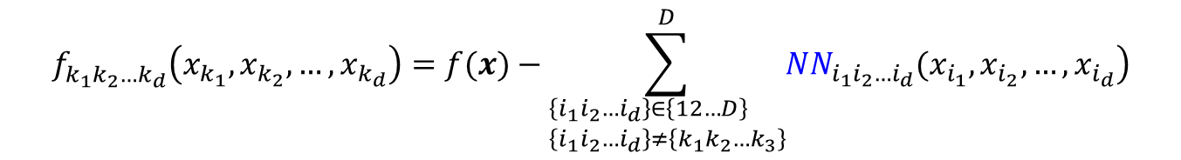
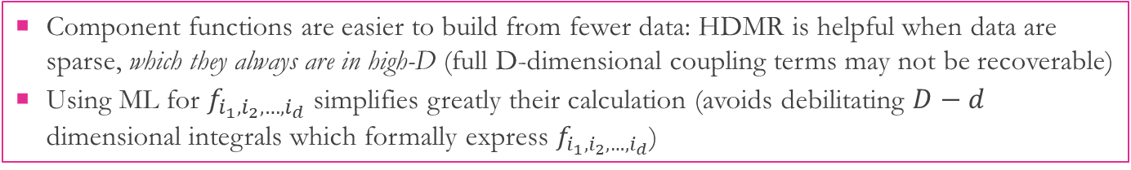
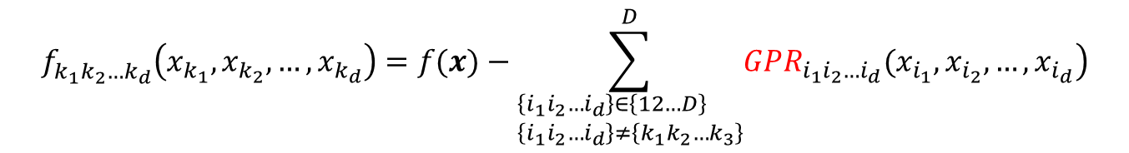
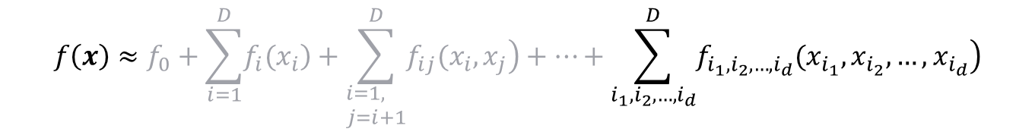
HDMR-ML: a powerful tool to work with sparse data
Review: Artificial Intelligence Chemistry 1, 100008 (2023)
$$f\left(x\right)≈f_{0}+\sum_{i=1}^{D}{\left.f_{i}(x_{i}\right)}+\sum_{\begin{aligned}&i=1, \\ &j=i+1\end{aligned}}^{D}{\left.f_{ij}(x_{i},x_{j}\right)}+…+\sum_{i_{1},i_{2},…,i_{d}}^{D}{\left.f_{i_{1},i_{2},…,i_{d}}(x_{i_{1}},x_{i_{2}},…,x_{i_{d}}\right)}$$
$$f_{k_{1}k_{2}…k_{d}}^{}\left(x_{k_{1}},x_{k_{2}},…,x_{k_{d}}\right)=f(x)−\sum_{\begin{aligned}&\left\{i_{1}i_{2}…i_{d}\right\}∈\left\{12…D\right\} \\ &\left\{i_{1}i_{2}…i_{d}\right\}≠\left\{k_{1}k_{2}…k_{3}\right\}\end{aligned}}^{D}{\left.{NN}_{i_{1}i_{2}…i_{d}}(x_{i_{1}},x_{i_{2}},…,x_{i_{d}}\right)}$$
Cycle through all functions until convergence
Comput Phys Commun 180 (2009) 2002
Chem Rev 121 (2021) 10187 & refs therein
$$f_{k_{1}k_{2}…k_{d}}^{}\left(x_{k_{1}},x_{k_{2}},…,x_{k_{d}}\right)=f(x)−\sum_{\begin{aligned}&\left\{i_{1}i_{2}…i_{d}\right\}∈\left\{12…D\right\} \\ &\left\{i_{1}i_{2}…i_{d}\right\}≠\left\{k_{1}k_{2}…k_{3}\right\}\end{aligned}}^{D}{\left.{GPR}_{i_{1}i_{2}…i_{d}}(x_{i_{1}},x_{i_{2}},…,x_{i_{d}}\right)}$$
J Phys Chem A 124 (2020) 7598
Comput Phys Commun 271 (2022) 108220 (with example of KED)
Component functions are easier to build from fewer data: HDMR is helpful when data are sparse, which they always are in high-D (full D-dimensional coupling terms may not be recoverable)
Using ML for $f_{i_{1},i_{2},…,i_{d}}$ simplifies greatly their calculation (avoids debilitating $D−d$ dimensional integrals which formally express $f_{i_{1},i_{2},…,i_{d}}$)

Slide 11

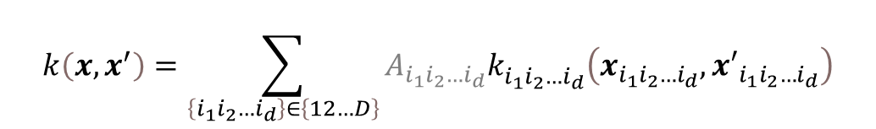
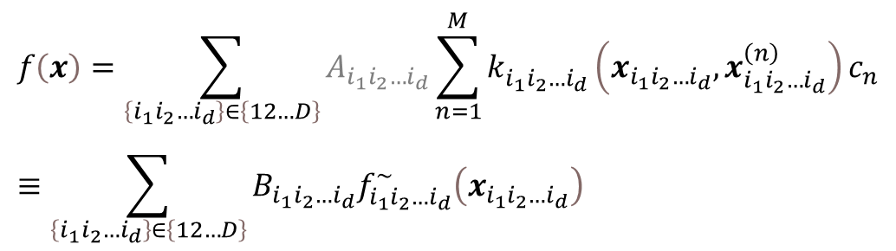
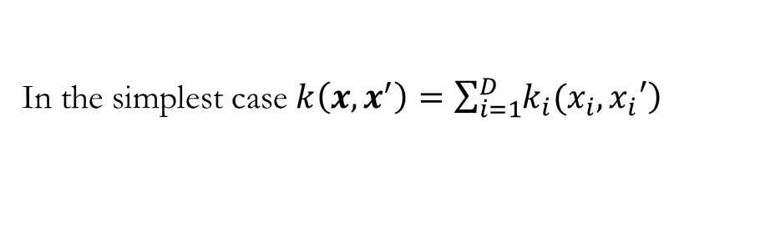
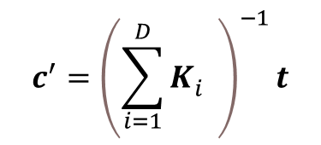
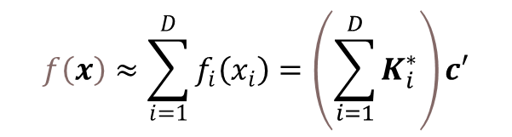
HDMR representation achieved via GPR kernel design
$$k\left(x,x^{′}\right)=\sum_{\left\{i_{1}i_{2}…i_{d}\right\}∈\left\{12…D\right\}}{A_{i_{1}i_{2}…i_{d}}k_{i_{1}i_{2}…i_{d}}^{}\left(x_{i_{1}i_{2}…i_{d}},{x′}_{i_{1}i_{2}…i_{d}}\right)}$$
$$f\left(x\right)=\sum_{\left\{i_{1}i_{2}…i_{d}\right\}∈\left\{12…D\right\}}{A_{i_{1}i_{2}…i_{d}}\sum_{n=1}^{M}{k_{i_{1}i_{2}…i_{d}}^{}\left(x_{i_{1}i_{2}…i_{d}},x_{i_{1}i_{2}…i_{d}}^{\left(n\right)}\right)c_{n}}}≡\sum_{\left\{i_{1}i_{2}…i_{d}\right\}∈\left\{12…D\right\}}{B_{i_{1}i_{2}…i_{d}}f_{i_{1}i_{2}…i_{d}}^{\sim }\left(x_{i_{1}i_{2}…i_{d}}\right)}$$
Amplitudes of individual terms are unimportant and can be omitted
$$f_{k_{1}k_{2}…k_{d}}^{}\left(x_{k_{1}},x_{k_{2}},…,x_{k_{d}}\right)=K_{i_{1}i_{2}…i_{d}}^{∗}c$$
In the simplest case $k\left(x,x^{′}\right)=\sum_{i=1}^{D}{\left.k_{i}(x_{i},x_{i}′\right)}$
$$c^{′}={\left(\sum_{i=1}^{D}{K_{i}^{}}\right)}^{−1}t$$
$$f\left(x\right)≈\sum_{i=1}^{D}{f_{i}\left(x_{i}\right)}=\left(\sum_{i=1}^{D}{K_{i}^{∗}}\right)c′$$
$K_{i}^{∗}$ is a row vector with elements $k_{i}^{}\left(x_{i},x_{i}^{(n)}\right)$
Duvenaud et al. Adv Neural Inf Process Syst (2011) 226–234
Manzhos et al. Machin Learn Sci Technol 2 (2022) 01LT02
Rassmussen GPR books also talks about additive kernels
If the kernel is in HDMR form the final function representation also is

Slide 12
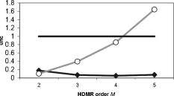
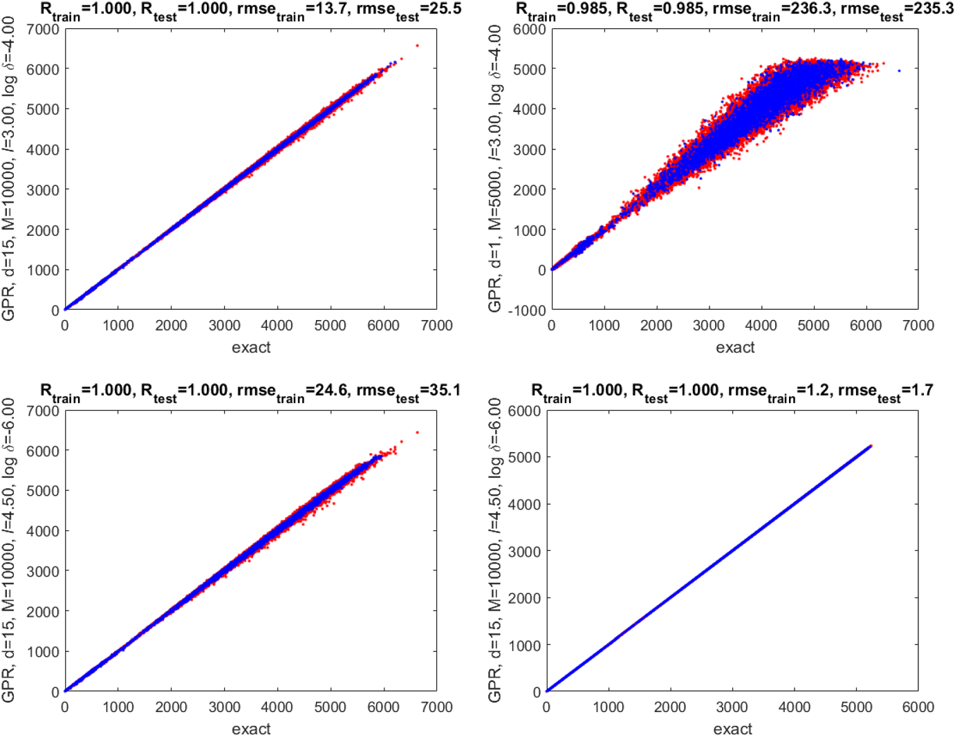
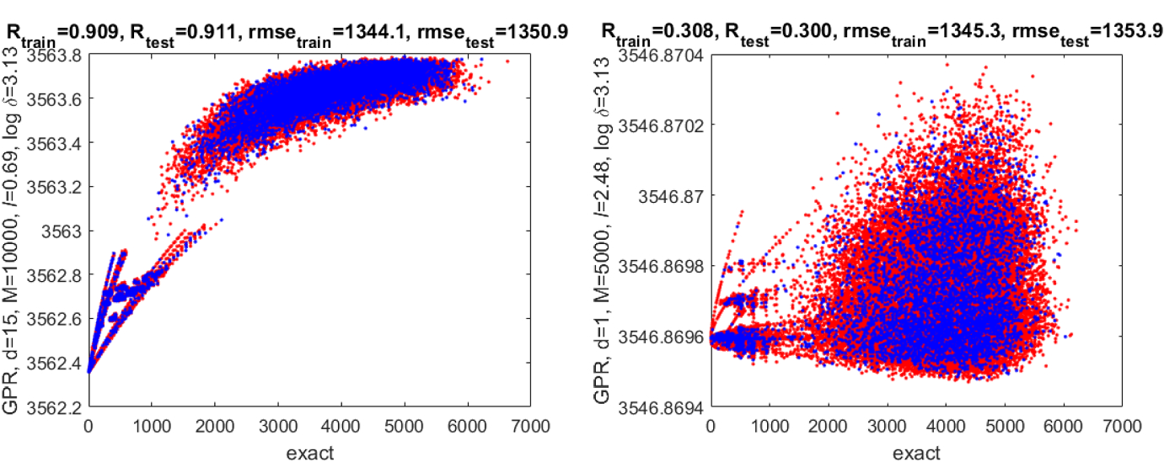

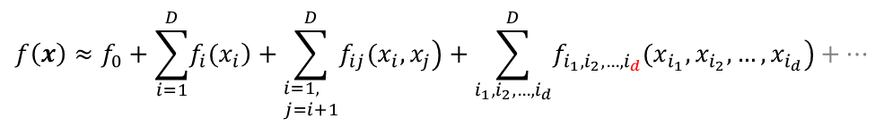

Use of hdmr to Generate synthetic data to help tune hyperparameters
Relative uncertainties of NN parameters in an HDMR-NN fit of H₂O₂ PES (J. Chem. Phys. 125 (2006) 084109)
$$f\left(x\right)≈f_{0}+\sum_{i=1}^{D}{\left.f_{i}(x_{i}\right)}+\sum_{\begin{aligned}&i=1, \\ &j=i+1\end{aligned}}^{D}{\left.f_{ij}(x_{i},x_{j}\right)}+\sum_{i_{1},i_{2},…,i_{d}}^{D}{\left.f_{i_{1},i_{2},…,i_{d}}(x_{i_{1}},x_{i_{2}},…,x_{i_{d}}\right)+…}$$
Low-order terms can be reliably determined from few data
Manual ref: d=1
l_{opt} of ref
RBF
Higher order terms may not be recoverable
Achievable quality of fit is limited by the density of sampling
MLE
J. Math. Chem., 61, 7 (2023)

Slide 13
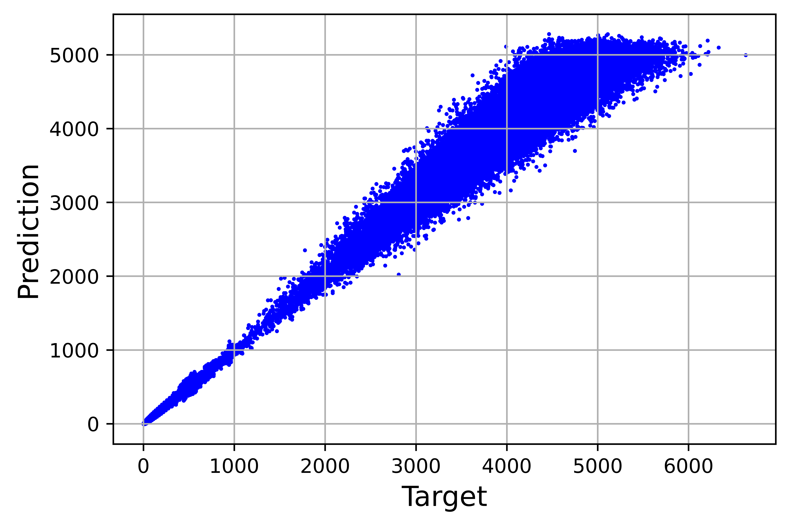
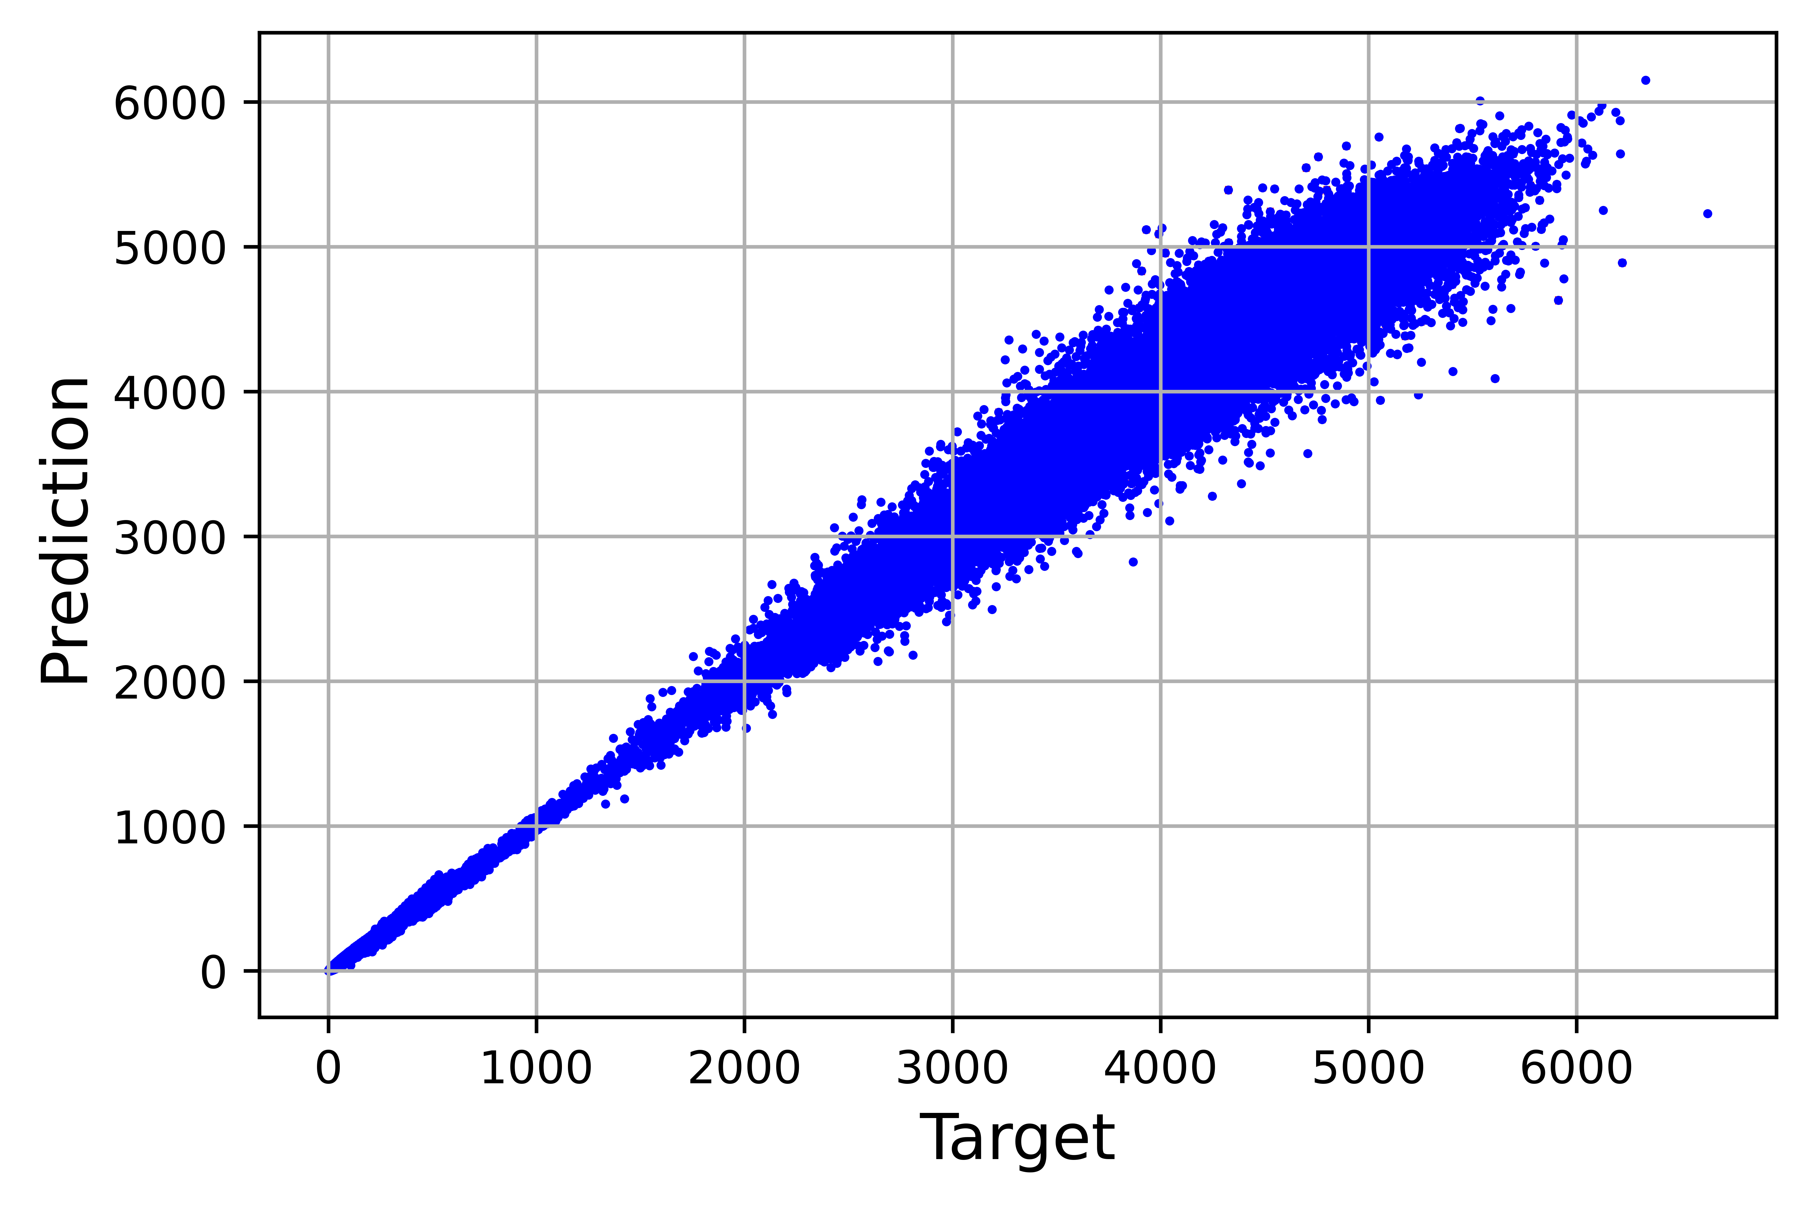
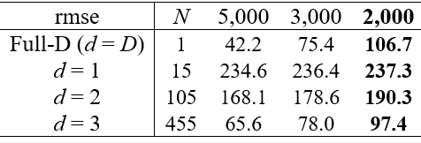
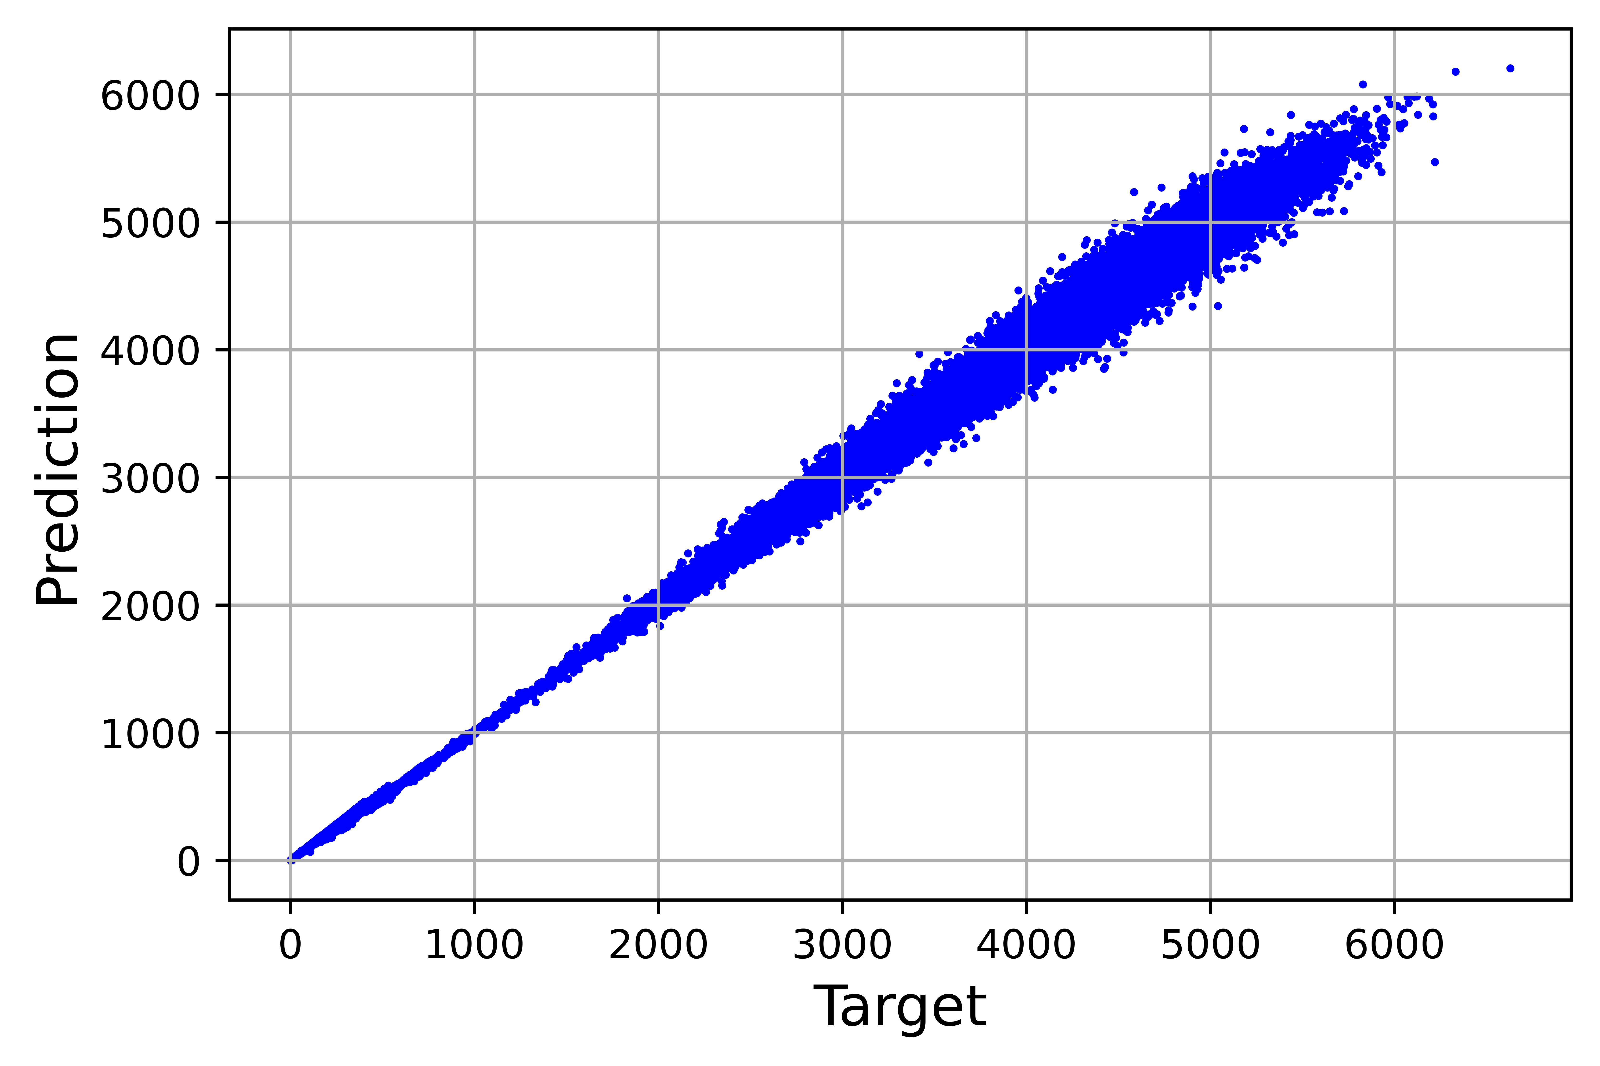
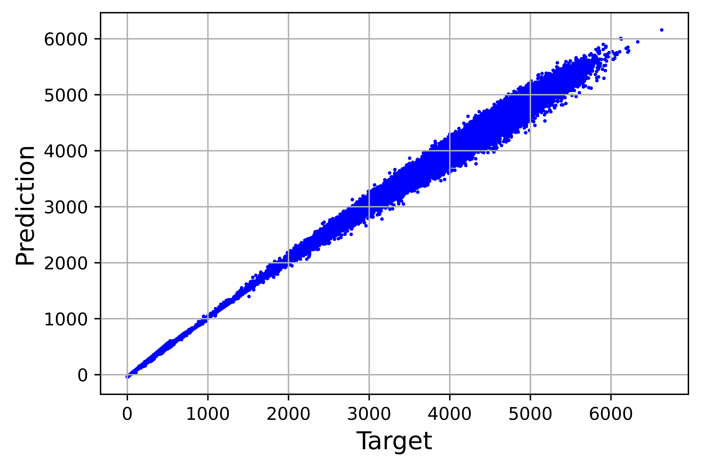
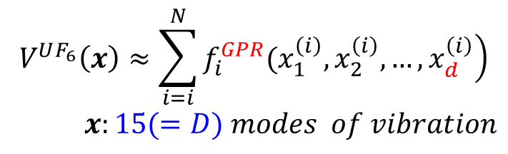
With Sparse data only low-order terms are recoverable : example of UF6 interatomic potential
$$V^{UF_{6}}\left(x\right)≈\sum_{i=i}^{N}{\left.f_{i}^{GPR}(x_{1}^{\left(i\right)},x_{2}^{\left(i\right)},…,x_{d}^{\left(i\right)}\right)}$$
$$x:15(=D) modes of vibration$$
d=1
d=2
d=3
d=15
Test set of 50,000 pts
, cm⁻¹
With 2000 points in 15D space
1.66 data per degree of freedom
rmse(3d-HDMR-GPR) < RMSE(full-D GPR)
A finite dataset in D-dimensional space is not a D-dimensional object
J Phys Chem A 2020, 124, 7598
Notes:
The following example demonstrates that with a low density of training data, a low-order HDMR not only makes a more reliable model, it makes a more accurate model than full-dimensional machine learning. We learn a 15-dimensional interatomic potential energy function of a UF6 molecule. We use between 2 and 5,000 training data. We use a large test set of 50,000 data to reliably gauge the global quality of the model. We use HDMR-GPR models of different orders small d. The plots show correlations between predicted and exact function values for the case of 3,000 training points.
With 5,000 training data, the best test error is obtained with a full-dimensional 15D model. But with only 2000 training data, the best test set error is obtained with a third-order model. This is a very sparse dataset, with only about 1.7 data per dimension. With such a low density of sampling it’s impossible to recover the full, capital D,-dimensional function. Low data density also increases the danger of overfitting. All this together argues for representations with lower-dimensional functions such as those based on HDMR.
Ultimately this has to do with the fact that a finite-size dataset in a D-dimensional space is not a D-dimensional object but has a dimension anywhere between 0 and D.

Slide 14
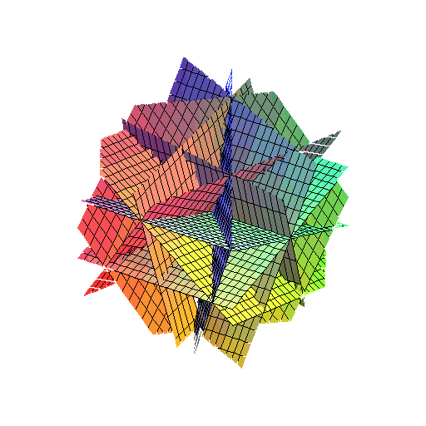

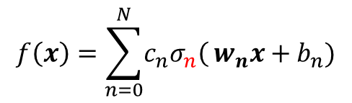
How to deal with overfitting and non-linear optimization? - Beyond traditional NN
traditional NN: w, b define hyperplanes that are optimized for given data, σ(x), and N_{neurons}
$$f\left(x\right)=\sum_{n=0}^{N}{\left.c_{n}σ_{n}\right(}w_{n}x+b_{n})$$
$$σ\left(w_{n}x+b_{n}\right)$$
We will instead define w, b with rule and then optimize σ(x) for given data and N_{neurons}
w define planes’ orientations – sample them
b define distance from origin – we will not need to deal with them
“ridge NN”
Avoid non-linear optimization
No particular advantage using the same activation function for all neurons if parameters are not optimized
Can optimize neuron activation functions for a particular problem
This makes sense if we can build cheaply… which we can

Slide 15

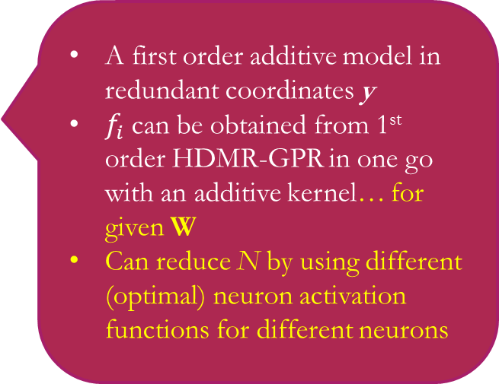

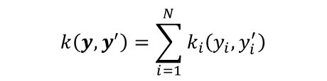
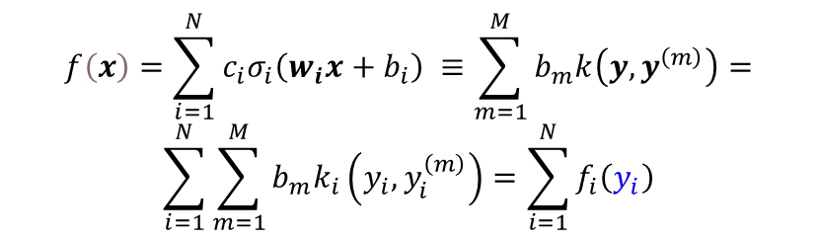
NN as an additive model in redundant coordinates
The only extra cost vs standard GPR is summation in the kernel (parallelizable)
$$k\left(y,y^{′}\right)=\sum_{i=1}^{N}{k_{i}\left(y_{i},y_{i}^{′}\right)}$$
$$k_{i}\left(y_{i},y_{i}^{′}\right)=exp\left(−\frac{{\left(y_{i}−y_{i}^{′}\right)}^{2}}{2l^{2}}\right)$$
A first order additive model in redundant coordinates y
$f_{i}$can be obtained from 1st order HDMR-GPR in one go with an additive kernel… for given W
Can reduce N by using different (optimal) neuron activation functions for different neurons
$$f\left(x\right)=\sum_{i=1}^{N}{c_{i}σ_{i}\left(w_{i}x+b_{i}\right) }≡\sum_{m=1}^{M}{b_{m}k\left(y,y^{\left(m\right)}\right)}=$$
$$\sum_{i=1}^{N}{\sum_{m=1}^{M}{b_{m}k_{i}\left(y_{i},y_{i}^{\left(m\right)}\right)}}=\sum_{i=1}^{N}{f_{i}\left(y_{i}\right)}$$
NN in x
$$y_{n}=x^{T}s_{n}$$
1d-GPR in y
Elements of Sobol sequence
𝒘_{𝒊} define “directions” of 𝑦_{𝑖} - distribute them pseudorandomly
J Phys Chem A 127, 7823 (2023)
Avoid nonlinear parameter optimization with rule-based NN weights
With no nonlinear optimization, no advantage for all neuron activation functions to be the same
Without nonlinear parameter optimization… what happens to overfitting as the no. of neurons is increased beyond optimum?

Slide 16
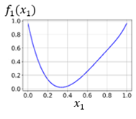
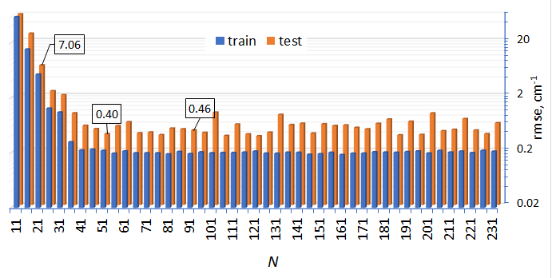
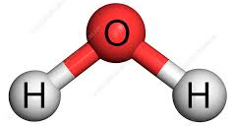
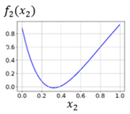
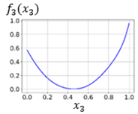
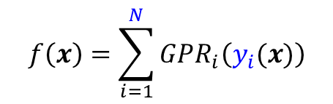
NN with optimal NN neurons built with 1st order HDMR-GPR
$$f\left(x\right)=\sum_{i=1}^{N}{GPR_{i}\left(y_{i}(x)\right)}$$
Cf range = 20,000 cm⁻¹
J Phys Chem A 127, 7823 (2023)
H₂O PES, training on 1000 samples, large test set of 9000 samples
no overfitting as no. of neurons grows due to absence of nonlinear optimization
Combines expressive power of NN with robustness of linear regression
See Huixin Liu (刘辉鑫)'s poster for use of GPR-NN for nuclear mass prediction
See J. Phys. Chem. Lett. 15, 6974 (2024) for use in studies of neuromorphic computing

Slide 17
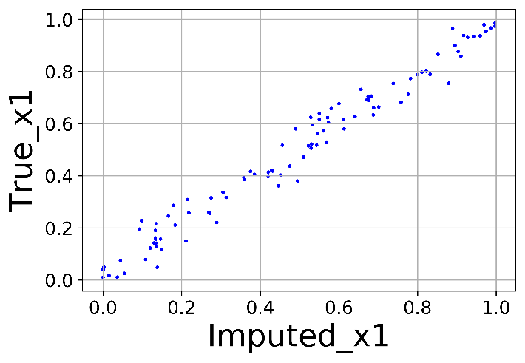
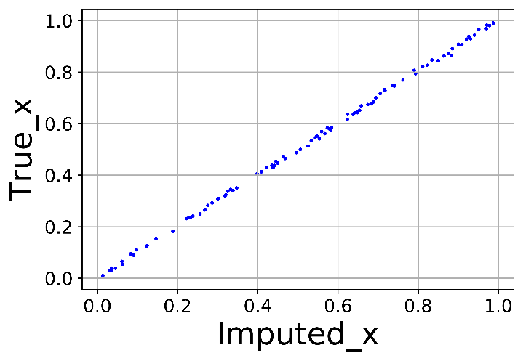








Other advantages of HMDR-GPR: helps impute missing data…
$f(x,y,z) = x + y + z$+noise
$$f\left(x\right)≈f_{0}+\sum_{i=1}^{D}{\left.f_{i}(x_{i}\right)}$$
$$f_{i}\left(x_{i}^{m}\right)=f\left(x_{m}\right)−f_{0}−\sum_{\begin{aligned}&j=1, \\ &j≠i\end{aligned}}^{D}{\left.f_{j}(x_{j}^{m}\right)}$$
$$\left.x_{i}^{m}=f_{i}^{−1}(y_{i}^{m}\right)$$
$$f(x,y,z) = x + y + z$$
$f(x,y,z) = x + y + z$ with bad distribution
Comput Phys Commun, 271, 108220 (2022)
Code: https://github.com/owen-ren0003/rshdmrgpr
… and helps find optimal hyperparameters when data are sparse: J Math Chem 61, 7 (2023)

Slide 18




ML-to-formula: ML-guided KEF construction
“insightful” ML
See Digital Discovery 3, 1967 (2024), J. Mater. Inform. 5, 38 (2025) for uses in materials informatics
$$\text{Kinetic} \text{energy} \text{in} \text{Orbital}\text{−}\text{free} \text{DFT}$$
$$E_{kin}=\int{τ\left(r\right)dr}$$
$$x=\left(\overline{τ_{TF}}, \overline{τ_{TF}p}, \overline{τ_{TF}p^{2}},\overline{τ_{TF}pq}, \overline{τ_{TF}q^{2}}, \overline{{ρV}_{eff}}\right)$$
$$\overline{τ}\left(x\right)=\sum_{i=1}^{N}{GPR_{i}\left(y_{i}(x)\right)}$$
$$E_{kin}=V\overline{τ}$$
Additive model, feature importance
Coupling terms
$$\overline{τ}\left(x\right)=\sum_{i=1}^{D}{f\left(x_{i}\right)}+\sum_{i=D+1}^{N}{f_{i}\left(y_{i}(x)\right)}$$
Scaled gradient expansion (4th order)
$$τ_{GE4}\left(r\right)=τ_{TF}\left(r\right)\left(1+\frac{5}{27}p\left(r\right)+\frac{20}{9}q\left(r\right)+\frac{8}{81}{q\left(r\right)}^{2}−\frac{1}{9}p\left(r\right)q\left(r\right)+{\frac{8}{243}p\left(r\right)}^{2}\right)$$
$$p=\frac{{\left|∇ρ\right|}^{2}}{4{\left(3π^{2}\right)}^{2/3}ρ^{8/3}}, q=\frac{Δρ}{4{\left(3π^{2}\right)}^{2/3}ρ^{5/3}}$$
Functional form
ML-guided analytic KEF
$$\overline{τ}=\sum_{n=1}^{6}{\sum_{p=1}^{P_{n}}{a_{np}{\left(x_{n}^{′}\right)}^{p}}}$$
Mach. Learn. Sci. Technol. 6, 035002 (2025)

Slide 19





GPR-NN with optimized redundant coordinates could obviate deep NN in some applications
Cf. kernel regression $f\left(x\right)=\sum_{i=1}^{M}{c_{i}k(ξ |x,x^{\left(i\right)})}$
$$f\left(x\right)=\sum_{k_{n}=0}^{N_{n}}{{w_{l,k_{n}}^{(n)}σ}_{n, k_{n}}^{}\left(\sum_{k_{n−1}=0}^{N_{n−1}}{{w_{k_{n},k_{n−1}}^{(n−1)}σ}_{n−1,k_{n−1}}\left(…\sum_{k_{1}=0}^{N_{1}}{{w_{k_{2}k_{1}}^{(2)}σ}_{1,k_{1}}\left(\sum_{i=0}^{d}{w_{k_{1}i}^{(1)}x_{i}}\right)}\right)}\right)}≡\sum_{i=0}^{N_{n}}{c_{i}}θ_{i}(W|x)$$
Approaches expressive power of deep NN in diadic approximation
$$θ_{i}\left(x\right)=θ_{i}\left(x_{0}\right)+∇θ_{i}\left(x_{0}\right)Δx+\frac{1}{2}{\left(Δx\right)}^{T}H Δx+…$$
$$f_{GPRNN}\left(x\right)=\sum_{i=1}^{N}{c_{i}σ_{i}\left(w_{i}x+b_{i}\right) }≡\sum_{m=1}^{M}{b_{m}k\left(y,y^{\left(m\right)}\right)}=$$
$$\sum_{i=1}^{N}{\sum_{m=1}^{M}{b_{m}k_{i}\left(y_{i},y_{i}^{\left(m\right)}\right)}}=\sum_{i=1}^{N}{f_{i}\left(y_{i}\right)}$$
$$y=Wx$$
$$f_{n}\left(y_{n}\left(x\right)\right)=f_{n}\left(y_{n}\left(x_{0}\right)\right)+\left(w_{n}{\left.\frac{df_{n}}{dy_{n}}\right|}_{y_{n0}}\right)Δx+\frac{1}{2}{\left(Δx\right)}^{T}\left({\left.w_{n}w_{n}^{T}\frac{d^{2}f_{n}}{dy_{n}^{2}}\right|}_{y_{n0}}\right)Δx+…$$
arXiv:2509.08457v1

Slide 20


Ease of building an orders-of-coupling (HDMR) representation
$$f\left(x\right)=\sum_{i=1}^{N}{c_{i}σ_{i}\left(w_{i}x+b_{i}\right) }=\sum_{i=1}^{N}{f_{i}\left(y_{i}\right)}$$
0.5 | 0.5 | 0.5 | 0 | 0
0.75 | 0.25 | 0.75 | 0 | 0
0.25 | 0.75 | 0.25 | 0 | 0
0.375 | 0.375 | 0.625 | 0 | 0
0 | 0.5 | 0.5 | 0.5 | 0
0 | 0.75 | 0.25 | 0.75 | 0
0 | 0.25 | 0.75 | 0.25 | 0
0 | 0.375 | 0.375 | 0.625 | 0
0 | 0 | 0.5 | 0.5 | 0.5
0 | 0 | 0.75 | 0.25 | 0.75
0 | 0 | 0.25 | 0.75 | 0.25
0 | 0 | 0.375 | 0.375 | 0.625
0 | 0.5 | 0 | 0.5 | 0.5
0 | 0.75 | 0 | 0.25 | 0.75
0 | 0.25 | 0 | 0.75 | 0.25
0 | 0.375 | 0 | 0.375 | 0.625
0.5 | 0 | 0 | 0.5 | 0.5
0.75 | 0 | 0 | 0.25 | 0.75
0.25 | 0 | 0 | 0.75 | 0.25
0.375 | 0 | 0 | 0.375 | 0.625
$$y_{n}=x^{T}s_{n}$$
D-dimensional vector with
d elements of d-dimensional Sobol sequence
D - d elements are zero
Order of coupling d | No. of coupling terms | Test rmse, cm⁻¹ (this work) | Test rmse, cm⁻¹ (Ref. [44])
1 | 6 | 1302.7 | 1315.6
2 | 15 | 385.5 | 410.0
3 | 20 | 20.4 | 29.1
4 | 15 | 14.6 | 16.1
5 | 6 | 16.5 | 14.4
6 | 1 | 19.6 | 23.8
When data density is low, full-D terms may not be recoverable
…
Artificial Intelligence Chemistry, 1, 100013 (2023)

Slide 21
Conclusions
ML methods are useful in high-dimensional problems as they avoid direct product representations, but when data density is very low or dimensionality is high, off-the-shelf methods may fail
Many non-linear parameters in NNs that also scale with D
Data are always sparse in high-D and high-order coupling terms (full-D function) may not be recoverable - Cannot be palliated by just adding more data
GPR/KRR are attractive as they combine high expressive power of nonlinear kernel and robustness of linear regression
Can collapse in very high D
Loss of kernel resolution / property of locality of Matern kernels, loss of advantage of multi-ζ bases
Loss of advantage vs low-order polynomial regression
One can stabilize the solution by using orders of coupling representations
Low-order (low-d) terms are easier to build (fit) and to use
It is convenient to use machine-learned component functions: HDMR-NN, HDMR-GPR
Low-order HDMR helps impute missing data and optimize hyperparameters
It is possible to combine advantages of NN and GPR:
GPRNN: NN in original feature space, additive GPR in redundant coordinates
No nonlinear optimization
The shapes of all neuron activation functions are gotten in one go from 1d-HDMR-GPR
Optimal for given data, weights, and NN size
Provides an easy way to build orders-of coupling representations
With optimized redundant coordinates conceptually approaches expressive power of deep NN
We provided examples from computational chemistry but these approaches are general

Slide 22






Thanks
Funders
NSERC
Mitacs
Ministry of Education of Singapore
JST
Dlab
Digital Research Alliance of Canada
Select collaborators, group members
Manabu Ihara
Johann Lüder
Tucker Carrington
Dmitry Voytsekhovsky
Owen Ren
Pavlo Golub
Eita Sasaki
Shunsaku Tsuda
Hyojae Lee
Heejoo Yoon
Mohamed Boussaidi

Slide 23
Appendix

Slide 24








Recap of some major ML methods: Neural networks
σ
σ
σ
σ
x₁
x₂
x_{D}
weights
biases
$$f_{k}\left(x\right)=\sum_{n=0}^{N}{\left.c_{nk}σ_{n}\right(}w_{n}x+b_{n})$$
V
$$\frac{∂V}{dx_{i}}$$
Training set
$$\left\{f^{\left(j\right)},x^{\left(j\right)}\right\}, j=1,…,M; x∈R^{D}$$
$$⋮$$
Often $σ\left(x\right)={\left(e^{x}−e^{−x}\right)}/{\left(e^{x}+e^{−x}\right)}$
but can be any smooth nonlinear function
$$⋮$$
$$⋮$$
Key works by Kolmogorov, Specher, Hornik, Gorban
An analogy with a biologic neural network is often made
As a mathematical object used for non-linear regression, a view of a representation in a non-direct product basis is useful
A single hidden layer NN is a universal approximator
Think carefully if you actually need a “deep” NN as it comes at a price of a large no. of non-linear parameters
Notes:
Artificial neural networks are an example of a representation of a multivariate function with univariate functions which are adapted to the problem by the choice of parameters. They are often presented with the help of an analogy with a biologic neural network, but I find more useful the following interpretation. We expand a function f in a basis of univariate functions sigma_ν with coefficients c_n. The basis functions depend on all components of x but their arguments are scalars dependent on x as well as on weights w and biases b. This parameterization by w and b makes a flexible, non-direct product basis. This representation goes back to the Kolmogorov theorem of 1957 and since then there was a series of papers relaxing and relaxing restrictions on sigma. As of today, this expression is a universal approximator as long as sigma is smooth and nonlinear, that’s all. Typically sigma is the same for all n and typically it is the sigmoid function but it does not have to be.
The parameters w and b and the coefficients c are fitted to reproduce a set of known samples of f. The fit is nonlinear because sigma is nonlinear.
This equation expresses a so-called single hidden layer neural network, it can be graphically represented like this, where the arrows to each sigma, which are now called neurons, reflect the formation a single scalar input. These neurons form a hidden later. The outputs are collected in a sum to one or more outputs in the output layer, i.e. one can fit a multi-sheet function or a function and its derivatives by the same NN. These are called output neurons. One can collect the outputs of this last layer of neurons and feed them to yet another layer of neurons and so on, obtaining a multilayer or deep neural network.

Slide 25






Pros and cons of FFNN
Int J Quant Chem 2015, 115, 1012; Chem Rev 2021, 121, 10187
“Deep” NN:
$$f_{l}=σ_{out}\left(\sum_{k_{n}=0}^{N_{n}}{{w_{l,k_{n}}^{\left(n\right)}σ}_{n, k_{n}}^{}\left(\sum_{k_{n−1}=0}^{N_{n−1}}{{w_{k_{n},k_{n−1}}^{\left(n−1\right)}σ}_{n−1,k_{n−1}}\left(…\sum_{k_{1}=0}^{N_{1}}{{w_{k_{2}k_{1}}^{\left(2\right)}σ}_{1,k_{1}}\left(\sum_{i=0}^{d}{w_{k_{1}i}^{\left(1\right)}x_{i}}\right)}\right)}\right)}\right)$$
Non-direct product basis
$$σ=\exp\left(\right): f(x)=\sum_{i=0}^{M}{w_{i}^{\left(2\right)}\prod_{k=0}^{d}{e^{w_{ik}^{\left(1\right)}x_{k}}}}$$
$$\int{f\left(x\right)dx}=\sum{\prod{\int{dx_{i}}f_{i}\left(x_{i}\right)dx_{i}}}$$
J Chem Phys 2006, 125, 194105
$$f\left(x\right)=μ_{1}^{\left(2\right)}+\sum_{k_{1}=1}^{n_{1}}{w_{1,k_{1}}^{\left(2\right)}\prod_{k_{0}=1}^{J}{erf\left(μ_{k_{1}k_{0}}^{(1)}+w_{k_{1}1k_{o}}^{\left(1\right)}x_{k_{0}}\right)}}$$
Refs in color are ours
Neural Computation 2001, 14, 241
Refs in black are literature
A single hidden layer NN is a universal approximator
Think carefully if you actually need a deep NN as it comes at a price of a large no. of non-linear parameters
Easy to achieve sum-of-products
Important for multidimensional integration
$$∀δ>0,∃N<∞:$$
$$\left|t\left(x\right)−\sum_{n=0}^{N}{c_{n}σ\left(w_{n}x+b_{n}\right)}\right|<δ$$
Universal approximator theorems do not consider the data aspect
Notes:
The equation for a general multilayer neural network would then become this. I stress that a single hidden layer network is already a universal approximator. In many applications one layer would be sufficient and one needs to be sure if one actually needs a deep NN as it comes at a price of a large no. of non-linear parameters. I will show examples later when one actually needs a deep NN.
The fact that sigma can be any function opens new possibilities. We showed for example that with exponential neurons one easily obtains a sum of products representation with a relatively small number of terms. Sum of products representations are very useful because they greatly simplify integration of the function. In fact sum of product representations are required in certain computational methods, for example is some powerful quantum dynamics methods. A more complicated way to get a sum of products are multiplicative neural networks which use error function type of neurons. These are examples of a departure from the orthodox network designs which brings significant advantages. I will show later how with even more drastic changes in the architecture one can realize significant advantages.

Slide 26











GPR/KRR: linear regression with a nonlinear basis
what is the expected value of f at x given the set $\left\{f^{(n)},x^{(n)}\right\}$?
Matrix K can describe how correlated is each pair of data points
$$f\left(x\right)=K^{∗}\left(K^{−1}f\right)=\sum_{n=1}^{M}{b_{n}k\left(x,x^{(n)}\right)}$$
$$\left.k(x^{\left(2\right)},x^{\left(1\right)}\right)$$
$$var\left(f\left(x\right)\right)=K^{∗∗}−K^{∗}K^{−1}{K^{∗}}^{T}$$
$$K=\left(\begin{matrix}\begin{matrix}k\left(x^{\left(1\right)},x^{\left(1\right)}\right)+δ & \left.k(x^{\left(1\right)},x^{\left(2\right)}\right) \\ \left.k(x^{\left(2\right)},x^{\left(1\right)}\right) & k(x^{\left(2\right)},x^{\left(2\right)})+δ\end{matrix} & ⋯ & \begin{matrix}\left.k(x^{\left(1\right)},x^{\left(M\right)}\right) \\ \left.k(x^{\left(2\right)},x^{\left(M\right)}\right)\end{matrix} \\ ⋮ & ⋱ & ⋮ \\ \begin{matrix}\left.k(x^{\left(M\right)},x^{\left(1\right)}\right) & \left.k(x^{\left(M\right)},x^{\left(2\right)}\right)\end{matrix} & ⋯ & k(x^{\left(M\right)},x^{\left(M\right)})+δ\end{matrix}\right)$$
$$x^{(1)}$$
$$x^{(2)}$$
$$K^{∗}=\left(\begin{matrix}k\left(x,x^{\left(1\right)}\right) & k\left(x,x^{\left(2\right)}\right) & \begin{matrix}… & k\left(x,x^{\left(M\right)}\right)\end{matrix}\end{matrix}\right) K^{∗∗}=k(x,x)$$
Matern family of functions:
$$k\left(x,x^{′}\right)=σ^{2}\frac{2^{1−ν}}{Γ(ν)}{\left(\sqrt{2ν}\frac{\left|x−x^{′}\right|}{l}\right)}^{ν}K_{ν}\left(\sqrt{2ν}\frac{\left|x−x′\right|}{l}\right)$$
particular cases: exp, Gaussian
https://en.wikipedia.org/wiki/Matern_covariance_function
Optimized $l_{i}$ informs on relevance of the i-th variable (ARD, automated relevance determination)
hyperparameters
Robust (a type of linear regression) but
Hard to apply to large datasets
Defining eqs do not scale with D but can collapse in very high-D (Phys Chem Chem Phys 25 (2023) 1546)
$${ν=∞: (RBF): σ}^{2}exp\left(−\frac{{\left|x−x^{′}\right|}^{2}}{2l^{2}}\right)$$
$${ν=\frac{1}{2}: σ}^{2}exp\left(−\frac{\left|x−x^{′}\right|}{l}\right)$$
Can be palliated with additive GPR (HDMR)

Slide 27

HDMR avoids collapse of GPR in very high-D
kernel length parameters small enough to preserve the nonlinear nature of the model
l = 0.1, l = 0.5, l = 1, l =5, l = 10. Blue: target
value of Nikkei225 one week into the future with GPR from 2346 descriptors (normalized)
Test: 2012-2020
Training: 2002-2011
$$k\left(x,x^{′}\right)=\sum_{d=1}^{D}{exp\left(−{\left(\frac{x_{d}−{x′}_{d}}{l}\right)}^{2}\right)}$$
Phys. Chem. Chem. Phys. 25, 1546 (2023)
Notes:
Returning to the example of GPR collapse in very high dimension, by replacing the very high dimensional square exponential kernel with an additive kernel, the collapse is avoided, and the model behaves quite accurately for several months after the training was stopped. Eventually, of course, the accuracy drops without retraining, but there is no collapse, no misbehavior. Moreover, reasonable models are achieved with kernel length parameters small enough to preserve the nonlinear nature of the model.

Slide 28






HDMR able to recover the value of nonlinearity
$$f\left(x^{∗}\right)=f_{1}\left(x_{1}^{∗}\right)+…+f_{D}\left(x_{D}^{∗}\right)$$
$f_{i}\left(x_{i}\right)$ in the example of N225 forecasting
$$compare to linear regression using a basis: f\left(x\right)=\sum_{i=1}^{D}{c_{i}θ_{i}(x_{i})}$$
With
D = 2346
even 2nd order terms ($f_{ij}(x_{i},x_{j})$) are hard
l = 0.1 l = 0.5 l = 1
$$\sum_{i_{1},i_{2},…,i_{d}}^{D}{\left.f_{i_{1},i_{2},…,i_{d}}(x_{i_{1}},x_{i_{2}},…,x_{i_{d}}\right)}$$
… preserving a higher expressive power of a nonlinear model
Notes:
また、HDMRの大きな利点の一つは、入力と出力の関係の分析が容易であるということです。
関数fを1次元のcomponent functionの和で表す1-d HDMR kernelでは、
ある入力変数xiとその予測への寄与fi(xi)の関係を簡単に調べることができます。
入力$x_{i}$と出力$f_{i}\left(x_{i}\right)の$関係の複雑さ非線形性に着目して分析を行った結果、length scaleの大小が非線形性に大きく影響していることが分かりました
length scaleが小さいとき、直線性が小さい、すなわち予測への寄与が非線形である変数が多く存在しています
一方で、length scaleが10程度まで大きくなると、入力と出力の関係はほぼ完全に直線的になっています。
例として、入力変数である電力需要の予測への寄与を分析しました。
入力変数である“現在の”電力需要と予測目標の“1時間後の”電力需要の関係はほぼ直線であると考えられますが、
電力需要にはピークが存在するため、入力値がピーク付近では傾きが小さくなると考えられます。
length scaleが最適値の時、このような関係がモデルでも学習されていることが分かります。
一方でlength scaleが小さいとき、入力と出力の関係は必要以上に複雑になっていることが分かり、
過学習が起こっていると捉えることができます。
また、length scaleが大きいとき、入力と出力の関係は完全に直線となり、電力需要のピークを学習できていません。
以上のことから、適切なパラメータを持つ1-d HDMR kernel GPRは、 $x_{i}$と$f_{i}\left(x_{i}\right)$の非線形な関係を学習できることが分かりました

Slide 29
NN with optimal NN neurons built with 1st order HDMR-GPR
Element of insight
Correlation plot
Two neuron activation functions for terms with the largest magnitude
Two neuron activation functions for terms with the largest magnitude
J Phys Chem A 127, 7823 (2023)
Notes:
Because we don’t fit any nonlinear parameters of the NN, not only do we gain in speed of the calculation, we also avoid overfitting. The top plot here shows train and test set errors when fitting a three-dimensional interatomic potential energy function of the water molecule. As the number of yi, i.e. the number of neurons, is increased, both errors decrease and then level off. There is no increase in the test set error when the number of neurons is grown beyond optimal. The plot on the bottom right shows what happens with a conventional NN: as expected, after the number of neurons is higher than some optimum, the test error begins to grow substantially.
We thus have a method combining the expressive power of a neural network with the robustness of a linear regression. Please see these references for more details such as shapes of obtained neuron activation functions and higher-dimensional examples, as well as examples of using this approach to build an orders of coupling i.e. HDMR representation.

