Slide 1
U-spin symmetry energy and hyperon puzzle
第四届全国核物理及核数据中的机器学习应用研讨会2025.10.30-11.03
Xia, Cheng-Jun (夏铖君)
Center for Gravitation and Cosmology,
Yangzhou University
Collaborators: Hao-Song You, Ting-Lan Yu, and Ren-Xin Xu
@湖南衡阳

Slide 2
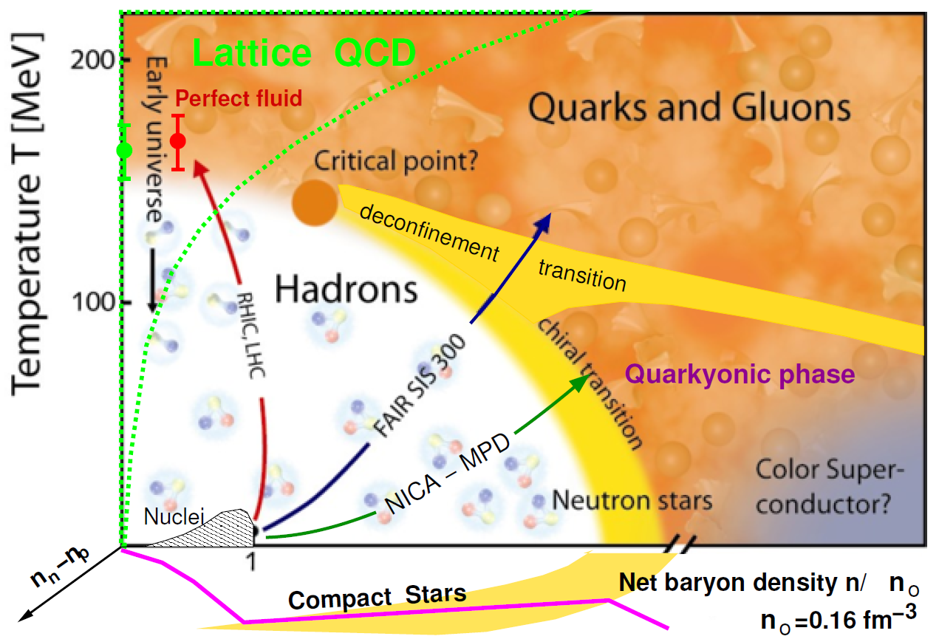
QCD Phase Diagram [McLerran2009_NPB195-275]
background

Slide 3

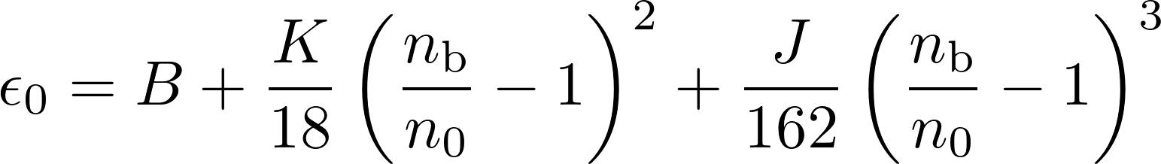
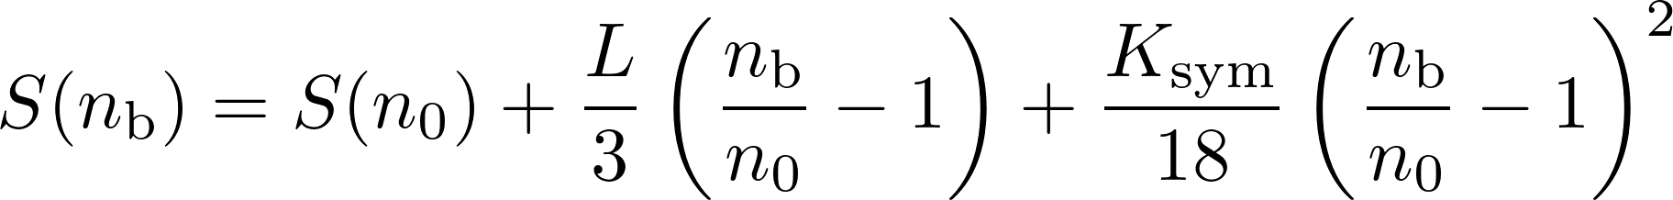


Constraints on nuclear matter properties
The binding energy per nucleon can be expanded as
Zhang et al.2020_PRC101-034303:
K = 250.23±20.16 MeV,
S = 31.35±2.08 MeV
L = 59.57±10.06 MeV
Lattimer_Steiner2014_EPJA50-40
with
Essick et al.2021_PRL127-192701:
S = 33.0^{+2.0}_{−1.8} MeV
L = 53⁺¹⁴₋₁₅ MeV
Farine et al.1997_NPA615-135:
J = −700±500 MeV Xie_Li2021_JPG48-025110:
J = −390⁺⁶⁰₋₇₀ MeV
Shlomo et al.2006_EPJA30-23:
background
Notes:
尽管核物质的具体结构和性质对中子星的性质及演化过程至关重要，但是当前我们对核物质性质的了解仅限于原子核所能涵盖的密度和不对称度附近。
from fits of generalized Skyrme force to breathing-mode nergies
empirical pressures in relativistic heavy-ion collisions K = 240±20 MeV
-180+100-110
由于我们对密度及不对称度远离原子核典型值的核物质性质还缺乏了解，因此有必要进行系统研究，得到模型计算的误差范围，为更进一步的研究奠定基础

Slide 4
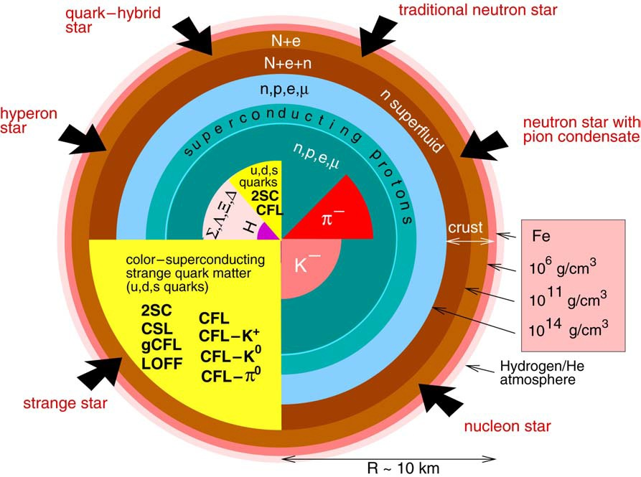
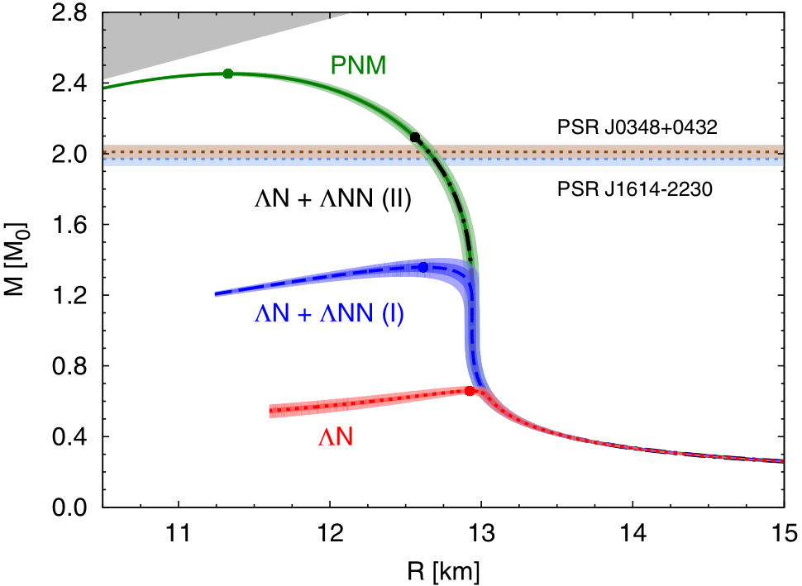
Compact star structures [Weber2005_PPNP54-193]
PRL 114 (2015) 092301
background

Slide 5
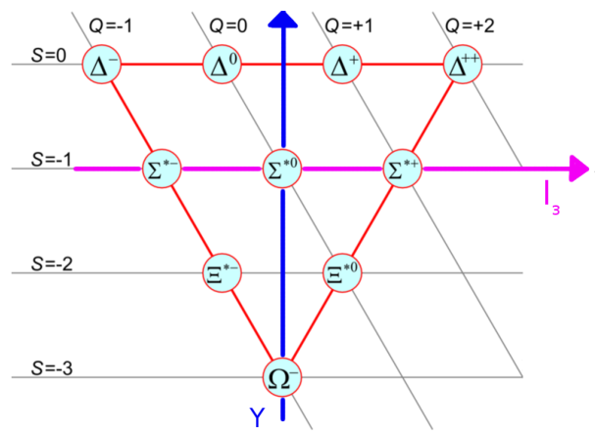
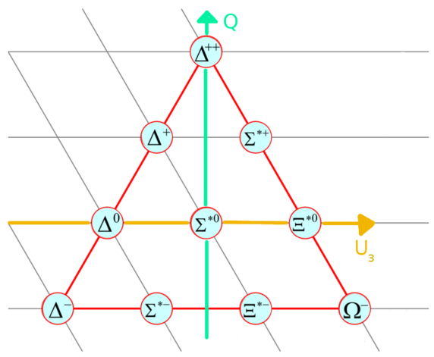







Flavor symmetry of light quarks
SU(2)_{I}$×$U(1)_{Y}
I-spin:
$$\left(\begin{matrix}u \\ d\end{matrix}\right)$$
_{Y = S + B}
SU(3)_{f}:
$$\left(\begin{matrix}u \\ d \\ s\end{matrix}\right)$$
SU(2)_{U}$×$U(1)_{Q}
U-spin:
$$\left(\begin{matrix}d \\ s\end{matrix}\right)$$
SU(2)_{V}$×$U(1)
V-spin:
$$\left(\begin{matrix}u \\ s\end{matrix}\right)$$
background

Slide 6
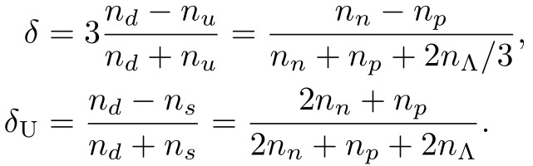
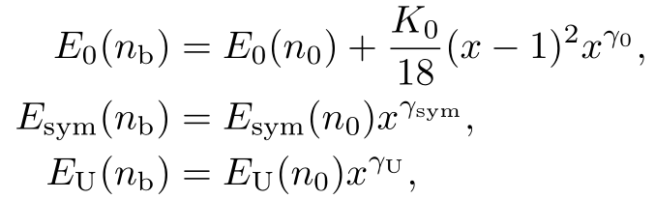












U-spin symmetry energy
The binding energy per baryon can be expanded as
Instead of Taylor expansions, we employ polytropic forms, i.e.,
Independent parameters:
SNM:
Symmetry energy:
U-spin symmetry energy:
Incompressibility K₀
Skewness

Slide 7
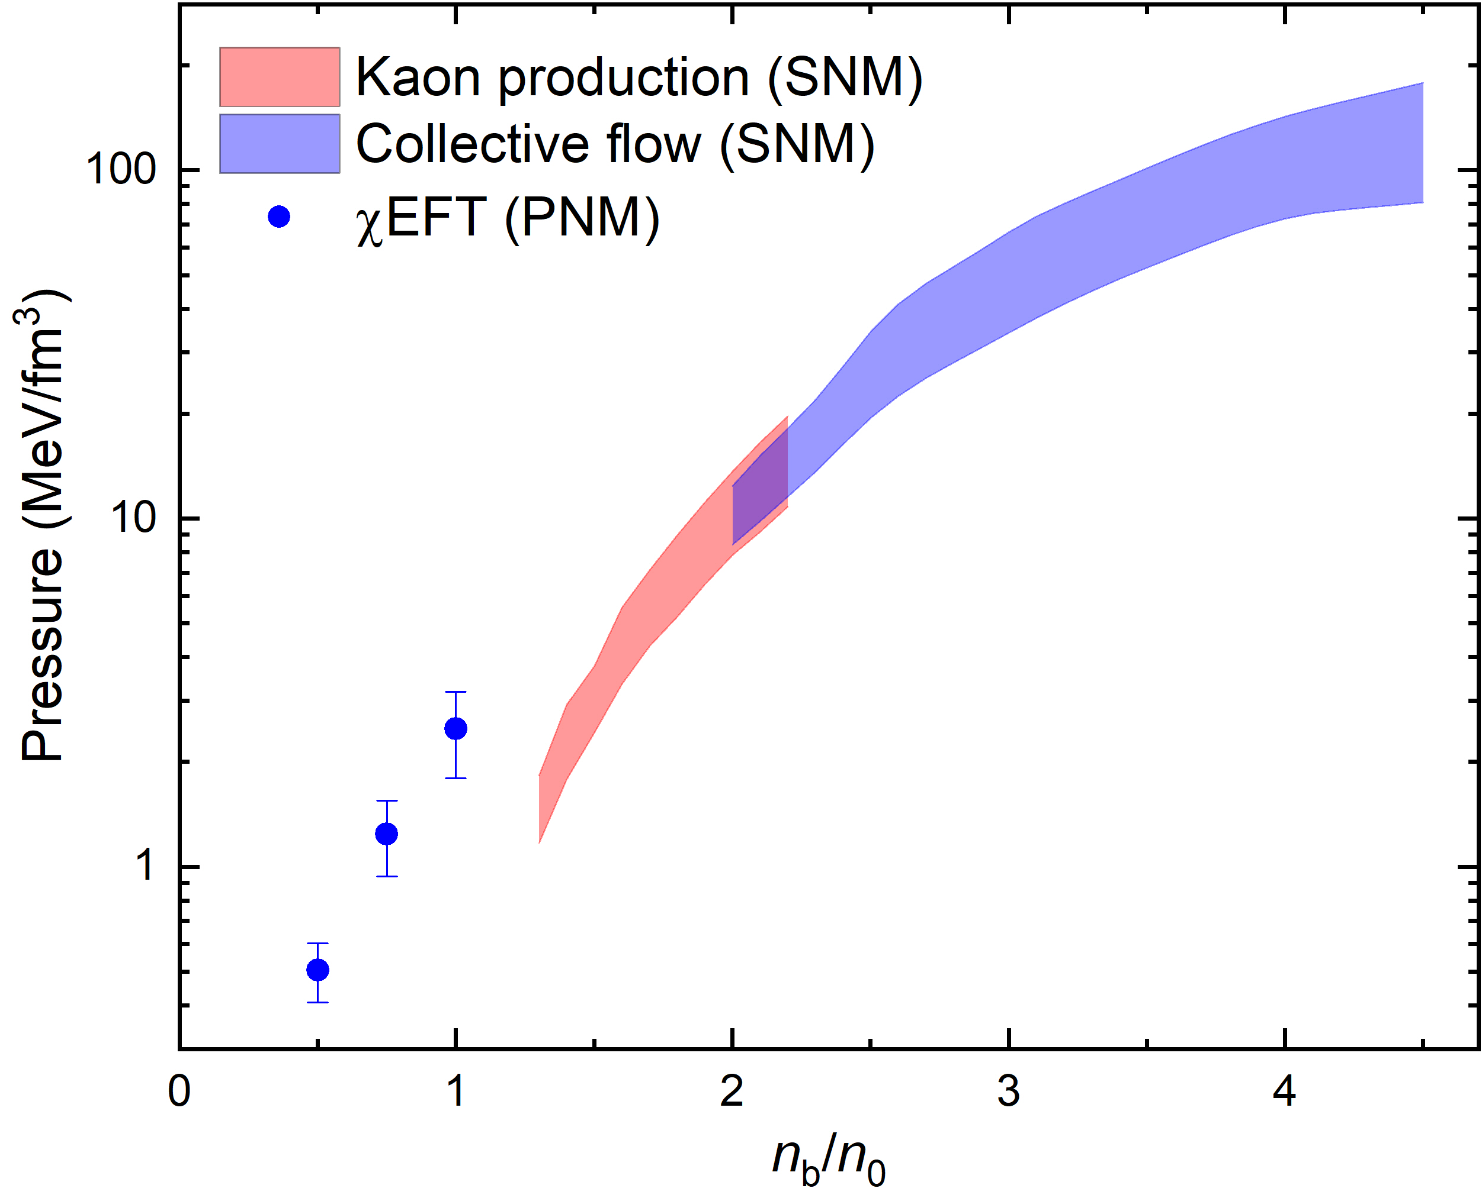
Nuclear constraints
SNM:
Danielewicz et al.2002_Science298-1592
Lynch et al.2009_PPNP62-427
Fuchs2006_PPNP56-1
PNM: Hebeler et al. 2013_ApJ773-11

Slide 8
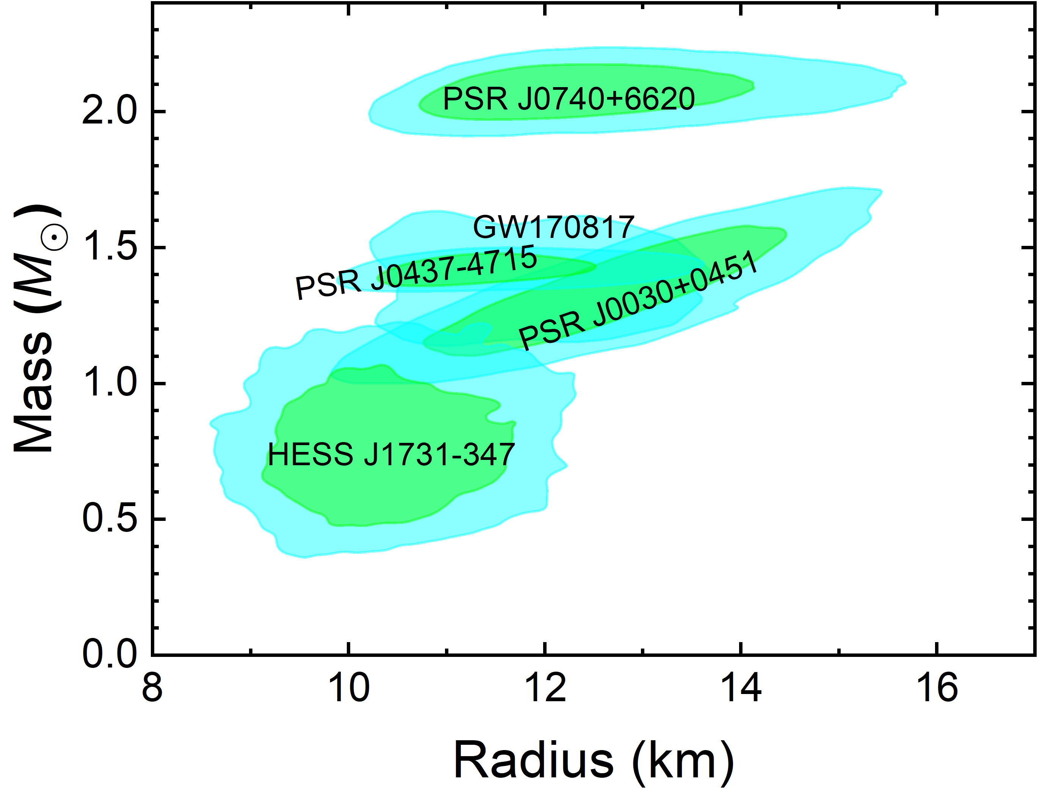
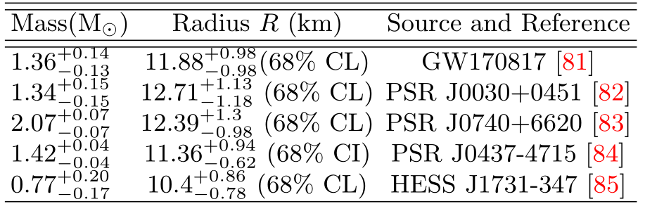
Astrophysical constraints
[81] LVC, PRL 121, 161101 (2018).
[82] Riley et al., ApJ 887, L21 (2019).
[83] Miller et al., ApJ 918, L28 (2021).
[84] Choudhury et al., ApJ 971, L20 (2024).

Slide 9
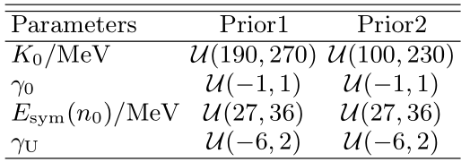
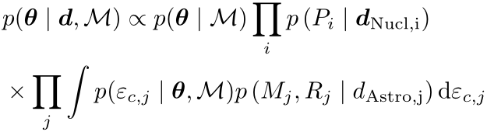

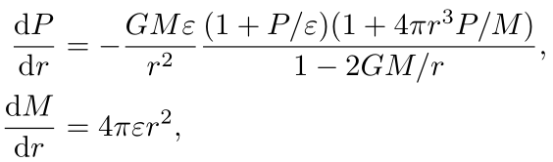
Bayesian inference
Prior ranges for the 4 parameters
Posterior probability [Greif et al.2019_MNRAS485-5363]:
MLFriends for the weighted sampling of the parameter vector θ using the emcee package
ε_{c,j}: central energy densities of neutron stars
: prior of central energy densities
Nuclear constraints: kaon production in HIC; collective flow in HIC; xEFT.
Astrophysical constraints:
GW170817; PSR J0030+0451; PSR J0740+6620; PSR J0437-4715; HESS J1731-347.
Neutron star structure:
Tolman-Oppenheimer-Volkoff equation
Other constraints:

Slide 10
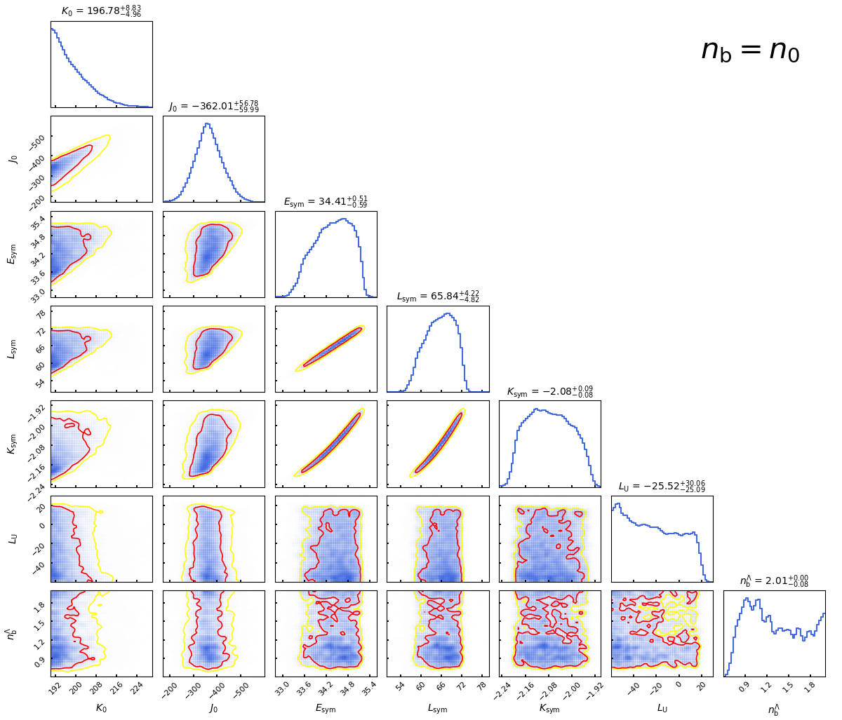
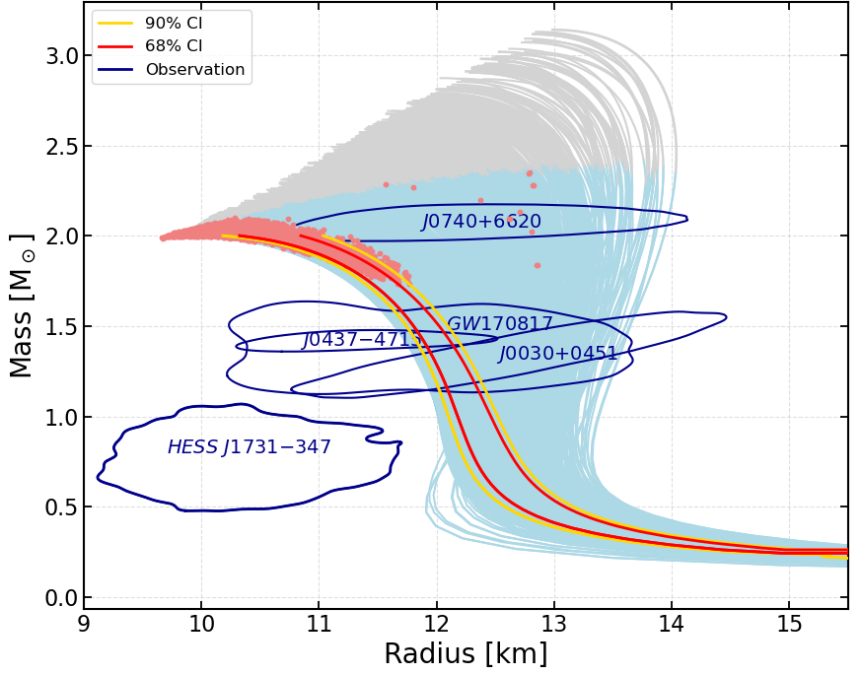
Posterior PDFs
Prior 1:
17.1%

Slide 11
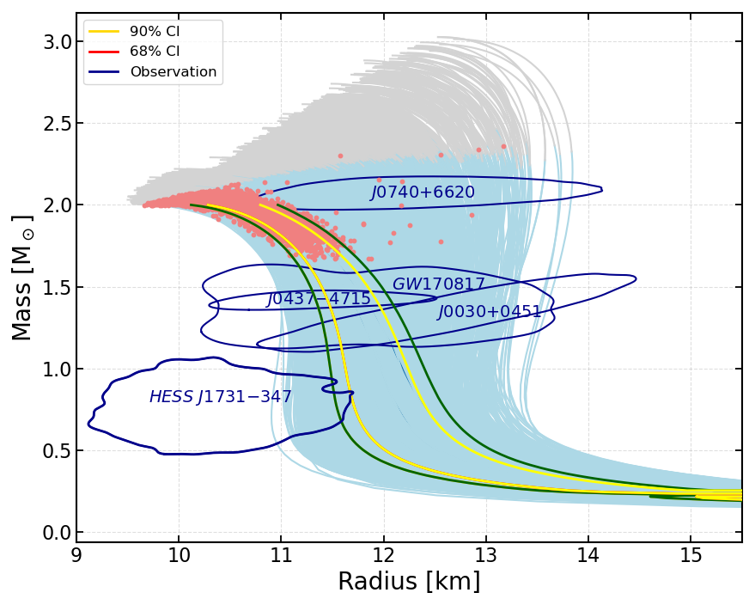
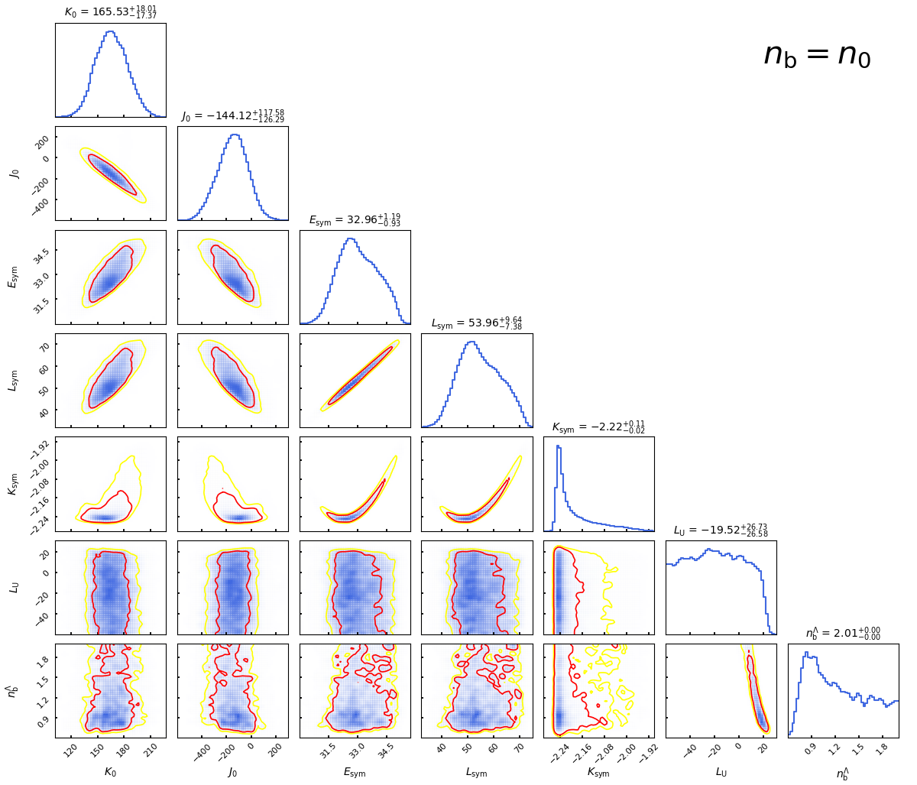
Posterior PDFs
Prior 2:
15.7%

Slide 12
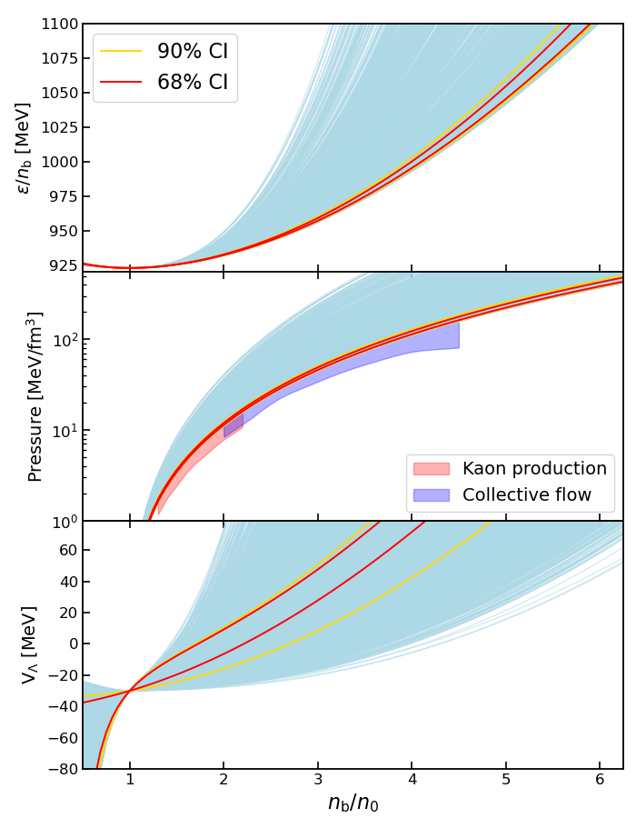
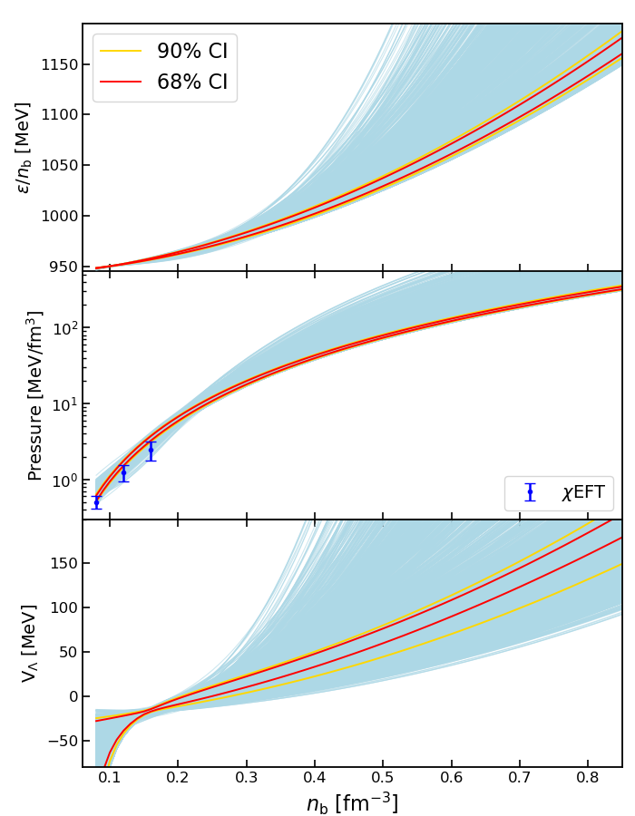
EOSs of SNM and PNM
Prior 1:
SNM
PNM

Slide 13
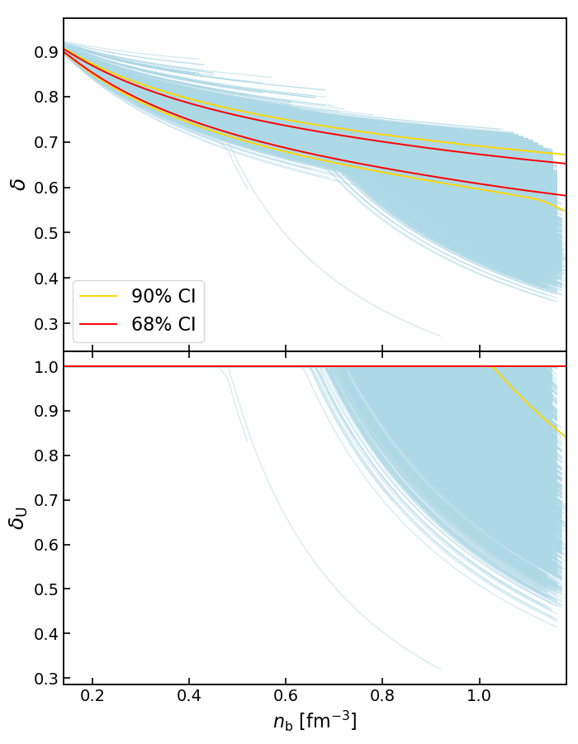
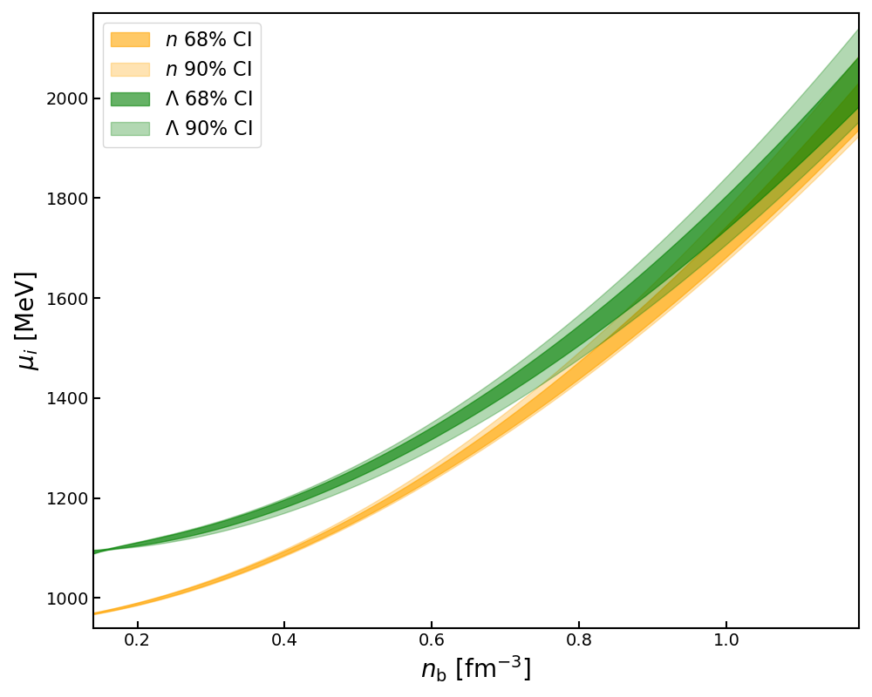
Asymmetry parameters
Prior 1:

Slide 14
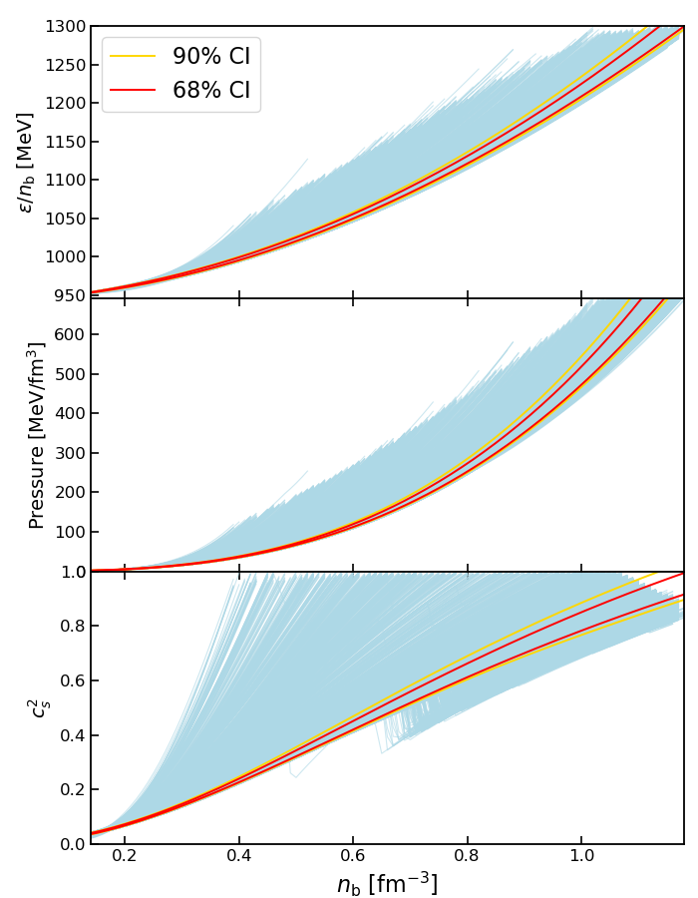
Neutron star EOSs
Prior 1:

Slide 15
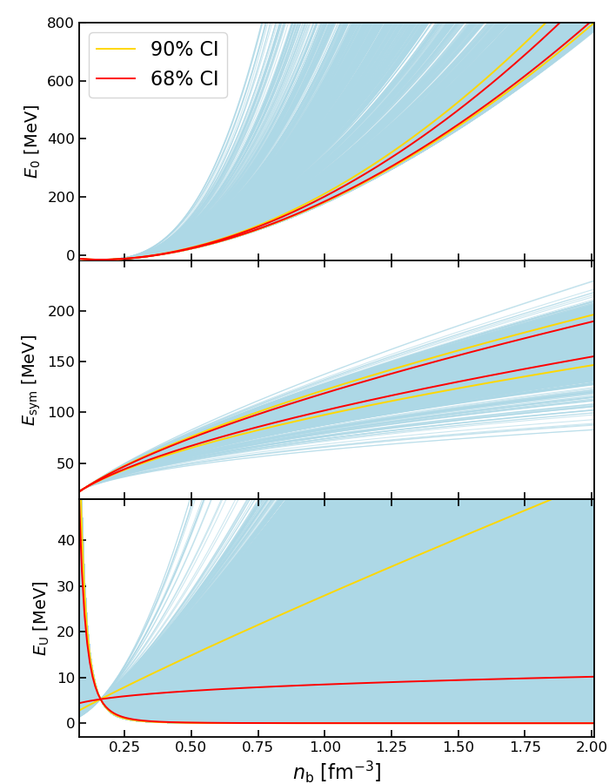
Symmetry energies
Prior 1:

Slide 16
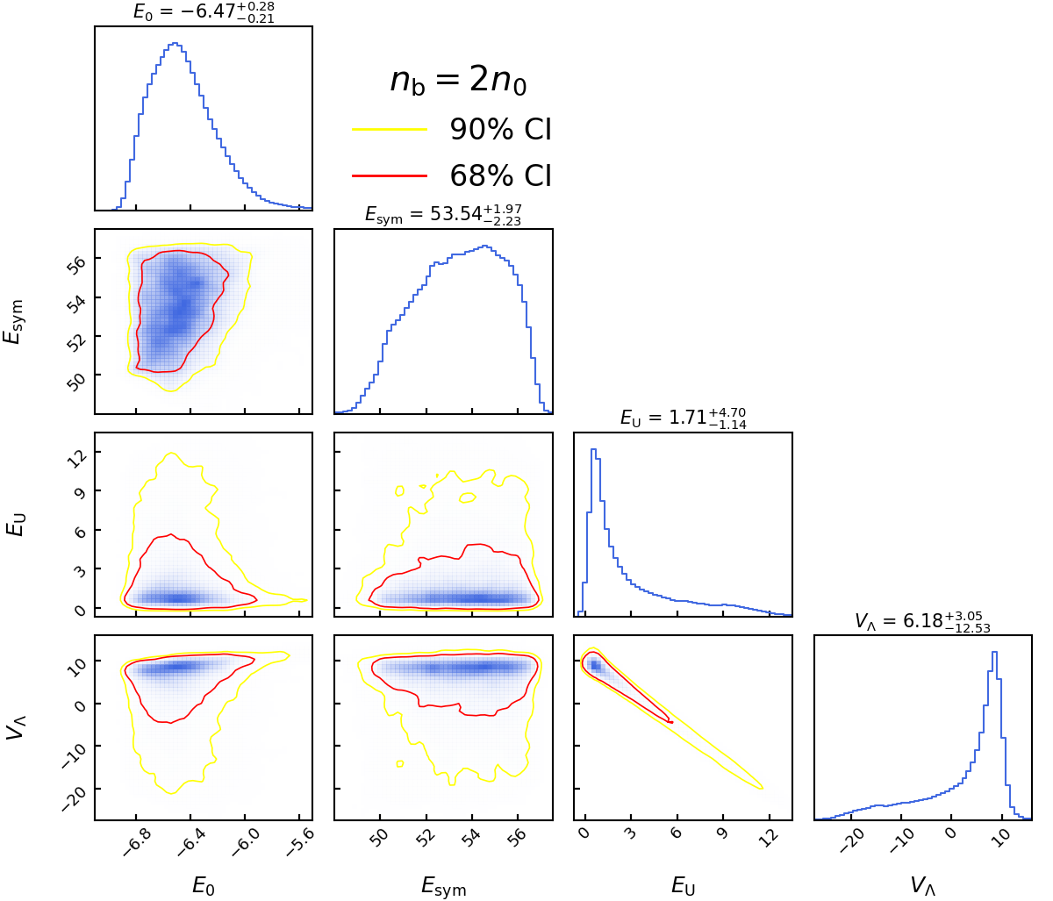
Constraints at 2n₀
Prior 1:

Slide 17
Summary
The I-spin counterpart for the interactions among nucleons has been extensively investigated, i.e., nuclear symmetry energy E_{sym}.
In this work, we propose U-spin symmetry energy E_{U} for (Λ) hyperonic matter, which are fixed according nuclear physics and astrophysical constraints using Bayesian inference approach. It is found：
E_{U} is much smaller than E_{sym}, indicating much stronger proton-neutron attraction than that of nucleon-hyperon pairs;
Λ hyperon potential increase significantly and become repulsive at large density: 82% probability Λ hyperons do not emerge in neutron stars.
For those emerge within neutron stars, the onset density of Λ hyperons n_{b}^{Λ} is typically larger than 0.8 fm⁻³, corresponding to neutron stars more massive than 1.7 M⊙.
Thank you!!!

