Slide 1

International Symposium Commemorating the 40th Anniversary of the Halo Nuclei (HALO-40)
Pairing Phase Transition
in Hot Nuclei
Lang Liu (刘 朗)
2025-10-14 @ Beijing

Slide 2
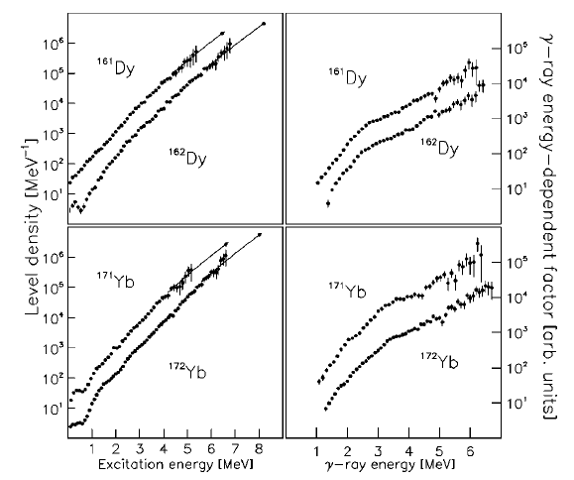
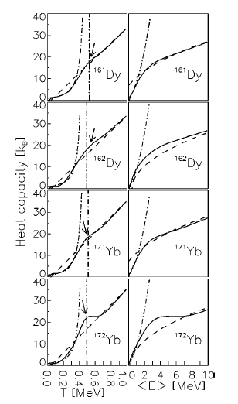
S-shaped Cv obtained from the experimental level density
Cv derived from experimental nuclear level density have consistently revealed an unexpected and intriguing feature.
E. Melby, et al. Phys. Rev. Lett. 83 3150 (1999)
A. Schiller, et al. Phys. Rev. C 63 021306R (2001)
Notes:
We begin with the experimental motivation. For many years, experimental data derived from nuclear level density—like those shown here for Dysprosium and Ytterbium isotopes—have consistently revealed an unexpected and intriguing feature: an S-shaped curve in the heat capacity of hot nuclei.

Slide 3
Introduction
Based on BCS or Bogoliubov transformation:
Finite-temperature Hartree-Fock-Bogoliubov:
J. L. Egido, et al., Phys. Rev. Lett. 85, 26 (2000);
Relativistic Hartree-Fock-BCS:
B. K. Agrawal, et al., Phys. Rev. C 62, 044307 (2000);
Finite-temperature relativistic Hartree-Bogoliubov theory based on a point-coupling functional, with the Gogny or separable pairing force:
Y. F. Niu, et al., Phys. Rev. C 88, 034308 (2013);
W. Zhang, et al., Phys. Rev. C 97, 054302 (2018).
Continuum coupling are supplemented to the BCS equation:
N. Sandulescu, et al., Phys. Rev. C 55, 1250 (1997); Phys. Rev. C 61, 044317 (2000).
Relativistic Hartree-Fock-Bogoliubov:
J. J. Li, et al., Phys. Rev.C 92, 014302 (2015).

Slide 4
Introduction
Based on projection method:
Particle-number projected statistics (PNPS):
C. Esebbag, et al., Nucl. Phys. A 552, 205 (1993);
Finite-temperature variation before projection BCS (FT-VBP):
K. Esashika, et al., Phys. Rev. C 72, 044303 (2005);
Finite-temperature variation after projection BCS (FT-VAP):
D. Gambacurta, et al., Phys. Rev. C 88, 034324 (2013).
Other works
S. Rombouts, et al. Phys. Rev. C 58, 3295 (1998); S. Liu, et al. Phys. Rev. Lett. 87, 1 (2001).
M. Guttormsen, et al. Phys. Rev. C 63, 044301 (2001); Phys. Rev. C 64, 034319 (2001).
This S-shape is crucial because it is considered a clear thermodynamic signature of a phase transition—specifically, the transition from a superfluid (paired) phase at low temperatures to a normal (non-paired) phase at high temperatures.

Slide 5
Introduction
Few work have been done for discussing the order of this phase transition. Ehrenfest's classification of phase transitions does not apply to small systems such as atomic nuclei.
A theorem on the distribution of roots of the grand parition function in small system.
T. D. Lee and C. N. Yang, Phys. Rev. 87, 410(1952).
This theorem has been extended to the canonical ensemble through the analytic continuation of the inverse temperature in the complex plane.
S. Grossmann, et al., Z. Phys. 207, 138 (1967);
Z. Phys. 218: 449-59 (1969).
P. Borrmann, et al., Phys. Rev. Lett. 84, 3511 (2000).
O. Mülken, et al., Phys. Rev. A 64, 013611 (2001).

Slide 6
Introduction
Covariant density functional theory (CDFT)
P. Ring, Prog. Part. Nucl. Phys. 37, 193 (1996)
J. Meng, et al., AAPPS Bulletin 31 (2021).
Shell-like model approach (SLAP)
Particle number conservation
No spurious states
Correctly treat blocking effects
Describe excited states
J. Y. Zeng, et al., Nucl. Phys. A 405, 1 (1983).
J. Meng, J. Y. Guo, L. Liu, et al., Front. Phys. China 1, 38 (2006).

Slide 7

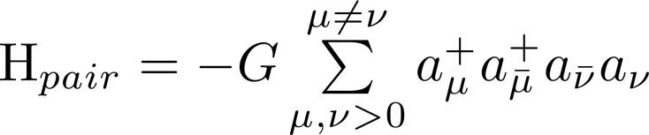
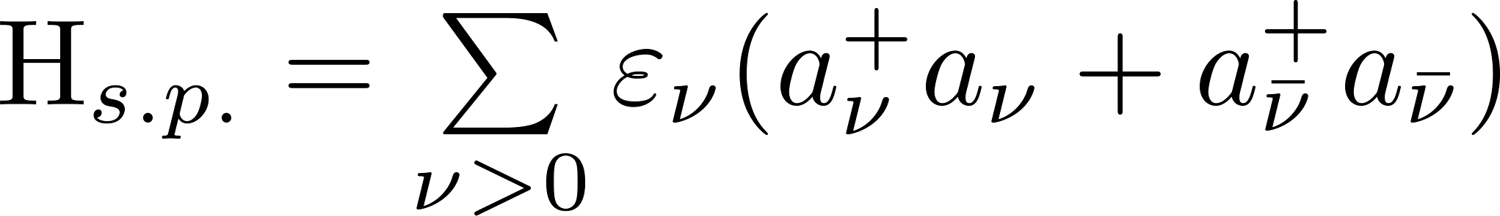
Theoretical Framework––SLAP Hamiltonian
Hamiltonian
where
single particle energy
pairing strength
Solve Dirac Eq. in CDFT to obtain single-particle levels;
Construct multi-particle configuration (MPC);
Diagonalize Hamiltonian in MPC.
J. Y. Zeng, and T. S. Cheng, Nucl. Phys. A 405, 1 (1983).
J. Meng, J. Y. Guo, L. Liu, S. Q. Zhang, Front. Phys. China 1, 38 (2006).

Slide 8


Multi-particle configuration (MPC)
Solve Dirac Eq. in CDFT to obtain single-particle levels;
Construct multi-particle configuration (MPC);
Diagonalize Hamiltonian in MPC.
Fully paired state (s=0)： ( s: Seniority）
n: number of pair
One pair broken state (s=2)：
…
For axial symmetrical case, K and parity are good quantum number, as well as the seniority.

Slide 9

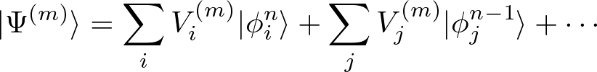

Wave functions and energies
Solve Dirac Eq. in CDFT to obtain single-particle levels;
Construct multi-particle configuration (MPC);
Diagonalize Hamiltonian in MPC.
wave function of the g.s. and excited states
energy spectra
m=0 (g.s), 1, 2, … ( excited states);
n: number of pair;
i, j: index of MPC

Slide 10
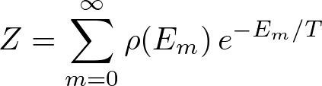
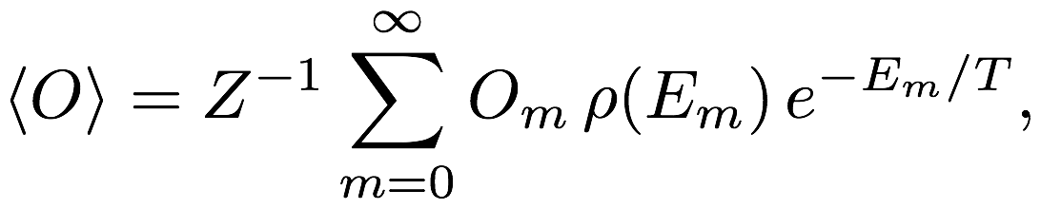
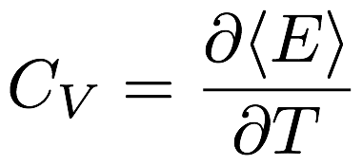
Thermodynamic quantities
wave function of the g.s. and excited states
energy spectra
Partition Function
Average of physical quantities
Heat capacity

Slide 11
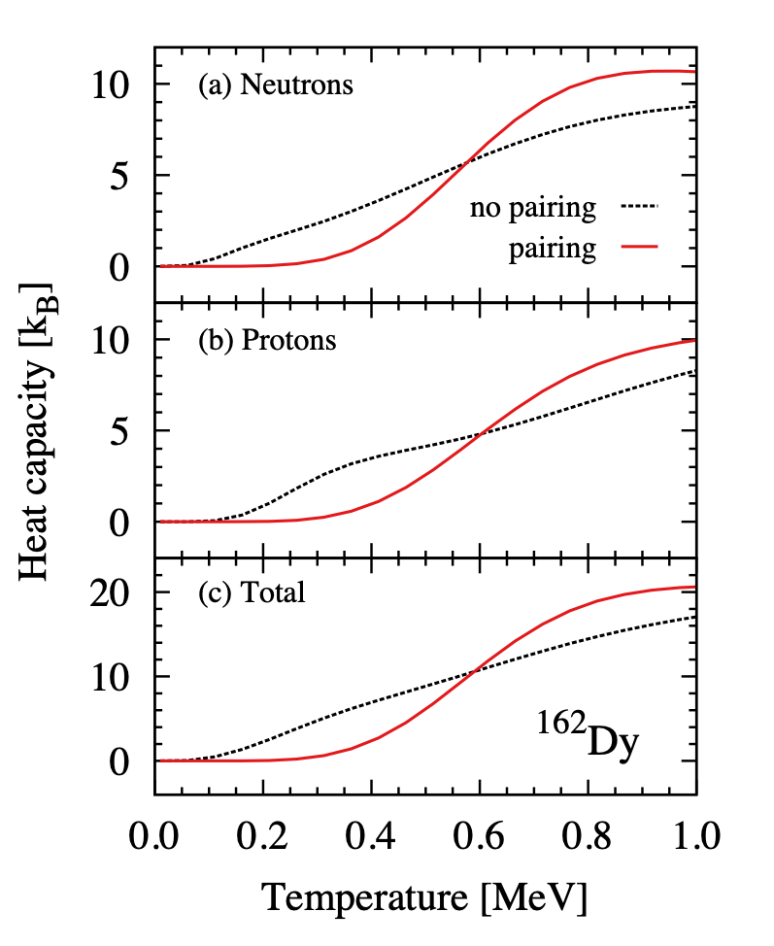
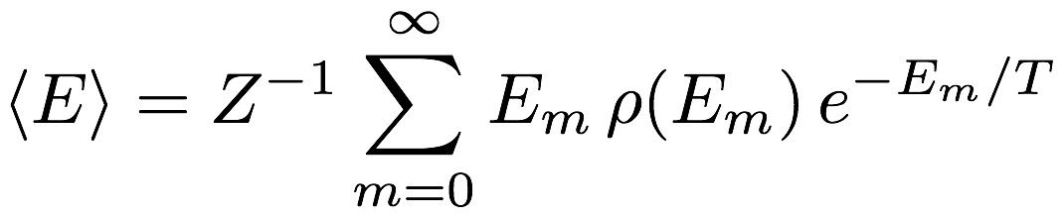

Heat Capacity
straight line w/o pairing
“S” shape with pairing
L. Liu, Z. H. Zhang, P. W. Zhao, PRC 92, 044304 (2015).

Slide 12
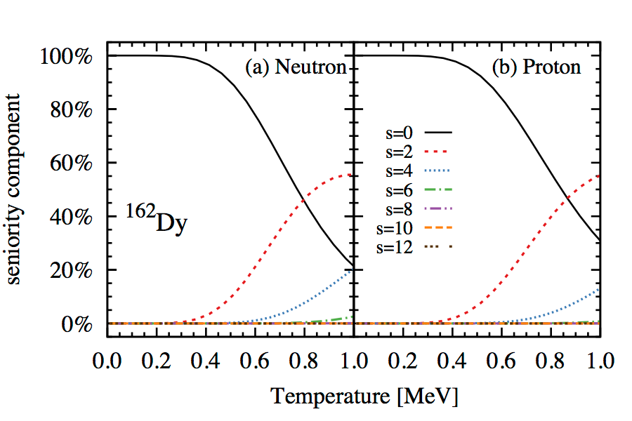
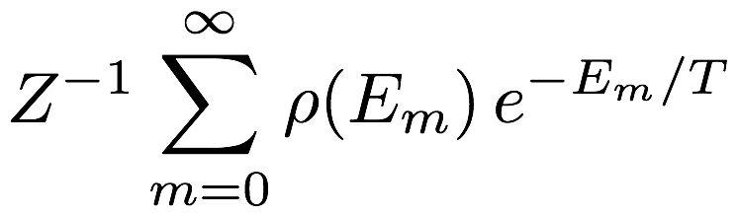
Seniority component
seniority component:
One-pair broken
m∈{s}
Two-pair broken
s=0 states dominant at low T;
s=2,4 states become important at high T;
L. Liu, Z. H. Zhang, P. W. Zhao, PRC 92, 044304 (2015).

Slide 13
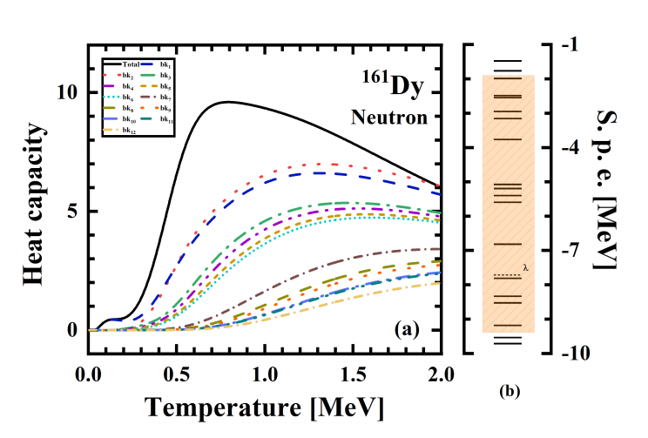
Odd-A nuclei Dy-161
total
bk2
bk1
Accurate treatment of Fermi surface blocking and its neighboring levels is crucial.
Y. M. Wang, Y. H. Gao and L. Liu, Chin. Phys. C 48:124104 (2024)

Slide 14
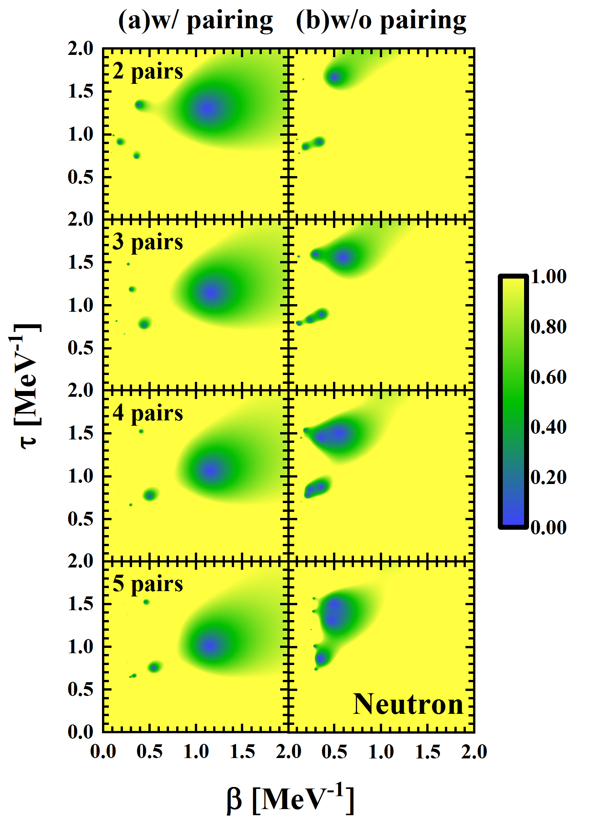
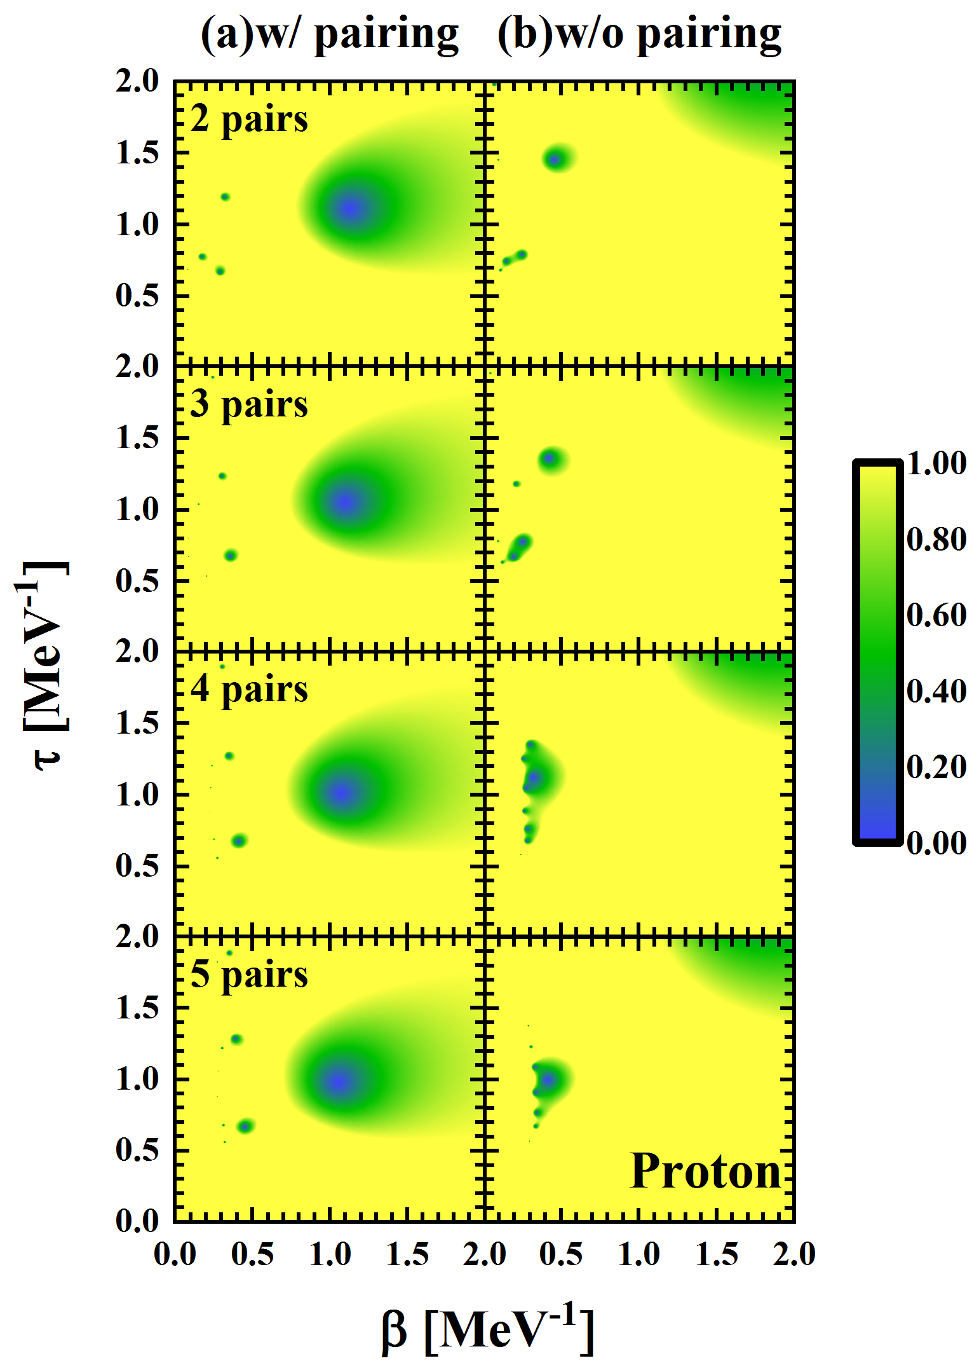
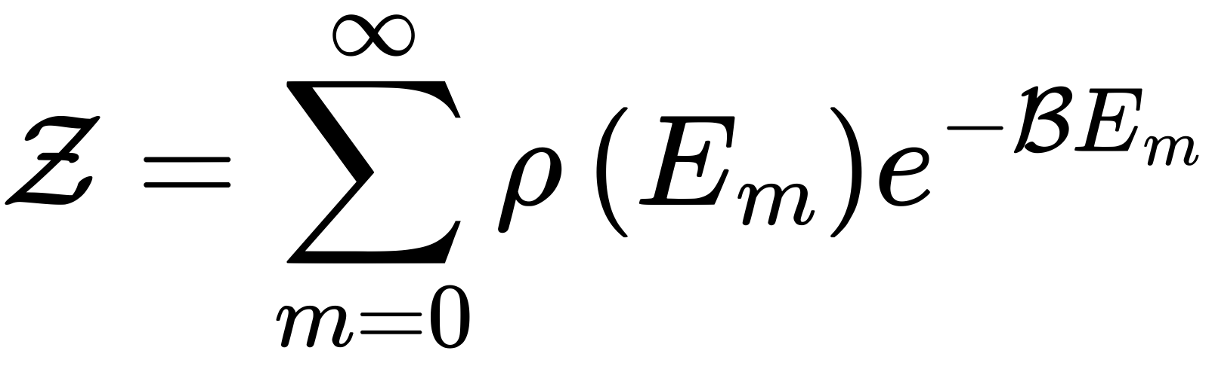


Partition function with complex temperature
¹⁶²Dy
Y. H. Gao, Y. L. Lin and L. Liu, Int. J. Mod. Phys. E 32:2350050 (2023)

Slide 15
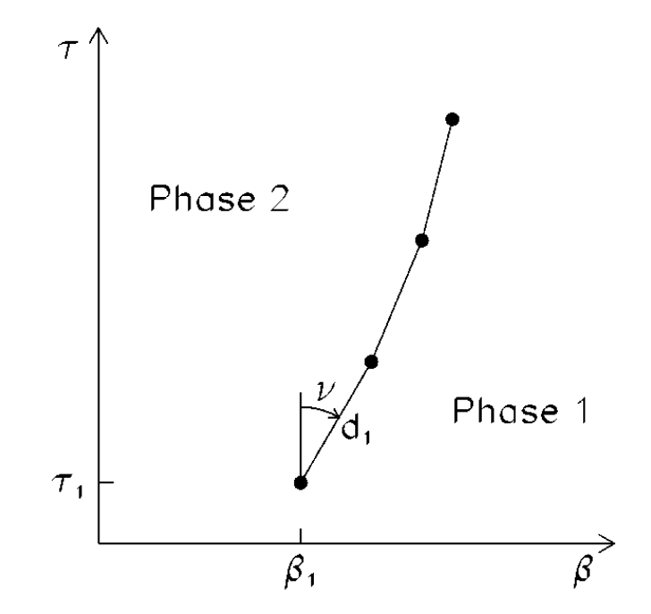
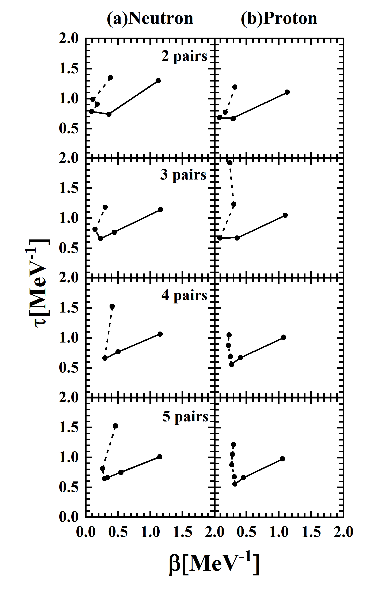
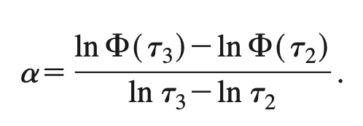
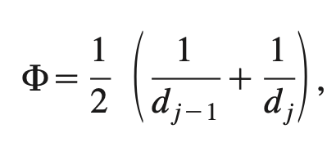

The distribution of zeros (DOZ) of the partition function
schematic diagram
𝜶 < 0
first order
0 < 𝜶 < 1
second order
𝜶 > 1
higher order
Y. H. Gao, Y. L. Lin and L. Liu, Int. J. Mod. Phys. E 32:2350050 (2023)
Phys. Rev. C 66, 024322 (2002).

Slide 16
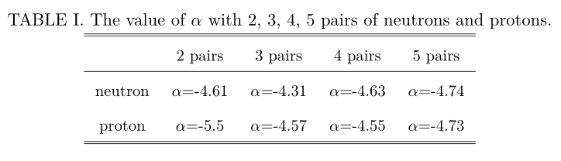
The DOZ of the partition function
The solid line represent the pairing phase transition and the defined α indicates that this phase transition is the first order phase transition.
Y. H. Gao, Y. L. Lin and L. Liu, Int. J. Mod. Phys. E 32:2350050 (2023)

Slide 17
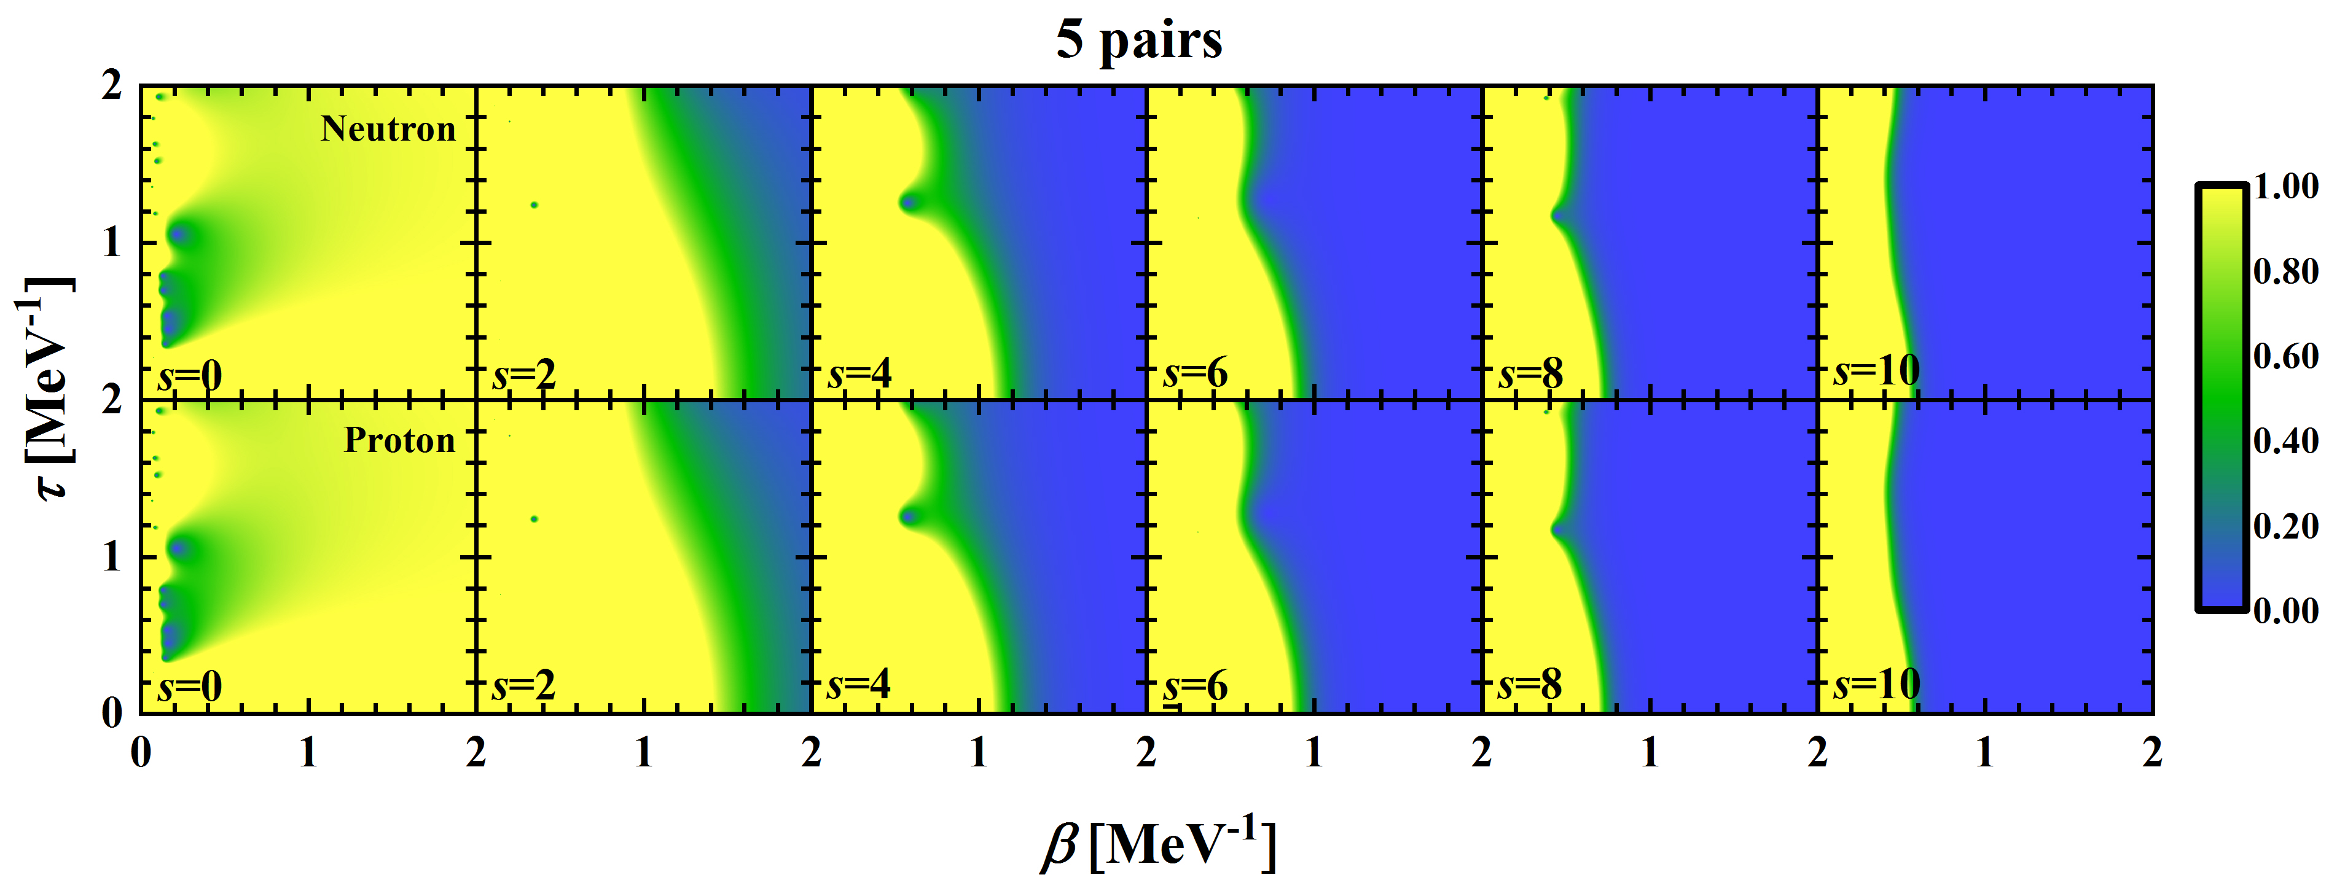
Evolution of pairing phase transition
s=0 (no pair broken)
s=2,4,6,8
s=10 (all pairs broken)
The nucleus is in the superfluid phase;
The normal and superfluid phases coexist;
The nucleus is entirely in the normal phase.

Slide 18
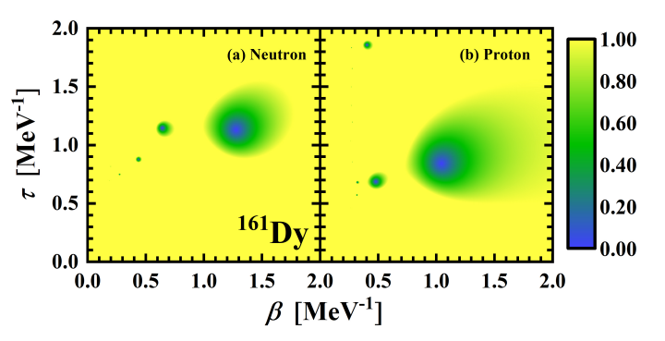
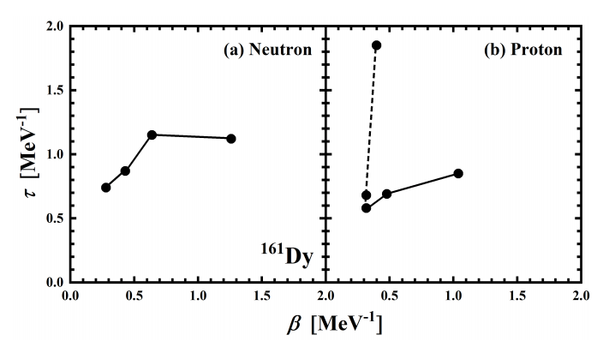
¹⁶¹Dy
critical T
α_{n}=-2.04
α_{p}=-5.66
first-order
Y. M. Wang, Y. H. Gao and L. Liu, Chin. Phys. C 48:124104 (2024)

Slide 19
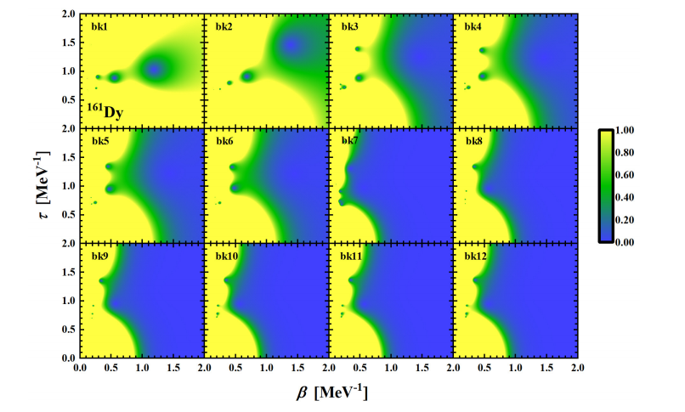
¹⁶¹Dy
“bk1” and “bk2” contribute the most
the superfluid and normal phases coexist

Slide 20
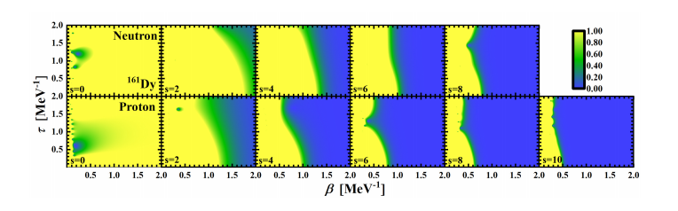
¹⁶¹Dy
s = 0 (fully paired state), entirely in the superfluid phase.
s = 2 (one pair broken state), the superfluid and normal phases coexist.
s = 8 or 10 (completely broken state), entirely in the normal phase.
The blocking effect hinders the evolution of the pairing phase transition.

Slide 21
Toy Model (10 equally spaced single-particle levels)
An ideal odd system and an ideal even system are constructed to explore the impact of pairing correlation strength on the pairing phase transition, as evidenced by changes in the order of the transition.
G | G ≤ 0.7 | 0.8 ≤ G ≤ 0.9 | G = 1
even | first-order | higher order | second-order
odd | first-order | higher order | higher order
even
odd
nonlinear relationship between G and the order of the pairing phase transition

Slide 22


Summary
We address a strict particle number conserving calculation to investigate the properties of pairing correlations in hot nuclei with CDFT+SLAP framework.
The clear “S” shape of CV curves for neutrons and protons of ¹⁶²Dy are presented. seniority=2,4 states.
The “S” shape of CV for odd system is studied in terms of blocking effect.
One calculates the negative values of α for this phase transition, indicating a first-order phase transition.

Slide 23
Thank you !
Collaborators:
Peking University：P. W. Zhao
North China Electric Power University：Z. H. Zhang
Jiangnan University：Y. M. Wang, Y. Tao，Y. L. Lin，Y. H. Gao

